Slide 1
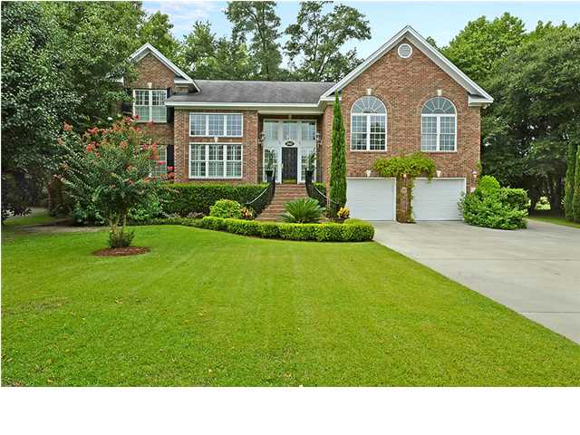
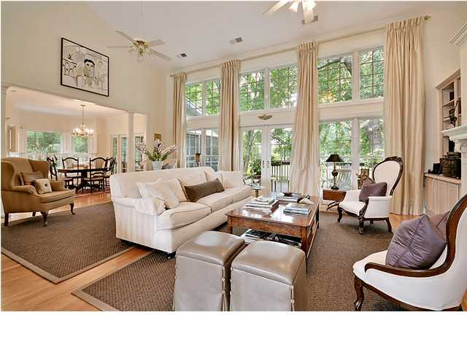
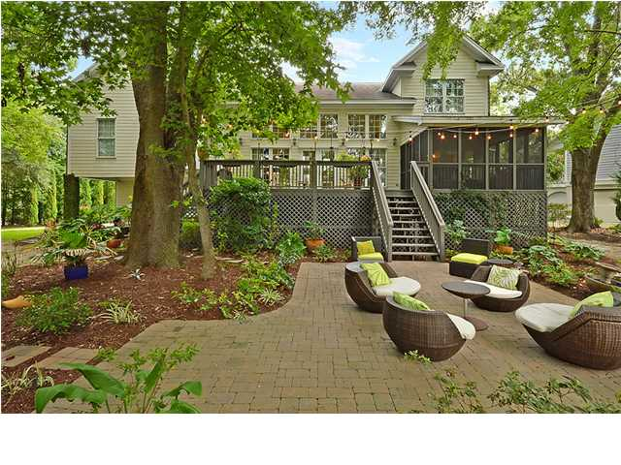
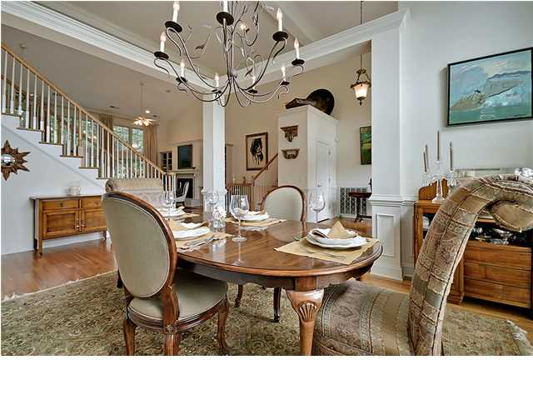
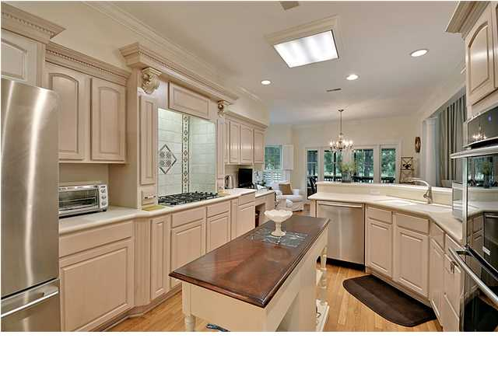
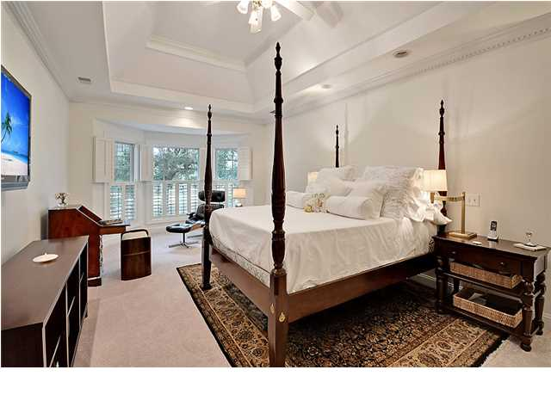
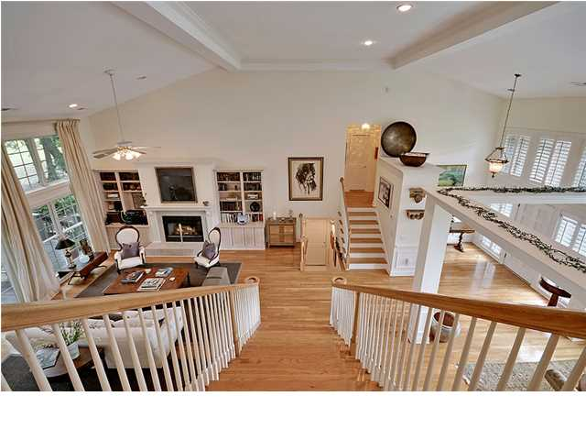
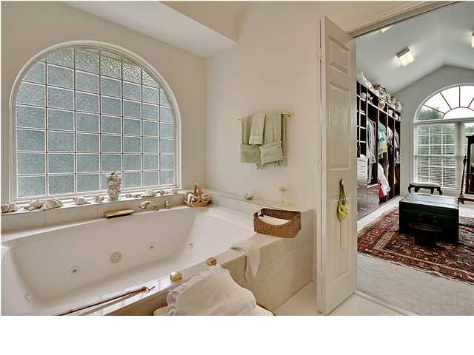
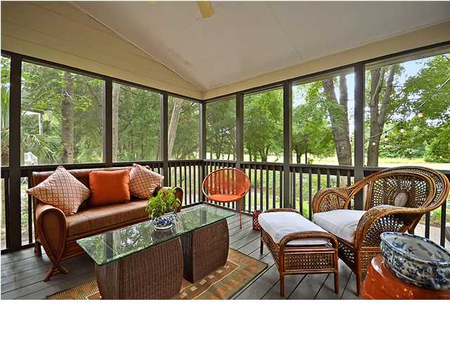
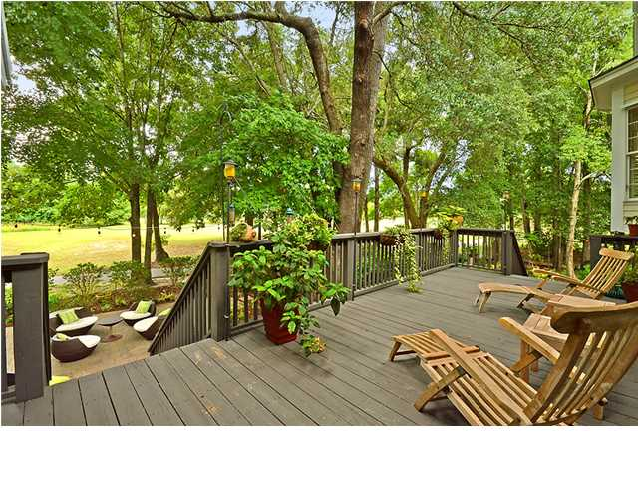
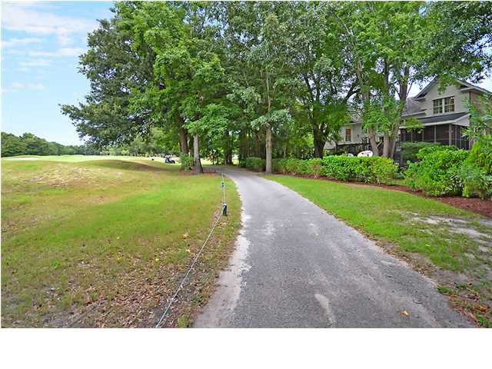

Price Reduced $150,000!
Charleston National Executive Stunner
3547 Somerset Hills Ct ~ Mt Pleasant ~ MLS# 1421195 ~ $649,000
Make no mistake about it, when it comes to living in Charleston National, this is the home and location you want to be at. With four bedrooms, three and a half baths and 3,320 square feet of living space, this two story home's cul-de-sac location in The Estates at Charleston National boasts gorgeous views of the 10th hole fairway of the golf course. From the pristine landscaping in the front, to the ivy covering on the brick exterior to the mature trees in the rear, you can tell how well maintained this home is. Step inside to find soaring 18' high ceilings, stunning hardwood floors, plantation shutters and floor to ceiling windows everywhere that allow natural light to pour in. Dine like royalty in the formal dining room where there's plenty of room for entertaining and wainscoting adds a nice touch. The living room features a gas fireplace and built-ins on either side. The gourmet kitchen makes cooking a breeze with a five burner gas cooktop, Corian counters, tons of cabinets for storage and a gracious eat-in area. From the eat-in area you can access the screened-in porch which is just one of three great outdoor living areas. When it comes enjoying some fresh air and the golf course view, you can be under cover in the porch, take a seat on the deck, or step down to the beautiful paver patio. Upstairs, the owner's retreat has an elegant tray ceiling, a sitting area, a jacuzzi tub and walk-in shower in the bathroom, and two custom His and Her walk-in closets you have to see to believe. In addition to all the lovely features this home has to offer, you'll have peace of mind knowing there are hurricane shutters for every window in the house as well as a wireless security system. While you may never want to leave this home once you move in, if you do venture out, be sure to take advantage of the community amenities which include the club house, swimming pool, tennis courts and golf course. If you've been looking for an unbeatable location and home, this one is for you!
Call or email for details: (843) 654-7777 or Spencer@MattOneillTeam.com

