Slide 1
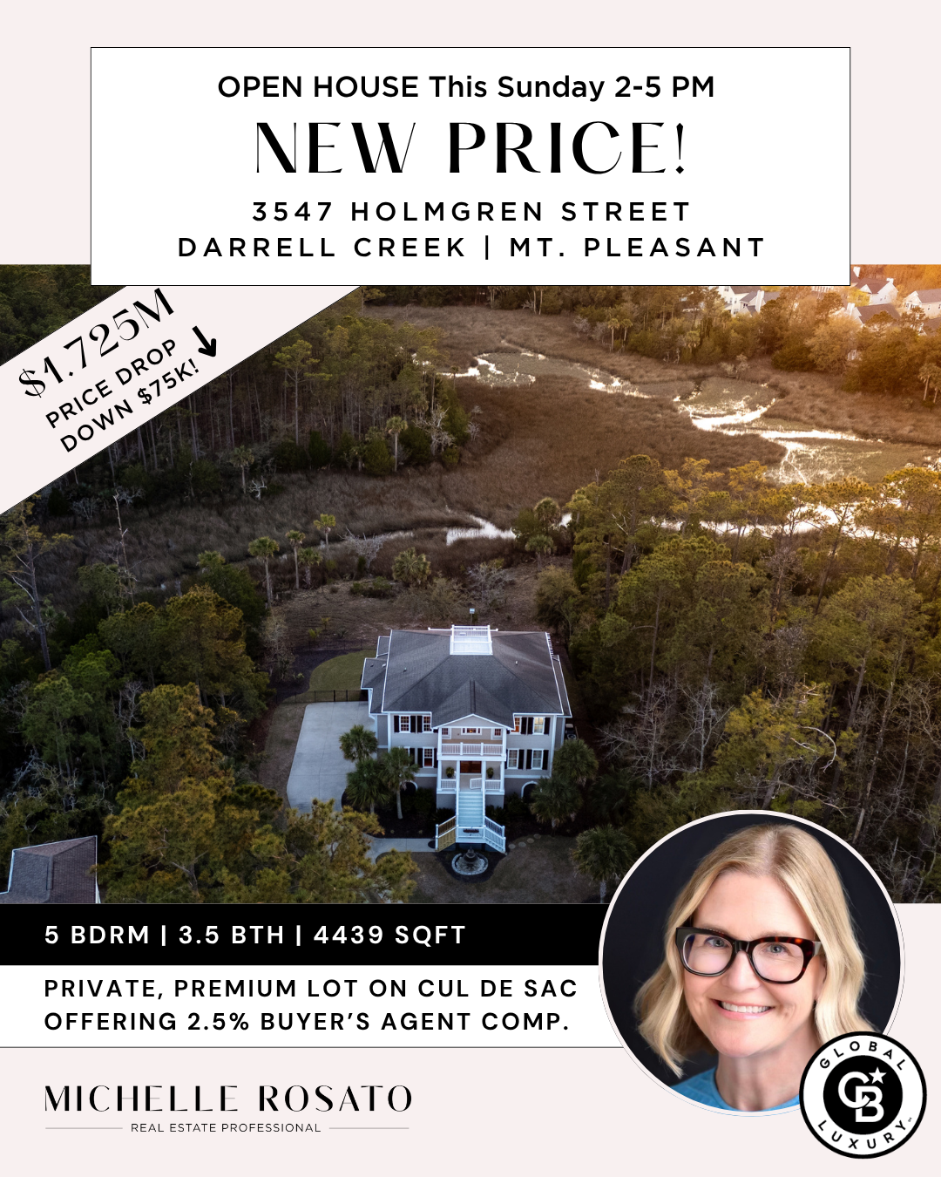
This is more than just a house - it’s a lifestyle.
$1,625,000
Set on a private cul-de-sac, enjoy stunning, unobstructed sunset views over the marsh every evening and a front-row seat to local wildlife. The best part? You don’t have to sacrifice a thing. You’re a five- minute drive from everything you need, including schools, hospitals and shopping. This is peaceful living perfectly located. And the best part, there is plenty of room for your boat on this parking pad!

