Slide 1
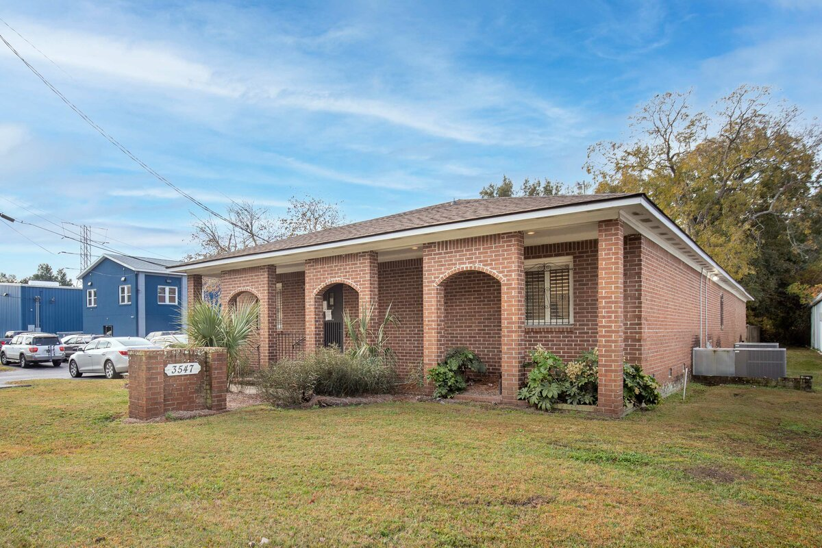
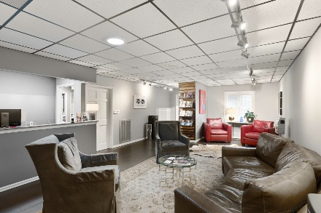
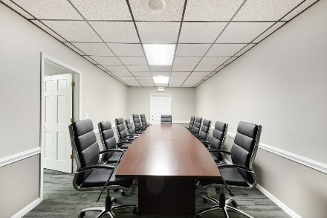
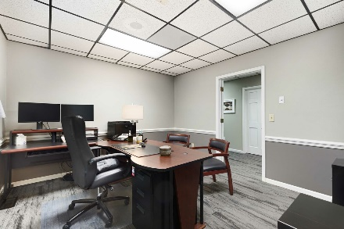
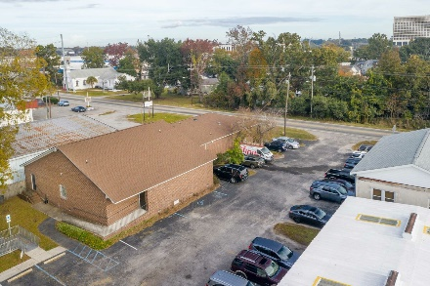


Invest or Occupy
3547 Meeting Street Rd
North Charleston, SC 29405
A well maintained, one story brick building that has been remodeled with a new roof, carpet, tile, interior and exterior paint, granite countertops, HVACs, and cabinets. The interior is made up of 16 offices, 6 half baths, a large conference room, a waiting room, and a receptionist office with a nice counter. Currently serving as the home of Palmetto Community Care, this property can be a perfect 1031 exchange option now or you can occupy this property later. This easy to park (30+ spaces) property provides quick access to major roads and interchanges. There is a handicap ramp. This office is located on a 1.43 acre lot in the downtown and booming area of North Charleston that is not far from downtown Charleston itself where the Medical University of South Carolina as well as many other very desirable businesses. Seller is open to a leaseback situation or is willing to vacate the property with acceptable terms.
MLS ID: | 30775798 | County: | Charleston
Property Subtypes: | Executive Suites, Coworking, Medical, Net Leased, Office Building, Other | Submarket/Township: | 31 - N.Charleston Area inside I-526
Building Size (RSF): | 5,089 SF | Tax ID/APN: | 469-06-00-089
Sale Price: | $1,375,000 | Zoning: | M-1
Property Visibility: | Excellent | Area Description: | Very vibrant area in a positive transition.
Year Built: | 1977 | Year Renovated: | 1984
Exterior Description: | Brick with brick arches. Signage is available. | Parking Description: | Flat. 20 spaces are marked (2 are marked as handicap). There are more unmarked spaces currently being used and once trailer is removed, more parking is possible.
Lot Frontage: | 125 | Lot Depth: | 428
Nearest MSA: | Charleston-North Charleston | Interior Description: | Modern and very well maintained. Owner has been meticulous in finishes and decor.
David H Seay
CCIM, BIC, CCIM, REALTOR®
843-364-6720
david@seaydevelopment.com
The Brokerage, LLC
3404-202A Salterbeck Street
Mt. Pleasant, SC 29466
thebrokerageyouwinhere.com
John Teffeau
REALTOR®/Co-Owner
843-813-1228
l.johnteffeau@gmail.com

