Slide 1
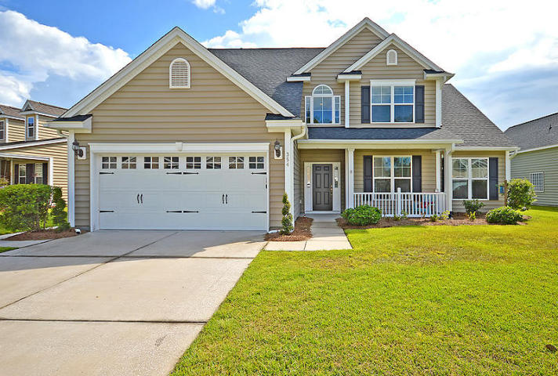
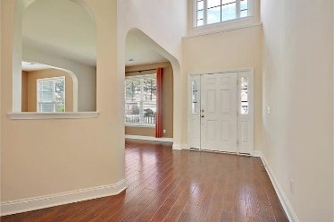
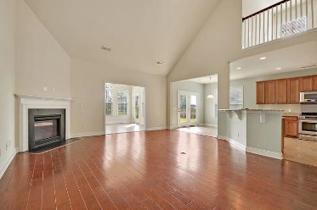
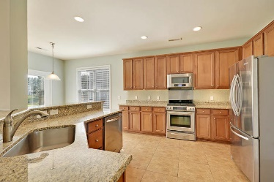
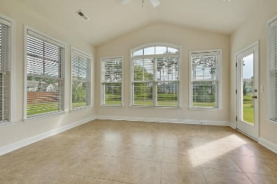
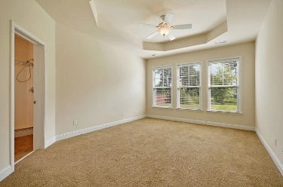
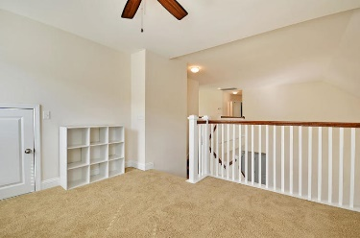
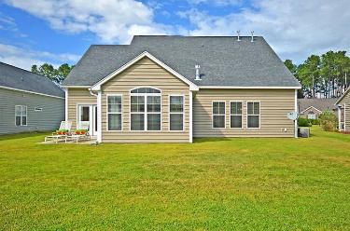
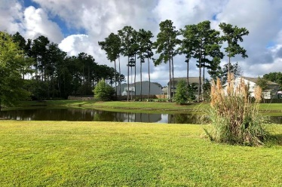

354 Decatur Drive Cane Bay Plantation · Summerville MLS# 18024439 · $289,000
CALLING ALL GOLFERS!!!
Cane Bay Back On Market!
Cane Bay Back On The Market!
Spacious BEAUTIFUL 4BR 2.5 BA home. 2823 sqft and loads of UPGRADES. Open floor plan. Master bedroom downstairs 3Br's and a loft upstairs. Downstairs is gorgeous with hand-scraped hardwood and ceramic tile floors; bedrooms and upstairs are carpet. The gourmet kitchen has oversized island, breakfast bar seating for 5, granite, backsplash, stainless steel appliances, pantry, butlers pantry, and eat-in area that is perfect for entertaining family and friends. The deluxe master bedroom suite has stunning views of the pond, ensuite spa-like master bath has relaxing soaking tub, separate shower, dual sinks, and large walk-in closet. Located on a pond with large backyard. Cane Bay in Summerville is a wonderfully landscaped community with schools, play park, walking trails, and pool!
The neighborhood is close to local shopping and grocery stores and is a short drive to downtown Charleston with 5-star restaurants, world class shopping and iconic history as well as a short drive to the beaches, the airport, Boeing and Daniel Island. Come take a look because you will not find another home that offers as much as this one!
Stan Huff
843-670-2835 stan.huff@agentowned.com
Jill Marcacci
843-297-5590 jill@agentowned.com
www.agentownedrealty.com
AgentOwned Realty Co. Preferred Group, Inc. | 824 Johnnie Dodds Blvd | Mt Pleasant, SC 29464

