Slide 1

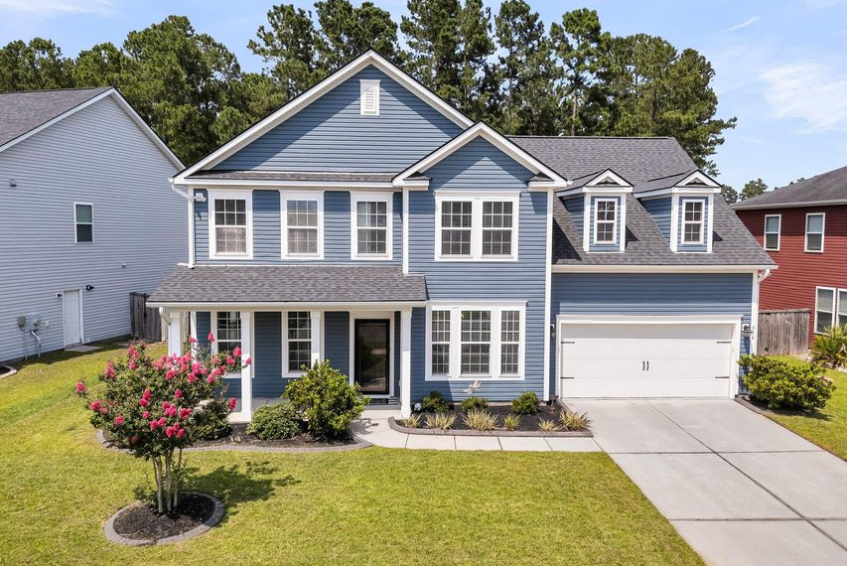
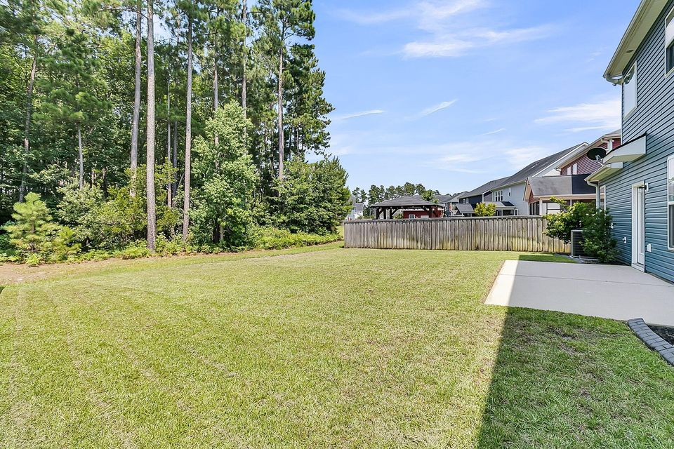
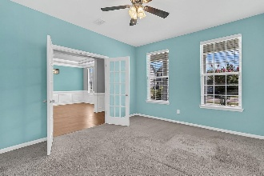
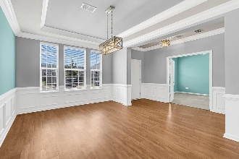
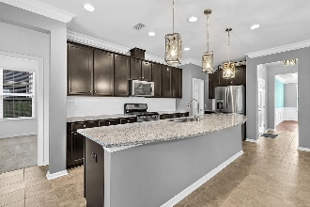
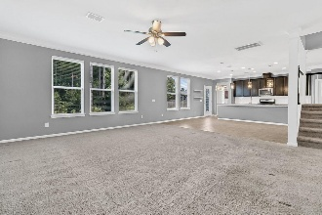
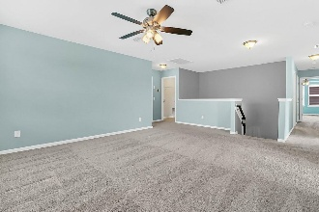

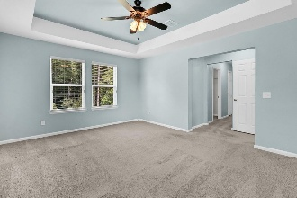
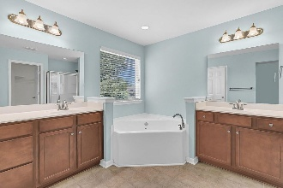
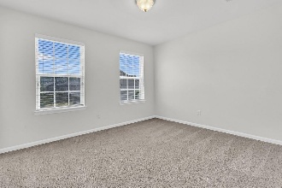
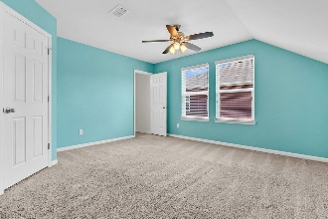
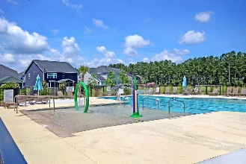
Debbie Cromer
ABR, RSPS, REALTOR, CRS
(843) 437-6342
debbie@debbiecromer.com
www.debbiecromer.com
Spacious Cane Bay Living
354 Beachgrass Lane
Cane Bay Plantation | Summerville, SC 29486 | MLS# 25017795 | $490,000
Beautiful & spacious 5BR/4.5BA home in The Oaks at Cane Bay offering exceptional square footage, a flexible layout, & a wooded backdrop for added privacy. This floor plan includes a first-floor guest suite w/ full bath, a dedicated office, separate dining room, & an open kitchen overlooking the breakfast area & large living space. The kitchen features granite countertops, stainless appliances, gas cooking option, & plenty of storage. Upstairs includes a generous primary suite w/ dual walk-ins & a large bath, a loft, plus three additional bedrooms all w/ walk-in closets. Enjoy a long driveway, 2-car garage, & an interior lot that doesn't back up to neighbors. Cane Bay offers a golf-cart lifestyle w/ miles of walking trails, community pool, nearby YMCA, Publix, Starbucks & schools.
Priced below similar 5BR homes on a price-per-sqft basis - great value for the size & location.
TAKE A VIRTUAL TOUR
Century 21 Properties Plus | 1090 Park West Blvd; Ste 103 | Mount Pleasant, SC 29466

