Slide 1

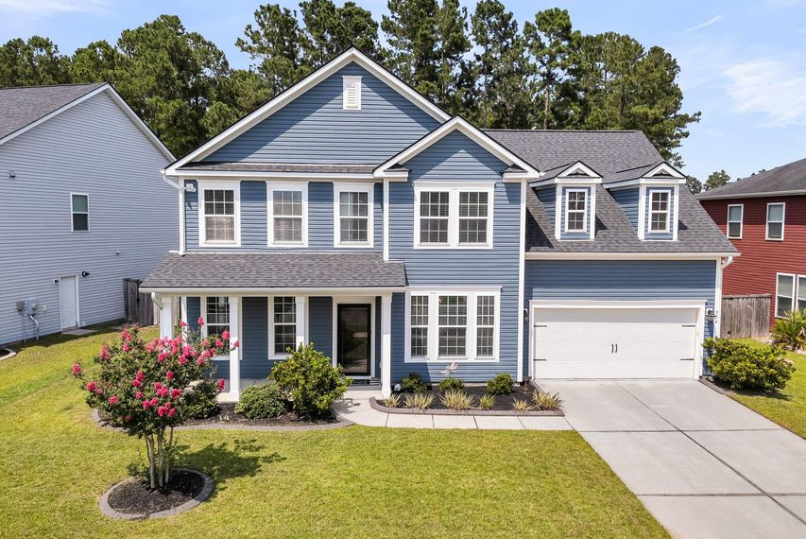
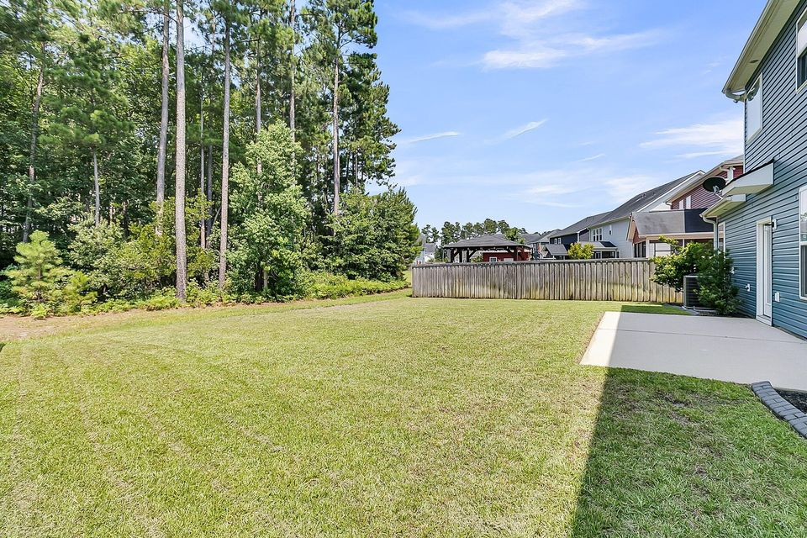
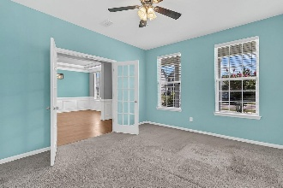
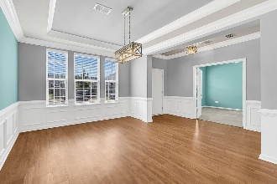
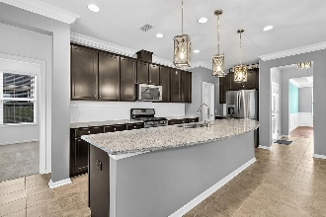
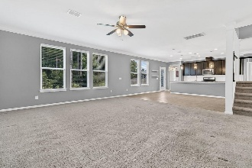
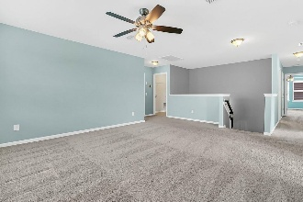

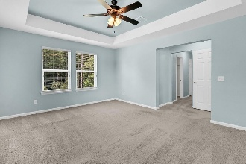
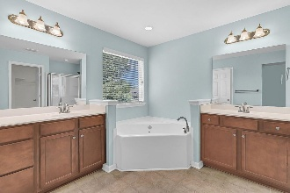
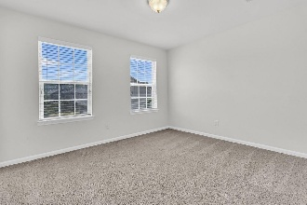
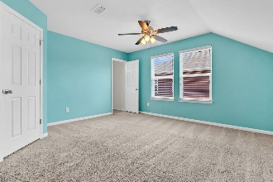
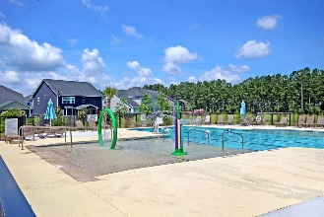
Debbie Cromer
ABR, RSPS, REALTOR, CRS
(843) 437-6342
debbie@debbiecromer.com
www.debbiecromer.com
Now Reduced + 2.5% to You
354 Beachgrass Lane
Cane Bay Plantation | Summerville, SC 29486 | MLS# 25017795 | $525,000
This stunning 5-bedroom, 4.5-bath home in the highly sought-after Oaks at Cane Bay offers the perfect blend of space, style, & convenience! The first floor features a private guest suite w/ full bath, a dedicated office, separate dining room, & a spacious open-concept layout that connects the living room, breakfast area, & gourmet kitchen—complete w/ granite countertops, stainless steel appliances, & ample cabinetry. Upstairs you'll find a large loft, three additional bedrooms, a full bath, & a luxurious primary suite w/ soaking tub, tiled shower, & dual vanities.
Situated on a beautiful lot that backs to mature trees, this home also features a long driveway, 2-car garage, & gas/electric hookups behind the stove & dryer. Enjoy resort-style living w/ access to an amenity center that includes a pool, playground, & miles of scenic walking/jogging trails. Take a golf cart ride to the nearby YMCA, Starbucks, Publix, restaurants, & more...don't miss your chance to call this beautiful Cane Bay home yours!
TAKE A VIRTUAL TOUR
Century 21 Properties Plus | 1090 Park West Blvd; Ste 103 | Mount Pleasant, SC 29466

