Slide 1
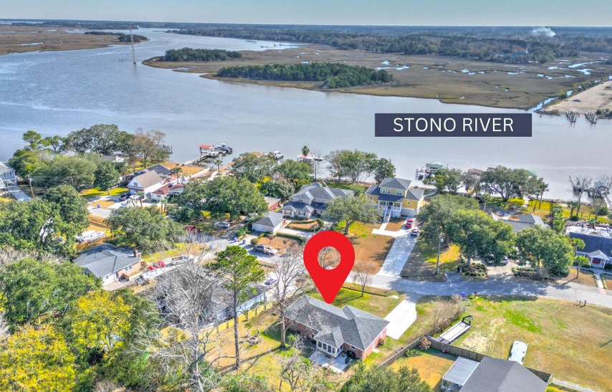
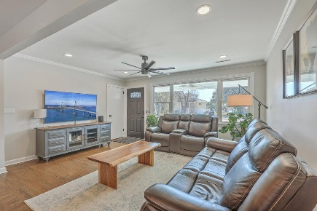
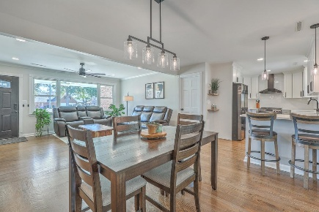
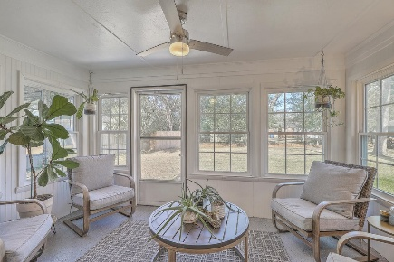
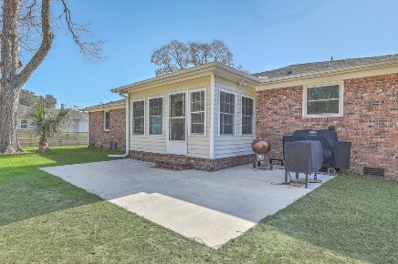






3552 OLD FERRY RD
$595,000
SHELL POINT · JOHNS ISLAND, SC 29455 · MLS# 25000773
PROPERTY FEATURES:
Take a video tour of this home
3 Bedroom 2 Bathrooms
1,362 Sq Ft
Welcome Home to this tastefully renovated 3BR/2BA brick ranch on nearly 1/2 acre! Since ownership (2022), the seller has been very busy with the transformation of the property.
HAYNES JOHNSON
843-864-8159
haynes.charlestonproperties@gmail.com haynes.findhomesforsaleincharleston.com

Slide 2
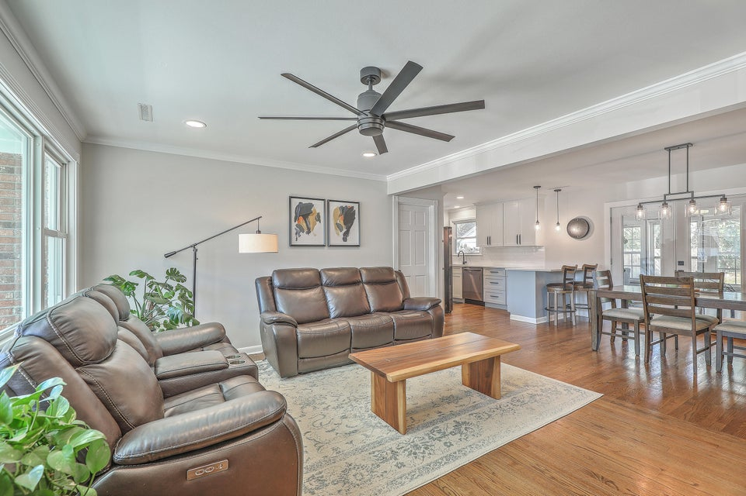
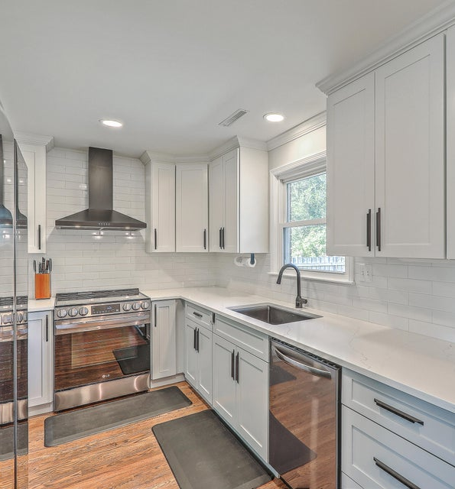
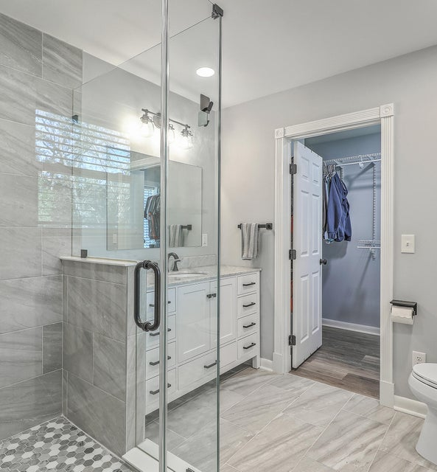
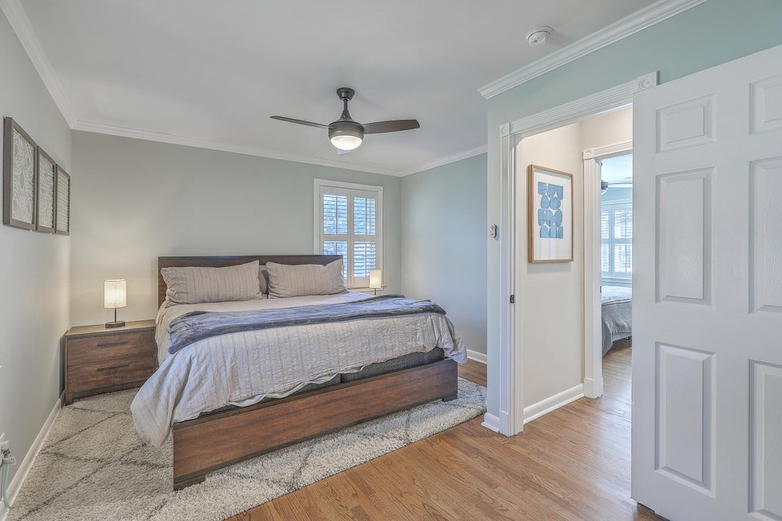
Interior
The Owner installed a brand new roof/HVAC/electrical/plumbing/hot water heater/appliances/added second full bath for a true Master BR/BA ensuite/kitchen renovation/bath(s) renovations/refinished hardwoods, fresh interior and exterior paint/new lighting package, installed gutters/spray foamed attic, & poured a new driveway. Soak in views of the Intracoastal Waterway from your couch and/or dining room table in this open floor plan.

Slide 3
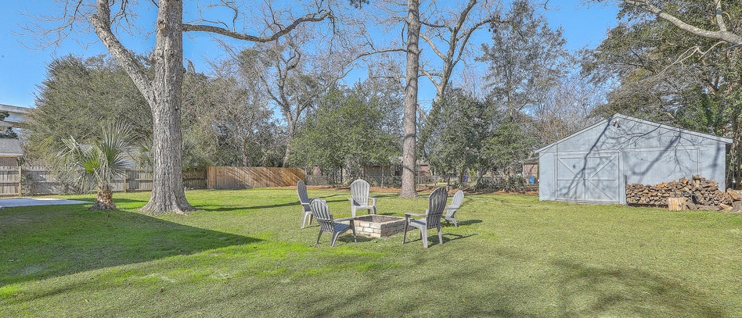
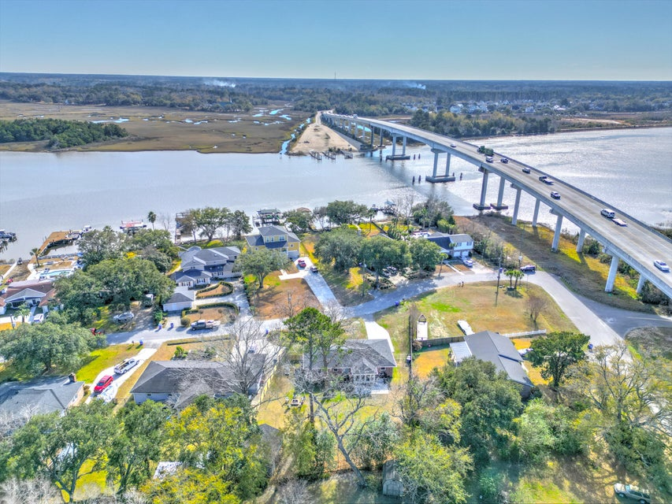
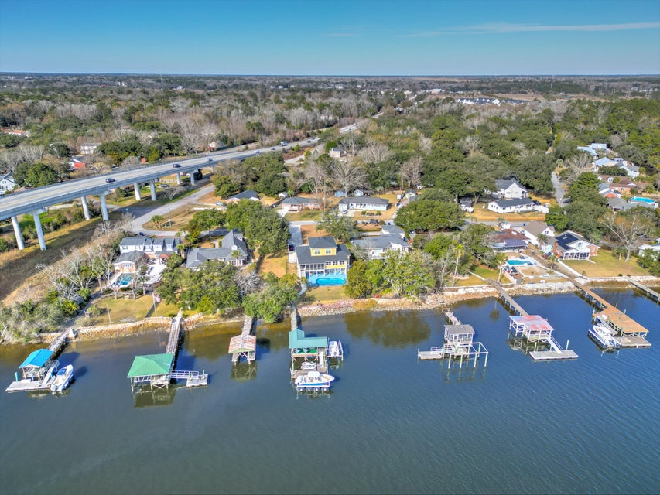
Exterior
This turn key home offers premium finishings, large private lot, gorgeous views, Limehouse Boat Ramp across the river, WA Greenway around the corner, proximity to 526 & Downtown, etc

