Slide 1
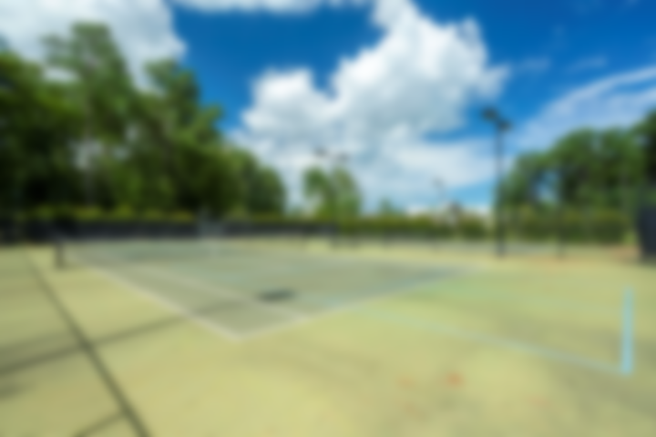
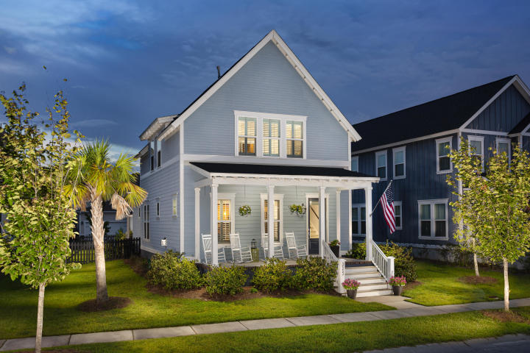
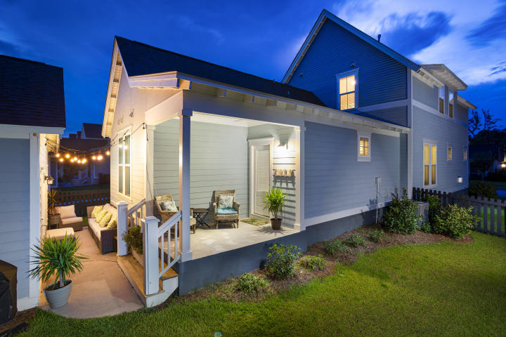
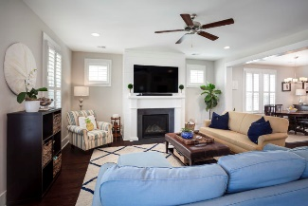
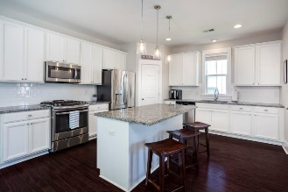
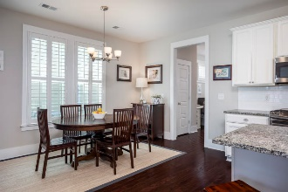
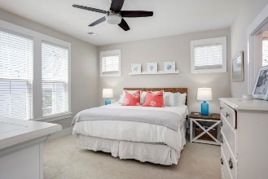
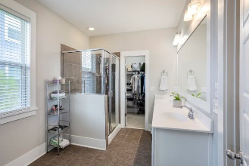
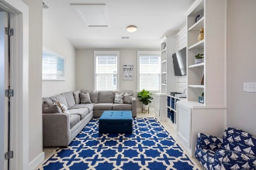
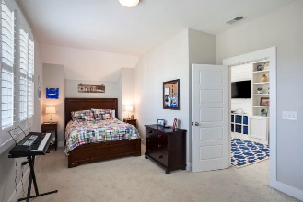
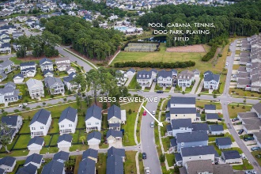
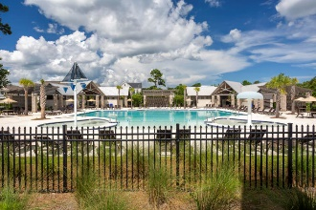



JUST LISTED! Carolina Park, Under 500k!
3553 Sewel Avenue
Carolina Park | Mount Pleasant, SC 29466 | MLS# 20021336 | $489,000
Classically styled and designed, this beautiful home is just steps away from the Carolina Park Residents Club and amenities. Built by award winning builder, Saussy Burbank, this Georgetown A offers a spacious 3 bedroom/2.5 bathroom open concept floor plan. Notice the welcoming front porch, perfect for enjoying a nice breeze and a cup of coffee. Upon entering the home, you will greeted with gorgeous hardwood floors and an open living room which joins the kitchen and dining area. This floor plan allows for a great entertaining space. Notice the shiplap that was added to the fireplace area as well as plantation shutters throughout. The spacious chef's kitchen includes a counter-height island with generous counter space, gas range, pendant lighting, a walk-in pantry, and an extra pantry/closet in the kitchen. As you walk to the back of the home, you will pass the laundry room and half bath on your right. This hall space is wonderful for an office or extra storage area. The first floor master suite is ideally situated in the rear of the home, adding extra privacy. It includes a en-suite bathroom with a dual-vanity and a spacious walk-in closet. The back entrance leads to a charming porch and patio area as well as a fenced in back yard and detached garage. The second floor includes an open-concept flex space/loft area that includes upgraded shiplap built-ins. Off of this space are two spacious bedrooms with large closets and a full bathroom. Walk or ride your bike to the brand new neighborhood Wando Library, Carolina Park Elementary, Wando High School, or Oceanside Collegiate Academy. Carolina Park's amenities include a junior Olympic sized swimming pool, outdoor pavilion with a gas fireplace and kitchen, lighted tennis courts, playground, fenced-in dog park, 20 acre Bolden Lake with trails, boardwalk and kayak launch.
Virginia Landon 803-493-9202
virginialandon@kw.com
virginialandon.kwrealty.com
Keller Williams Realty 496 Bramson Ct Ste 200 Mt. Pleasant, SC 29464

