Slide 1
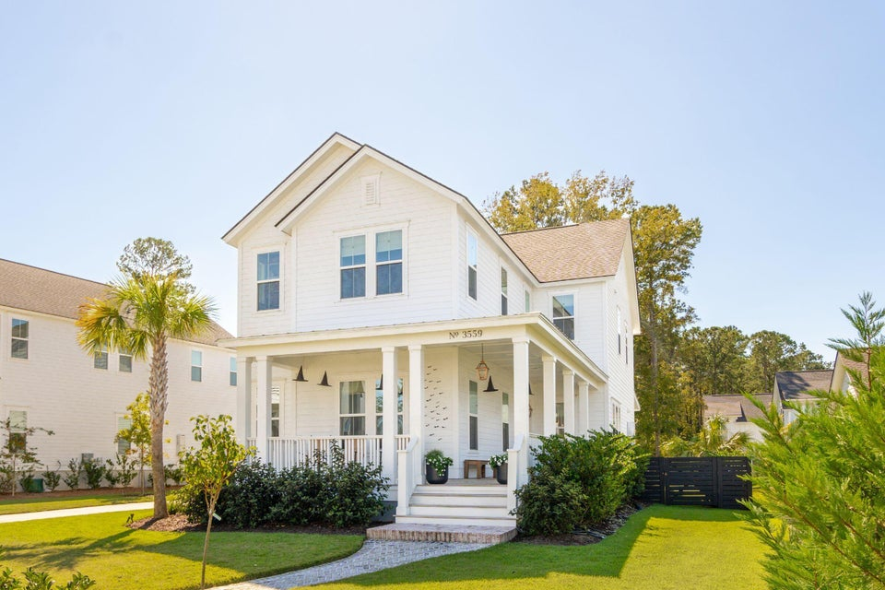
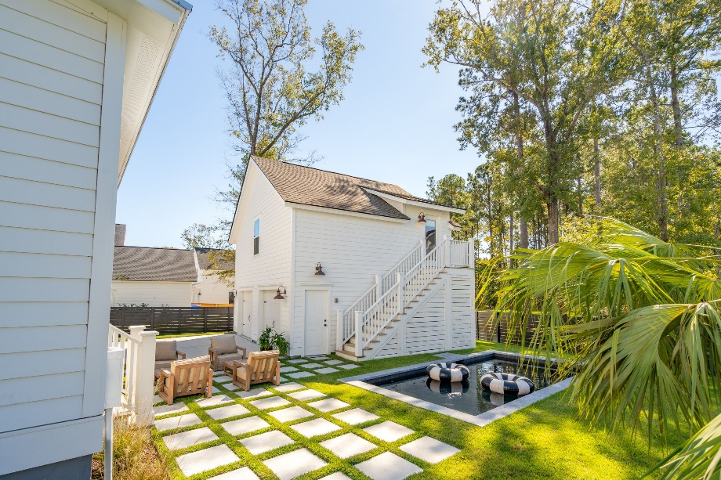
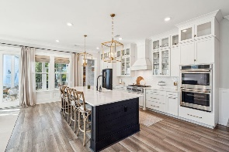
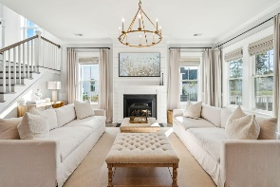
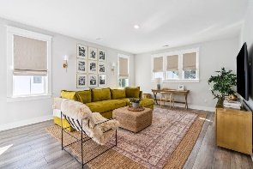
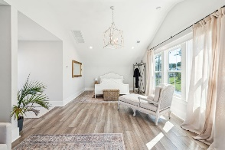
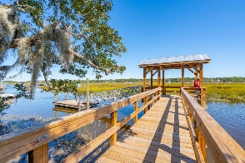
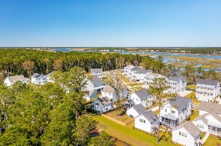


Broker Open House Thursday, Nov 14th 11:30- 1:30 | Light Lunch Provided | Broker Comp 2.5%
3559 Clambank Drive
Carolina Park | Mount Pleasant, SC 29466 | MLS# 24026363 | $1,750,000
**TOTAL SQUARE FEET: 3,712** Welcome to this stunning 6-bedroom, 5.5-bathroom home in the highly desirable **Riverside section of Carolina Park**! Built in 2023, this meticulously designed home offers an array of high-end upgrades, ensuring that no detail has been overlooked. Notable features include a gorgeous custom saltwater swimming pool with marble coping completed in 2024 by Blue Haven, a newly designed patio, lush zoysia grass, and professional landscaping with palm trees for added privacy. Custom lighting, elegant window treatments, and detailed millwork enhance the home's sophisticated charm, with designer wallpaper and luxury finishes throughout (PLEASE refer to the documents for a FULL LIST OF UPGRADES).
The exterior showcases a charming wraparound porch and a screened porch, ideal for enjoying the Lowcountry lifestyle. The first-floor primary suite, currently used as a sitting room, offers a spacious walk-in closet (currently used as a gym), a luxurious bathroom, and a convenient washer/dryer setup. The open floor plan is perfect for entertaining, centered around a stunning kitchen with new quartz countertops, stainless steel Café appliances, built-in double ovens, a microwave, and an island wrapped in shiplap with new pendant lighting. The walk-in pantry has been beautifully updated with a custom butcher block countertop, cabinetry, and a wine/beverage fridge.
Upstairs, you'll find four additional bedrooms, one of which is currently being used as the primary bedroom but could easily serve as a study, plus a spacious loft. The backyard is equally impressive, boasting a custom-designed pool, a newly added patio, and lush landscaping for added privacy and a coastal feel. The detached finished room over the garage offers a versatile guest suite or office space, complete with a bedroom, sitting area, full bathroom, and a large closet (currently used as a kids' bunk room).
Situated in the charming **Riverside section**, this home provides access to Carolina Park's outstanding amenities, including playgrounds, tennis courts, walking and biking trails, a dog park, and a pool overlooking scenic Bolden Lake. Located just across from the community dock, you'll have easy access to kayaking, fishing, and serene waterfront living, all while being conveniently close to top-rated schools, shopping, dining, and the best of Charleston. This home truly offers the perfect blend of luxury and location, a dream come true!
VIDEO TOUR
Debbie Rogers (843) 990-2915
deborah.rogers@carolinaone.com
www.DebbieRogersSellsCharleston.com
Carolina One Real Estate | 2713 Highway 17 North | Mt. Pleasant, SC 29466

