Slide 1
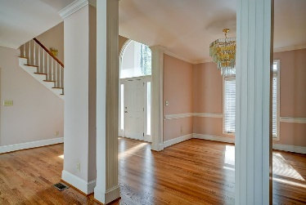
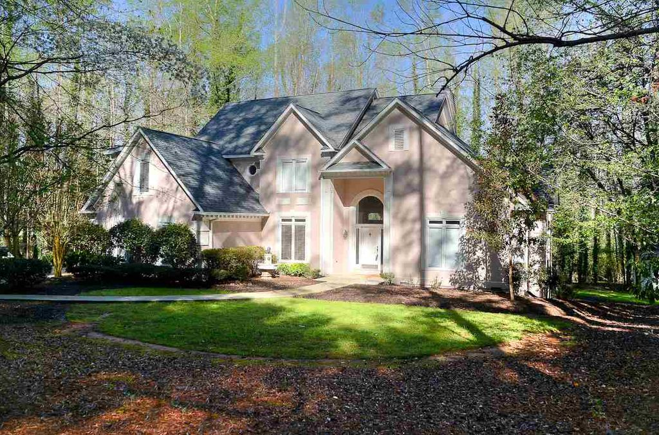
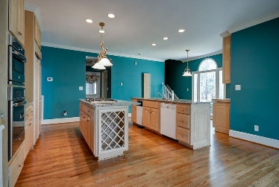
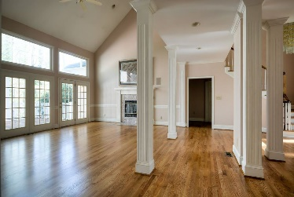
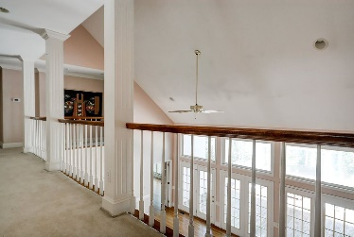
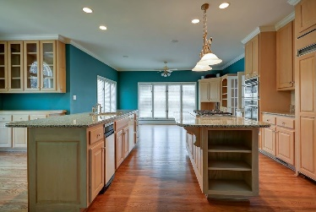
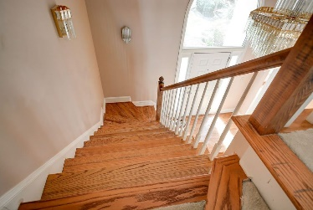
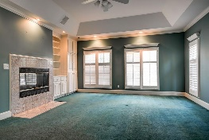
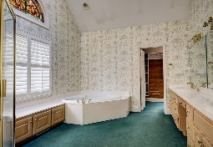
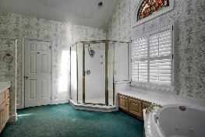
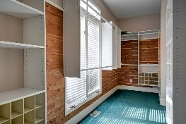
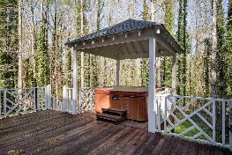


355 Montgomery Dr, Spartanburg, SC 29302
$444,000
Priced To Sell In Prestigious Eastside Spartanburg!
New Roof
Refinished hardwood floors
Almost 3 unrestricted acres
Wired for surround sound
High end appliances
Granite Counters
Walk in pantry
Plantation shutters
Large walk in cedar closet
Hot Tub
Gazebo
Outbuilding for storage or hobby space
Oversized 2 car garage
Backup Kohler generator
Leaf guard gutters
Peggy Wilson
Realtor, Broker, GRI, ABR
864-415-3958
peggy@realtysc.com
www.realtysc.com

