Slide 1
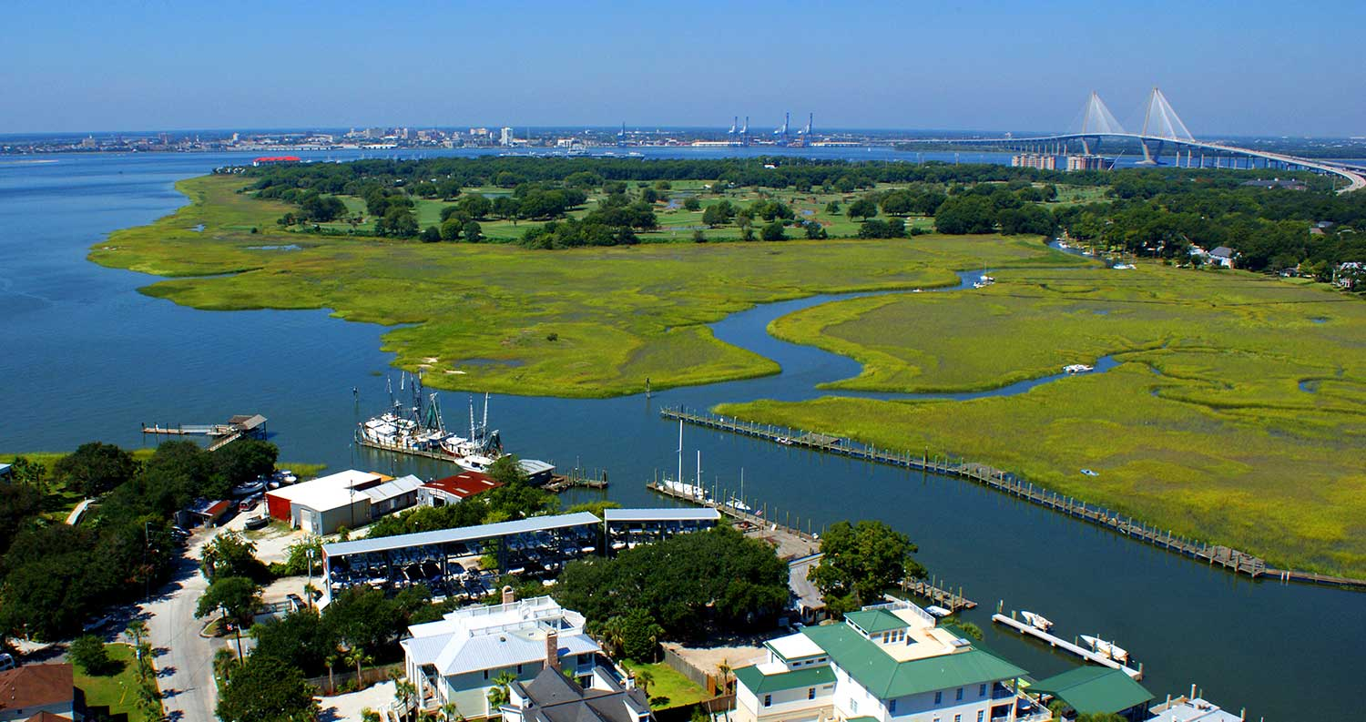

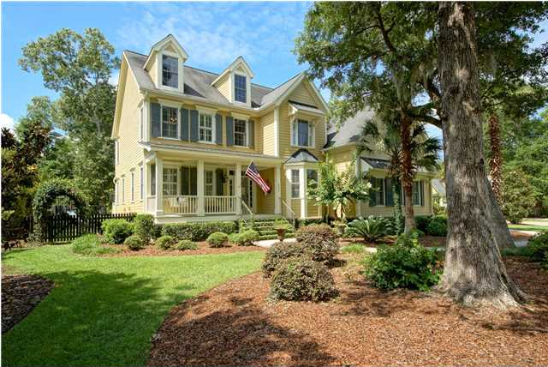
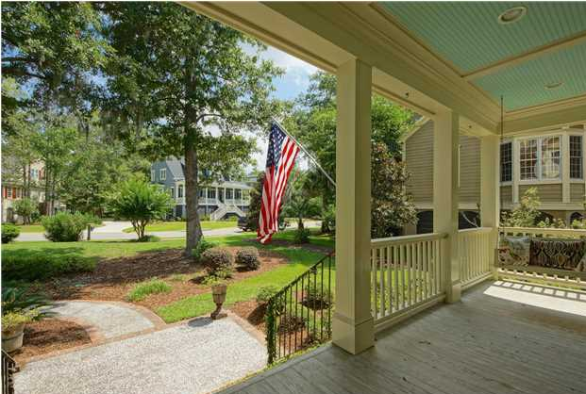
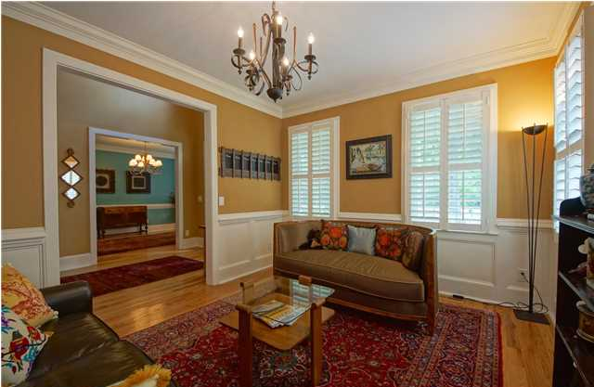
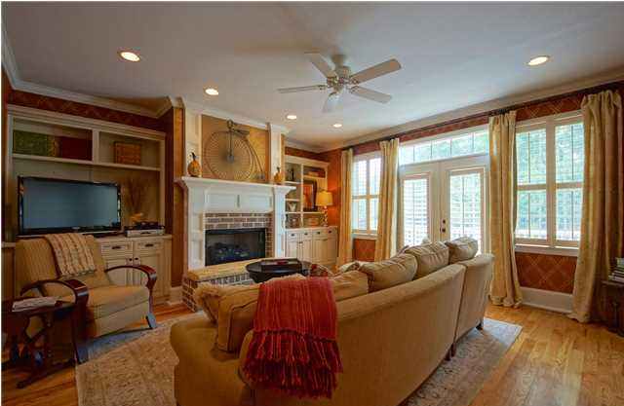
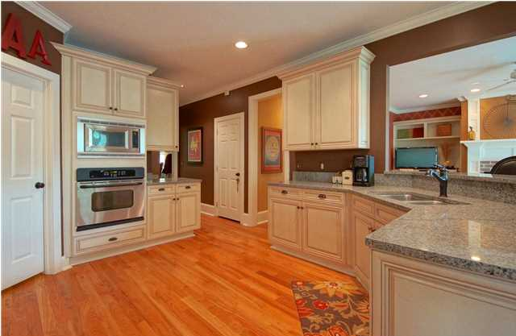
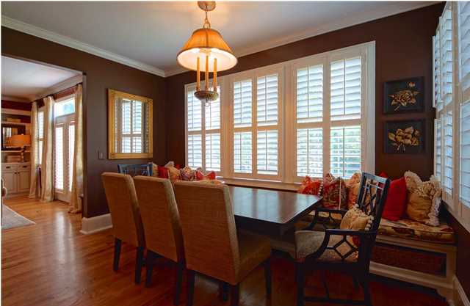
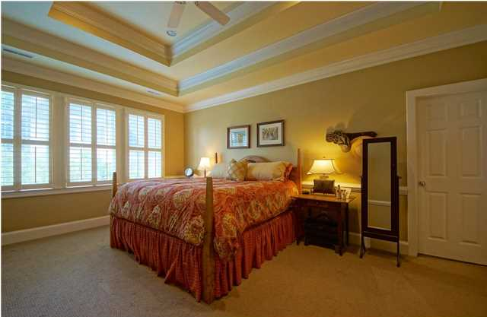


Custom Dream Home
3561 Henrietta Hartford Rd
Park West
Mount Pleasant
MLS# 1417494
$685,000
Beautiful, custom 6 bedroom / 4.5 bath home in desirable Tennyson section of Park West. With 3845 square feet, this spacious home has plenty of room for everyone. Originally built as a builder's personal residence, the attention to detail abounds with extensive trim work & crown molding, plantation shutters, and nine-foot ceilings throughout the home. Beautifully landscaped front yard and inviting front porch. Two-story foyer flanked on either side by living room/study and formal dining room. Downstairs offers hardwood floors, 1/2 bath, and guest suite. Warm family room, with custom built-in cabinets and custom brick fireplace with gas logs, opens into the chef's kitchen, including granite countertops, stainless appliances, custom cabinets, 5-burner gas cooktop, and tile backsplash. Spacious eat-in area features wall to wall, double-function banquette, providing extra seating and storage. Screened porch with coffered ceiling off of kitchen. Large master suite with double tray ceiling and substantial, custom, walk-in closet. Master bath has double vanities with granite countertops, spacious, tiled shower and jetted tub. Large media/game room over the garage with walk-in storage. Central vac system and custom closets throughout. Spacious deck off of the family room, leads to patio and fenced in back yard. Two car garage contains large built-in storage area. Exterior painted within the last year. This home is a must see! Tennyson Park is located just behind the homes across the street....a great spot for the kids to play & family picnics. Park West offers amenities including swimming pools, hiking and biking trails, tennis courts and quick access to public schools, shopping and Town of Mount Pleasant recreational facilities.
Bill Barnhill
843-364-6903
bill@billbarnhill.com
Virtual Tour Available at
http://tours.listingsinmotion.com/public/vtour/display/222956?idx=1
496 Bramson Ct., Suite 200
Mount Pleasant, SC 29464

