Slide 1
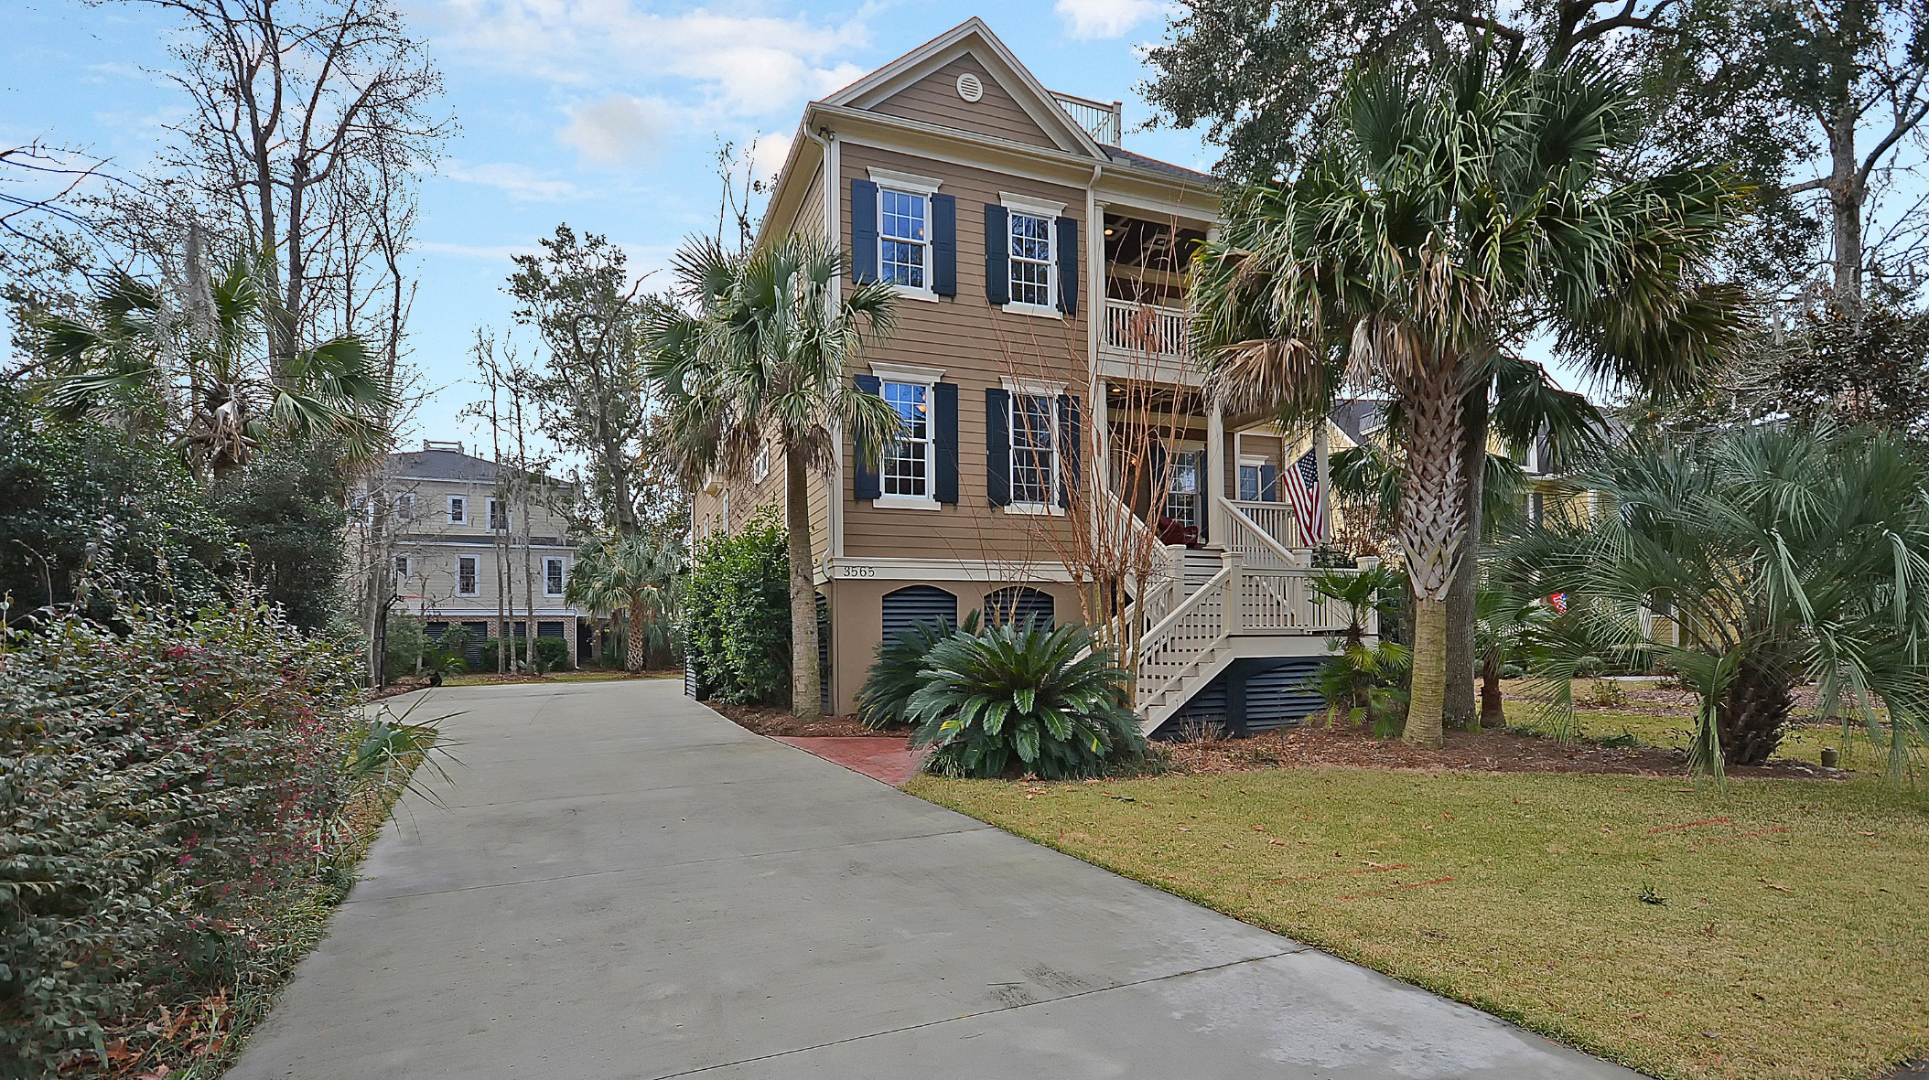
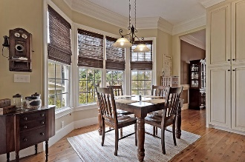
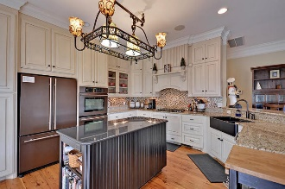
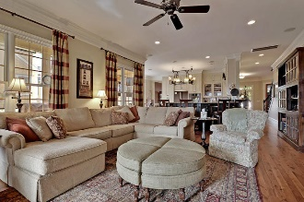
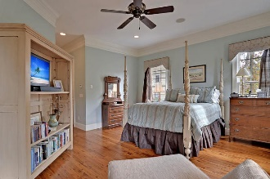
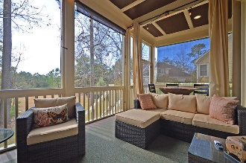

3565 Henrietta Hartford Road Park West | Mount Pleasant, SC 29466 | MLS# 17001255 | $789,000
Heart of Tennyson Park West
New Listing in Hibben
Beautiful custom home in highly sought after Park West community. Walk just across street through Tennyson Park and you will know you are at home. Australian Cypress hardwood floors throughout entire main living areas, extensive trim, and lovely oil rubbed bronze hardware are just a few of the many upgrades within. State of the art kitchen is equipped w Jenn-Air appliances, granite countertops, custom made cabinets, a large center island, and a spacious breakfast room. The home also has a private study on main floor that could be used as another bedroom. The family room is open to kitchen and overlooks a beautiful private pond known to residents for great fishing. Master suite is downstairs with master bathroom that includes additional custom cabinets and dual granite countertops.
Unique VRF HVAC system for residential home/ utilites on average are $279.00/month · Rainbird programmable Irrigation System · Alarm System · Tankless Water Heater ** Kitchen Light / Pot Rack does not convey
Stan Huff
843-670-2835 stan.huff@agentowned.com
Margaret Wannamaker
843-364-5851 wannamom66@gmail.com
www.agentownedrealty.com
AgentOwned Realty Co. Preferred Group, Inc. | 824 Johnnie Dodds Blvd | Mt Pleasant, SC 29464

