Slide 1
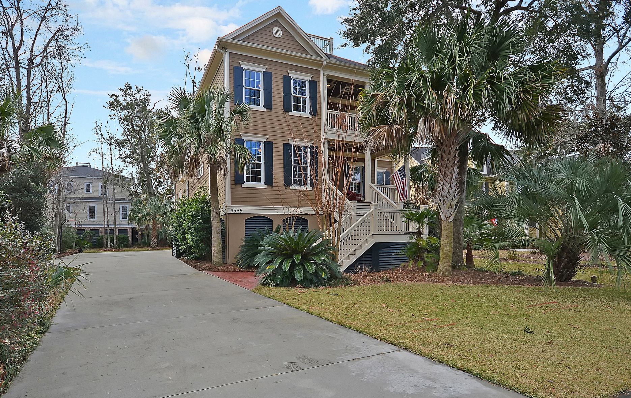
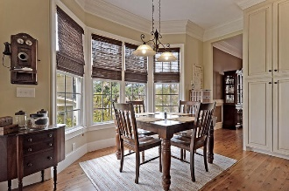
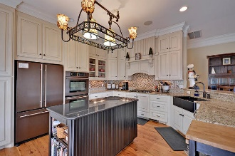
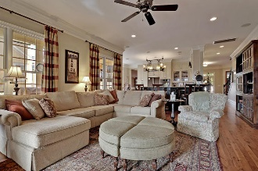
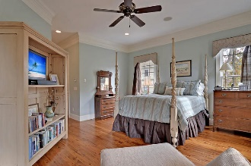
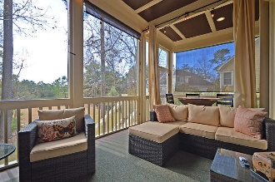

3565 Henrietta Hartford Road
Tennyson @ Park West | Mount Pleasant, SC 29466
MLS# 17001255 | $775,000
Price Reduction
in Park West
$775,000
Price Reduction in Park West ~ $775,000
Beautiful Tennyson
3884 sq/ft
4 BR/ 4 BA
Bonus Room and Office
Awesome view of pond
Walk across street through breathtaking Tennyson Park
3 car garage
Stan Huff
843-670-2835
stan.huff@agentowned.com
Margaret Wannamaker
843-364-5851
wannamom66@gmail.com
www.agentownedrealty.com
AgentOwned Realty Co. Preferred Group, Inc. | 824 Johnnie Dodds Blvd | Mt Pleasant, SC 29464

