Slide 1
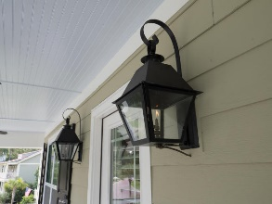
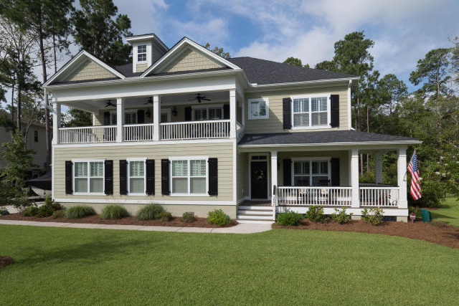
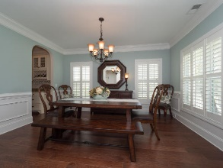
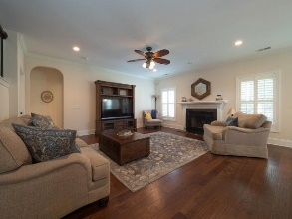
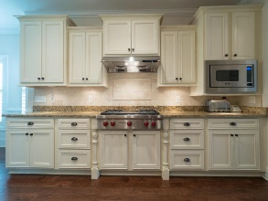
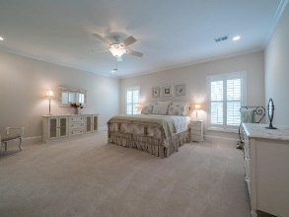
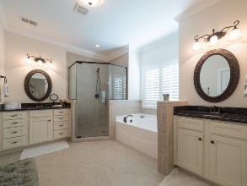
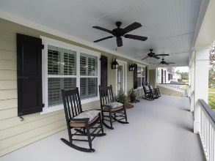
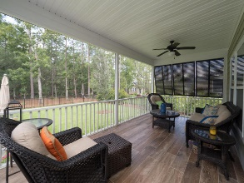
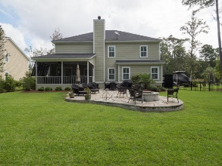


3571 Holmgren Street Darrell Creek :: Mount Pleasant :: MLS# 17023977 :: $650,000
The Only Deep Water Home On Daniel Island
Open House
Saturday, Sept 2nd ~ 10a–2pm
BE IN THE NEIGHBORHOOD OF PICTURESQUE HOMES on over a ½ acre fenced yard. Enjoy all the "Southern Charm" this lovely home will provide you and your family: wrap around front porch, gas lanterns, 2nd story porch with fans, dual masters, plantation shutters throughout, crown moldings, large dining room, chef's kitchen with WOLF cooktop with updraft hood. Sip tea on the screen porch or go out into the lush fenced backyard & relax on bluestone patio and enjoy the built in firepit. Side load oversized garage provides storage galore but there's so much more… Additional kitchen features include butler pantry, 42" & staggered ivory cabinets and soft close draws, granite, lots of prep-space, Blanco Farmhouse sink, stainless appliances pkg including a double-oven. Lg family room w/cozy fireplace is the center for entertaining as it is protected from loud kitchen activity with privacy wall (but if you prefer, it can be easily removed.) Downstairs master with spa bath is huge with closets galore. Head upstairs to find a large secondary living/flex space with high cathedral ceilings. The upstairs master with a spa bath also provides access to the large upper porch; there's plenty of space to unwind from your day in couple of rocking chairs. Three additional spacious bedrooms and another full bath are also upstairs. Other features include a full featured security system with cameras, remote control and home automation, storage, an irrigation system with a separate meter (cost saver). Stop now plan to see this better than new home with many upgrades in Darrell Creek where you'll find the tranquil lifestyle you are looking for, close to schools, hospital, shopping and restaurants. Neighborhood amenities include pool, a cabana area and a crabbing dock for a very reasonable HOA fee in comparison to surrounding communities.
Helen Hudson
843-991-9875
helen.hudson@carolinaone.com
Carolina One Real Estate
2713 Highway 17 North
Mt. Pleasant, SC 29466

