Slide 1
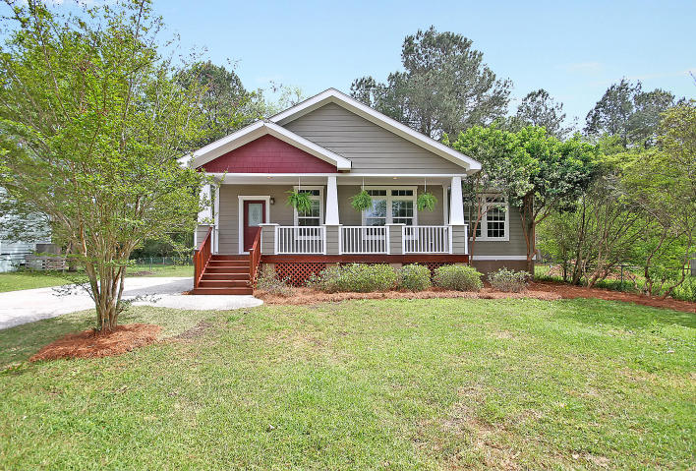
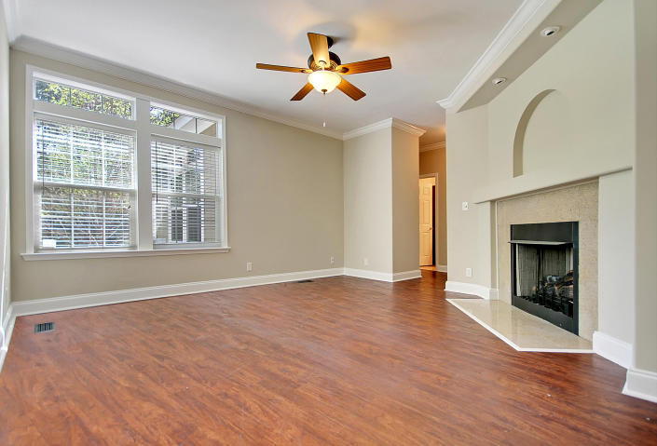
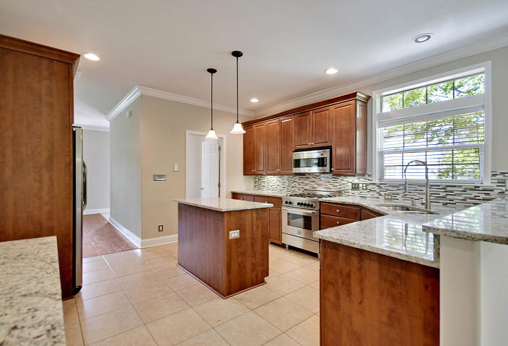
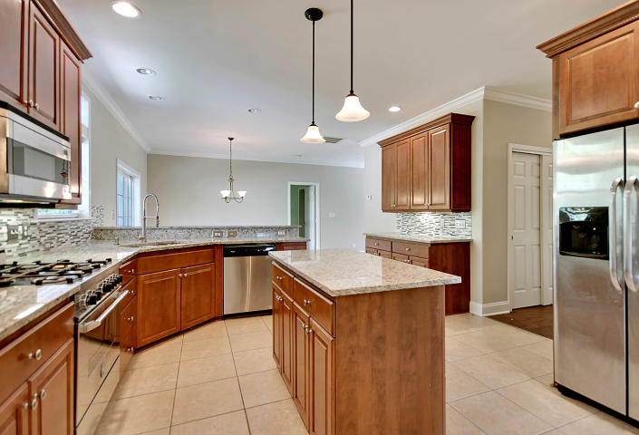
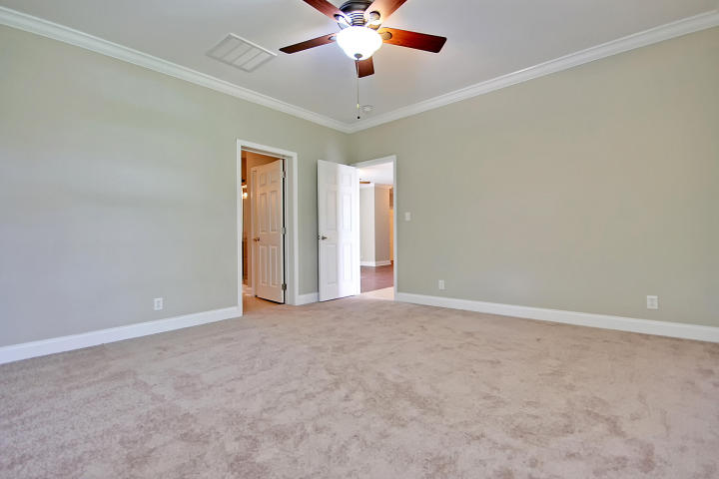
Large Three Bed Two Bath Renovated Johns Island
Reduced $200k!
3573 Walter Drive
Cedar Springs ~ Johns Island ~ MLS# 16009598 ~ $320,000
This amazing home has everything you could ever ask for: deep water (8 feet at low tide!), marsh and water views, a serene setting, and quite possibly the best, most convenient location in Mount Pleasant. This beautiful, custom built home sits on over 1.50 acres, and the lot can be subdivided. The home has hardwood floors, stainless steel appliances, and tons of natural light. This dock is a water-lover’s dream! The dock features a 13,000 pound boat lift attached to a 10x20 pierhead and a walkway to the floater. There is also a 8.5x20 jet dock, and a large boat can park beside the floater. The dock has power and lighting and two separate water accesses to the upper and lower portions of both lifts. The Long Point Community is located just minutes from 1-526, shopping, dining, and the incredible beaches of Sullivans Island and Isle of Palms. Book your showing today!
Additional information:
Added hardwood floors in the upstairs bedroom and closets.
Completed the outdoor porch to include; stainless steel wire with Ipe railings on the first and second level porches. The second level: completed a flat roof with Million dollar views including 7 coats of Hydro stop coatings.
Added a fluted ceiling on the porch, painted the entire first floor ceiling a birds eggshell blue. Replaced all wood flooring on porch, deck, painted and installed 3 fans
Dock additions; 1) structurally added a 13,000 pound lift.(12.5' X 12.5') 2. two 3' X 5' storage areas with 2 foot walls, close to pierhead, added a large jetdock (8' X 20' with extra blocks available in storage) 2. Installed new bracing below pierhead and throughout walkway. Installed full 220 outlet power with complete lighting to the pierhead, floater, and lifts. Installed water that is available on pierhead and floater for spray off stations for both lifts complete with coil hoses. 3. Step up system for the large lift to assist in easy access entering and leaving boat. Installed floodlights on pierhead.
Huge Lot In The Heart Of Johns Island
Renovated Kitchen With Stainless Appliances, Italian Gas Range, Granite, Glass Backsplash,
Renovated Bathrooms With Granite Counters
Large Master Suite
Two Large Living Areas, With Fireplace
Large Laundry Room
Great Front Porch, And Large Back Deck
Nate Gainey nate@mattoneillteam.com 843-513-2038

