Slide 1
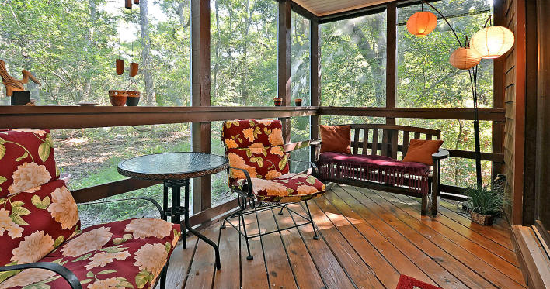
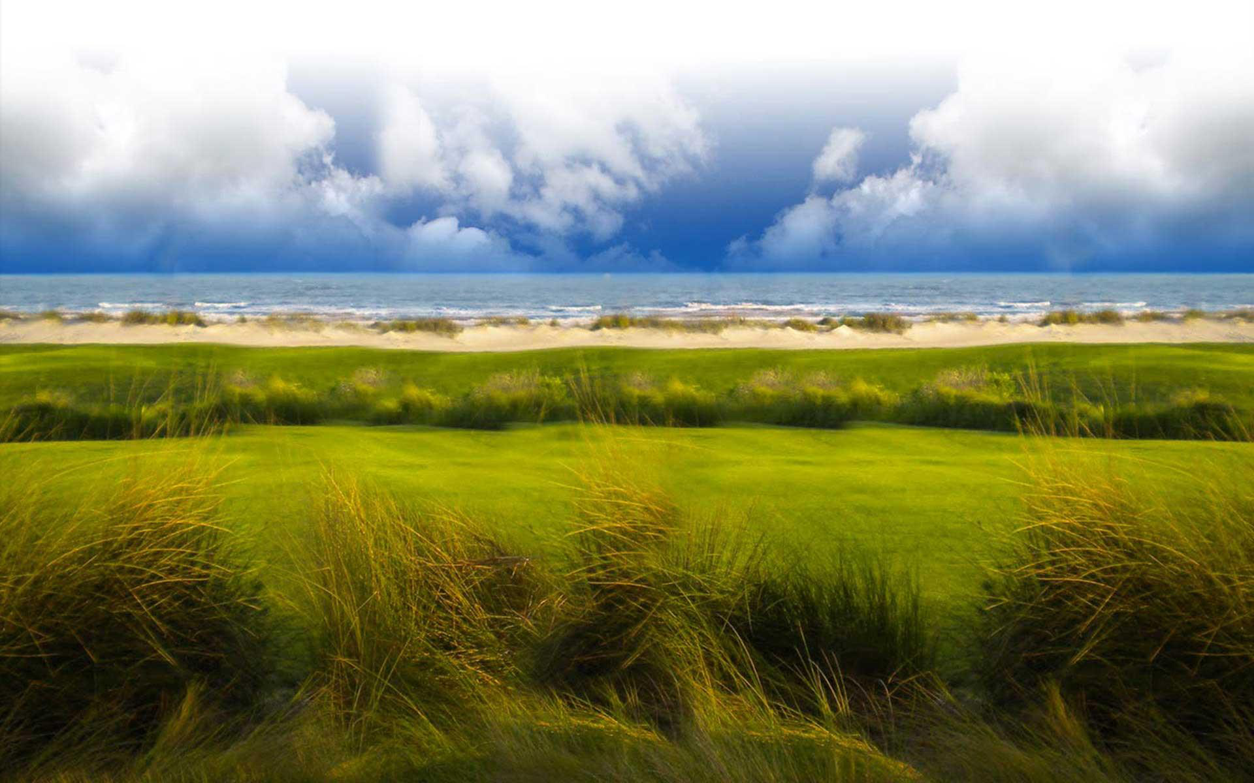
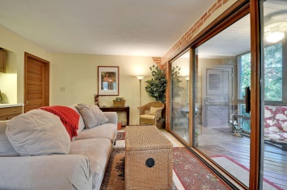
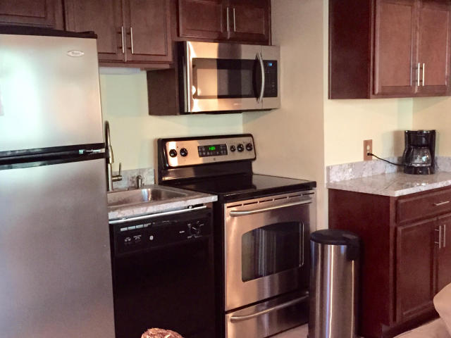
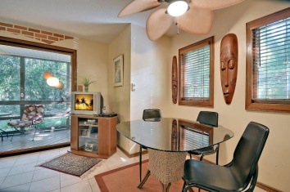
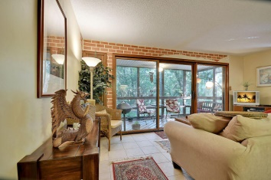
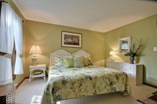
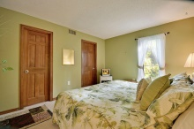
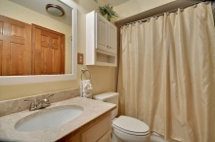


3576 Seascape Villa
Kiawah Island, SC
MLS# 15002307 ~ $214,000
Kiawah Turn-Key Unit with Rental Opportunities
This lovely first floor villa is a short walk to the beach, golf, tennis, dining and shops
The villa offers a living, dining and kitchen area opening to the screened porch
The kitchen has stainless steel appliances and new granite countertops
Sold furnished
Solid Rental history
Listed Exclusively by
Christina Bucci
843-830-0888 Cell
christina@sweetgrassps.com
RE/MAX Elite | Sweetgrass Properties, 91A Broad St, Charleston, SC 29401

