Slide 1
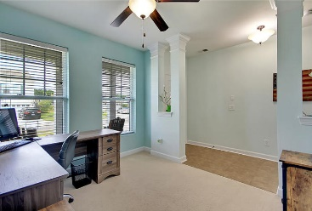
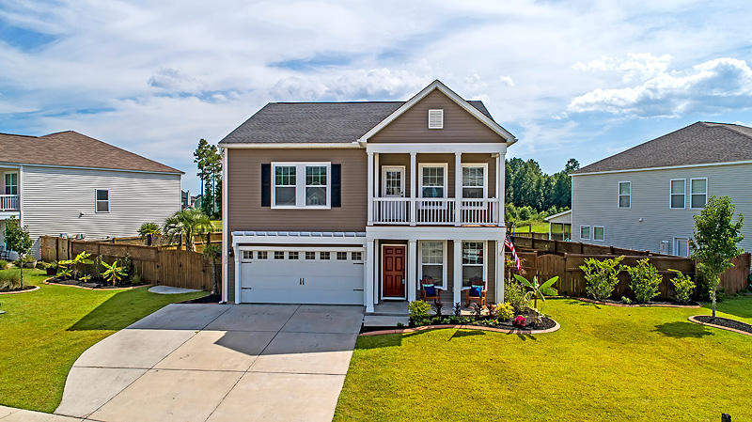
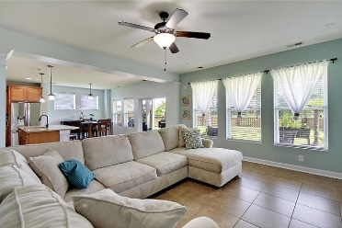
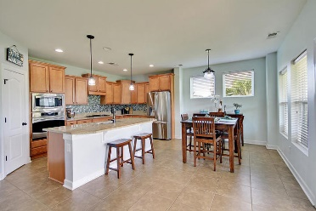
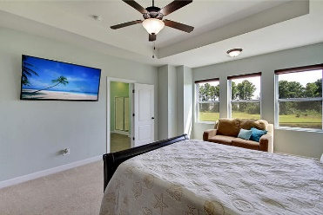
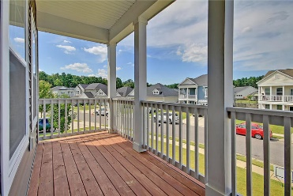
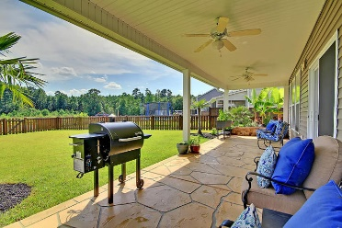
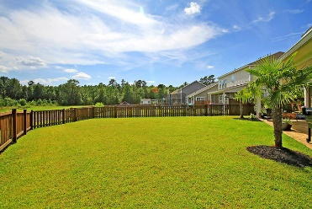
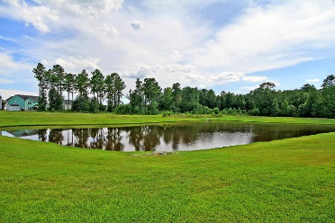

357 Fox Ridge Lane Foxbank Plantation · Moncks Corner, SC 29461 MLS# 19022234 · $285,000
Gorgeous Listing
New Low Price!
STUNNING 4 bed, 2.5 bath, home in Foxbank Plantation w/ GORGEOUS CURB APPEAL, BEAUTIFUL PROFESSIONAL LANDSCAPING, welcoming stacked front porches and large FENCED PRIVATE POND LOT. Entering the home you are greeted with stunning floors, open floor plan, and an abundance of natural light. To the right is an office/flex room/main level bedroom perfect for guest who do not want to do stairs. The chef inspired gourmet kitchen has a HUGE GRANITE ISLAND, 42" custom cabinets, gas range, stainless steel appliances, tiled backsplash, and pantry. The kitchen has a large eat-in area with a wall of windows leading to the full covered concrete stamped patio with fenced yard, amazing views of ponds, grilling area, and relaxing koi pond water feature-a true BACKYARD OASIS that is a must see!
The family room is open to the kitchen and is spacious enough to hold an oversized sectional couch. On the second floor landing there is a loft perfect for a living area, play room, workout room, or media room that has a second level porch! The master bedroom suite is big and bright and has a spa-like ensuite bath with relaxing large shower with shower rain head, dual sink vanity, and GIGANTIC closet. Bedrooms 3 and 4 are nicely sized and share a full bath. Finishing off the second floor is a generous laundry room. Foxbank Plantation in Moncks Corner is a wonderfully landscaped community with schools, play park, and community pool! The neighborhood is close to local shopping and grocery stores and is a short drive to downtown Charleston with 5-star restaurants, world class shopping and iconic history as well as a short drive to the beaches, the airport, Boeing, Volvo, and Daniel Island. Come take a look because you will not find another home that offers as much as this one: chef inspired kitchen perfect for entertaining and backyard oasis! Call today!
Stan Huff
843-670-2835 stan.huff@agentowned.com
Jill Marcacci
843-297-5590 jill@agentowned.com
www.agentownedrealty.com
AgentOwned Realty Co. Preferred Group, Inc. | 824 Johnnie Dodds Blvd | Mt Pleasant, SC 29464

