Slide 1
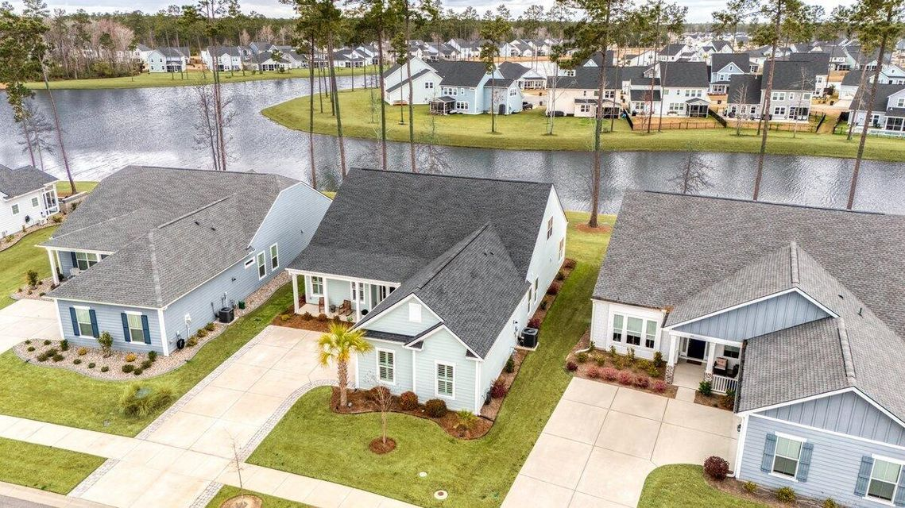
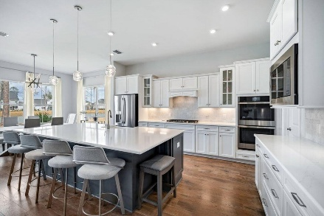
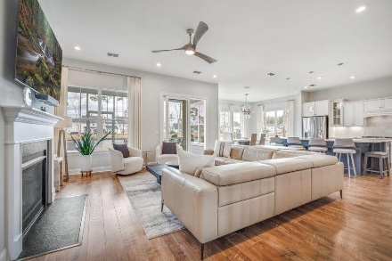
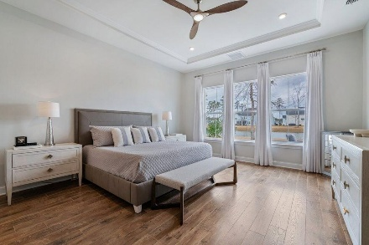
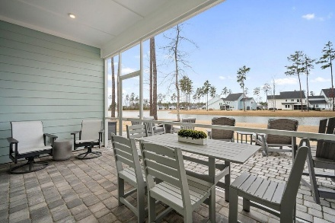

357 Tupelo Lake Drive
Four Seasons @ Cane Bay | Summerville | Mls# 25005862 | $784,900
Darrell Creek Elevated Home With Elevator & Salt Pool
$15,000 Price Reduction
Open House Sunday 4/6 From 1-3 PM
Co-hosting with
Lisa Wood from
Crown Home Mortgage
Offering $2500
Lender Credit
Welcome to Life on the Lake at 357 Tupelo Lake Dr! Located in the exclusive 55+ luxury lakeside community of Four Seasons, this home presents a rare opportunity to own a slice of paradise. Lake homes are highly sought after in Four Seasons, and with the builder no longer offering new homes on the lake, this 3-bedroom, 3.5-bathroom Ravenna Loft, with nearly 3,300 square feet of luxurious living space, is a one-of-a-kind find! As you approach the home, you're immediately greeted by a charming full front porch, hardie plank siding, a widened paver driveway, and a side-load 2.5-car garage that speaks to the home's upscale design. Step inside, and prepare to be wowed by the open, airy feel created by soaring 10-foot tray ceilings, wainscoting, plantation shutters, and premium LVP flooring.
The grand finale of this home is the stunning outdoor living space. The extended paver screen porch and patio are perfect for outdoor entertaining and relaxation. Whether you're dropping your boat in the lake, bird-watching from the back porch, or enjoying the cozy outdoor fire pit powered by an underground gas line, you'll be able to unwind in style. Fire up the grill, enjoy the sunset, and make the most of lakeside living!
In Four Seasons you will never be bored, as this is the only Active Adult Community in the area that is built around a 300-acre lake with its own private boat dock. Other amazing amenities include an indoor and outdoor pool, fitness center, ballroom, dog park, bocce, pickleball, tennis courts, a kayak launch and so much more! There is also a packed monthly events calendar and Full-time Lifestyle Director. Once you move to the Four Seasons, you will never want to leave!
This home has it all: luxury, functionality, and stunning views...offered at an incredibly competitive price. Don't miss this rare opportunity to own a piece of paradise!
House Tour
Elissa Campbell
843-853-1433 | elissa.campbell@agentownedrealty.com
AgentOwned Realty Preferred Group | 824 Johnnie Dodds Blvd | Mt Pleasant, SC 29464

