Slide 1
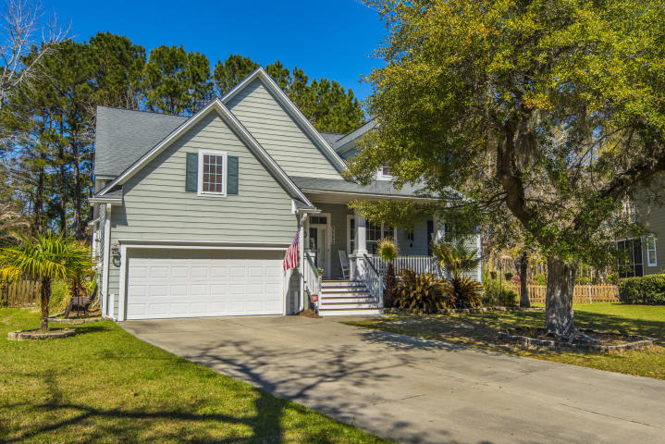
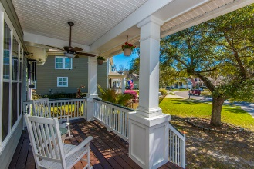
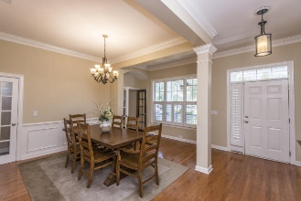
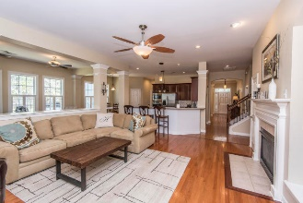
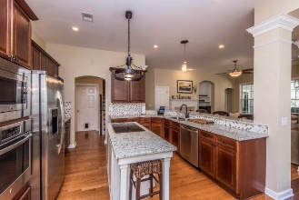
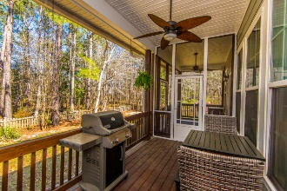
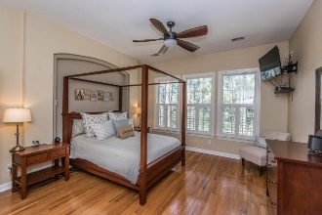
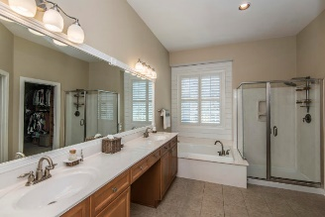
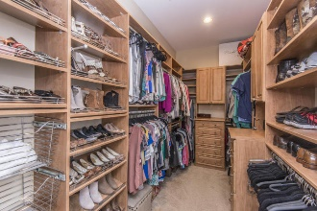
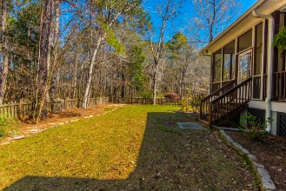
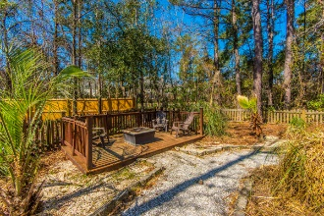


3582 Toomer Kiln Circle
Mount Pleasant, SC 29466 :: MLS# 18006642 :: $525,000
Must See In Park West! This Home Won’t Last!
David Weekley home on a private, wooded, over 1/3 acre lot that backs up to wetlands & views of a protected, wooded island across the street. Relax on the huge screened-in porch looking out over the large, private backyard in this highly sought after Coatbridge section of Park West. Entertain friends & family with the custom built deck & fire pit. Primarily one story with a bonus room upstairs that can also be a 4th bedroom with closet and private bathroom. Custom-built, walk-in closet system in the Master bedroom. Bright, open floor plan with 11' ceilings, plenty of windows with plantation shutters. Beautiful hardwood flooring throughout the 1st floor. New Trane 5 ton HVAC installed June 2017 and a 100,000 BTU furnace fan. Tankless hot water heater. Gorgeous granite countertops and kitchen island create the perfect space for gatherings in this spacious floor plan. Recently updated stainless steel appliances in the kitchen.
Stuart DeVault
(843) 754-1769
stuart@carolinaone.com
www.stuartdevault.com
Carolina One Real Estate
2713 Highway 17 North
Mt. Pleasant, SC 29466

