Slide 1
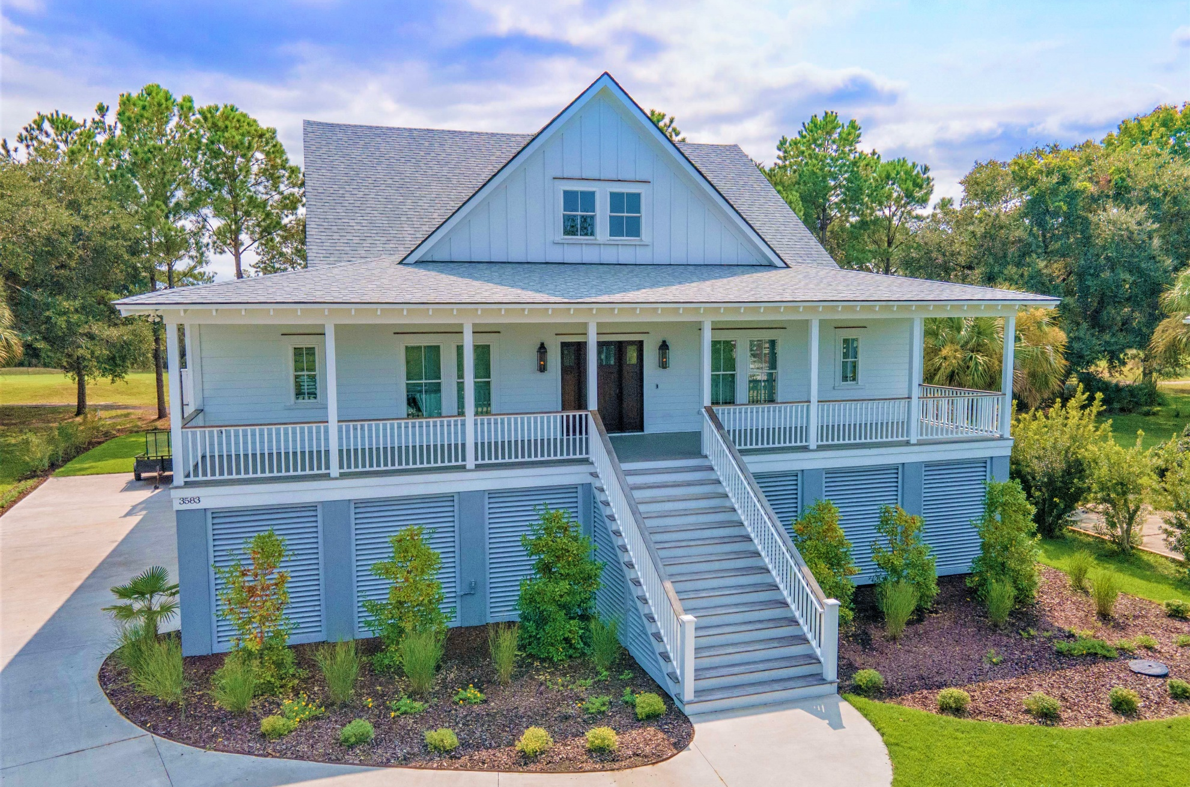
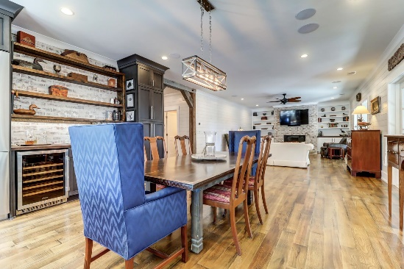
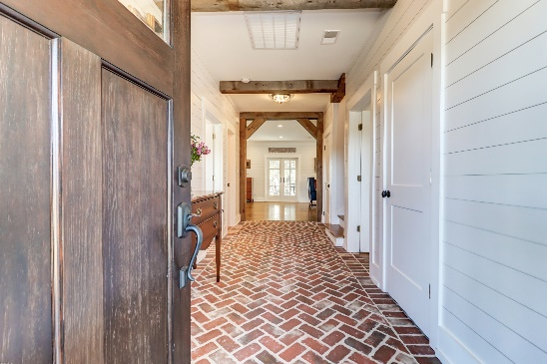



3583 Somerset Hills Court
The Estates at Charleston National | MLS# 21031524 | $1,395,000
New Construction Without The Wait!
New Price!
Mount Pleasant
Come Enjoy This Fabulous Lowcountry Gem! Beautiful selections and a great layout set the tone for the interior while the golf and marsh views, outdoor living space, and expansive porches invite you to enjoy the indoor to outdoor transition while enjoying the lush, natural setting. Entering through the mahogany front door, framed by gas lanterns, this 2019 custom-built Coastal Farmhouse welcomes you into a foyer accented with antique wood beams, unique brick flooring, and a clear sight line onto the 13th fairway of the famed Charleston National Golf Course.
Highlighted by white oak antiqued flooring, shiplap walls, and anchored by a brick fireplace with gas logs, built-in bookcases and cabinetry, the Living room is open to both the dining room and kitchen. All 3 areas flow onto the generous 12' deep rear porch. The screened section of the porch features a stone wood burning fireplace and gorgeous views of the golf course, endless marsh, and majestic wildlife!
Located on a private cul de sac in the established community of Charleston National, you are just a short distance to the beaches and Downtown Charleston. Amenities include community pool, playground, walking trails, and Golf Club with memberships available. Why wait for new construction when you can enjoy all the benefits of a new home in this amazing Lowcountry gem!
Take a virtual tour: https://www.seetheproperty.com/401333
Wendy Arnsdorff
843-364-8619
wendy.arnsdorff@carolinaone.com
www.wendyarnsdorff.com
Molly Ramey
843-224-6294
mramey@carolinaone.com
www.mollyramey.com/
Carolina One Real Estate :: Mt. Pleasant North Office :: 2713 N Highway 17 :: Mt. Pleasant, SC 29466

