Slide 1
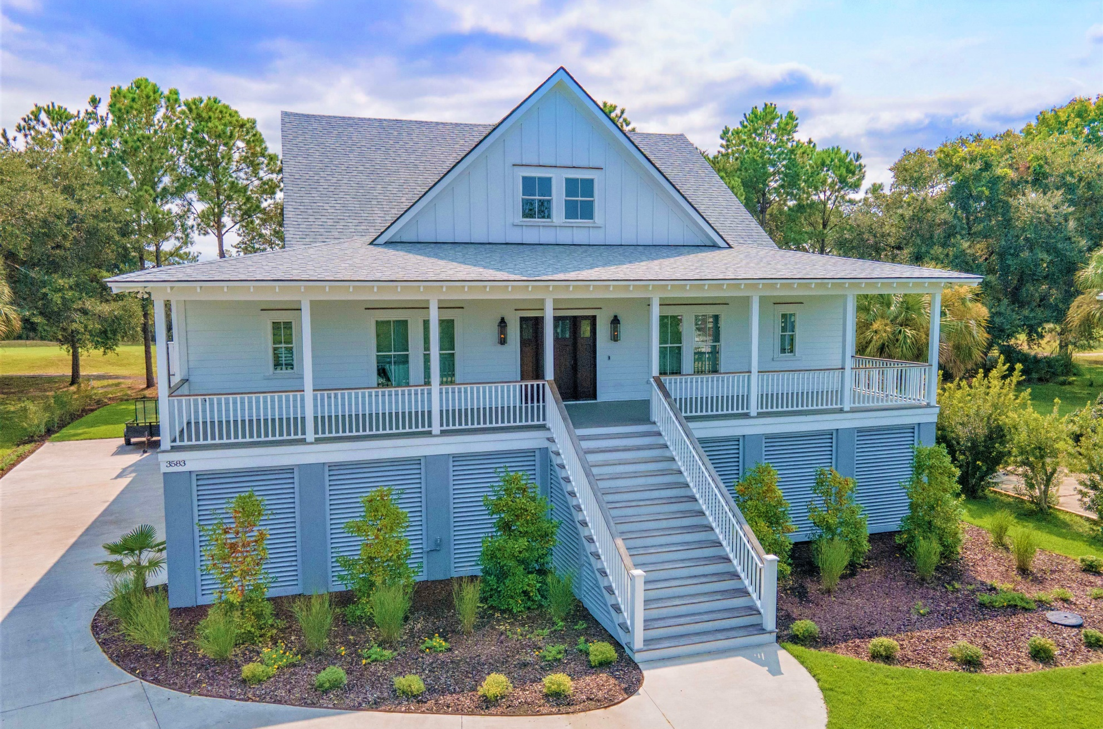
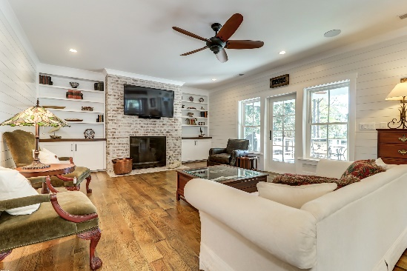
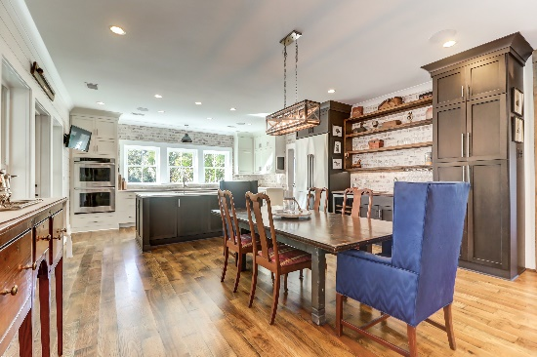



3583 Somerset Hills Court The Estates at Charleston National | MLS# 21031524 | $1,500,000
New Construction without the Wait!
New
Construction
5 Bedrooms, 4.5 Baths
Resort Style Pool and Patio Areas
Exceptional Rental History
Rare Double Lot
Block from Beach
2 Huge Great Rooms
Expansive Screened Porches
Separate Grilling and Observatory Decks
Multiple Fireplaces
Short walk to Restaurants & Shopping
You will enjoy this fabulous Lowcountry gem! Built in 2019, this custom home has 5 Bedrooms, 3.5 Baths, 3031 square feet of living space and graces the 13th fairway of the famed Charleston National Golf Course.
Highlighted by white oak antiqued flooring, shiplap walls, and a brick fireplace, the Living room is open to both the dining room and kitchen. All 3 areas flow onto the generous 12’ deep rear porch providing gorgeous views of the golf course, marsh, and majestic wildlife!
A large Dining Room is situated between the living area and kitchen and features a bar with a DACOR Wine Cooler.
In the Kitchen, the combination of bright white and ebony cabinetry topped with elegant quartz countertops and a brick backsplash is absolutely stunning! DACOR appliances make entertaining a breeze!
Also housed on the main level is an extra-large laundry room and pantry with brick flooring, a large guest bedroom with an ensuite bath, the powder room, and a spacious Master Suite with walk-in closet, a free-standing tub, dual vanities, and a luxurious steam shower.
Upstairs houses a large bedroom with a sun deck overlooking the rolling golf course and marsh, a full bath with walk-in shower, and 2 additional bedrooms, one of which is perfect to serve as a work-at-home office, or maybe you need a workout room!
Why wait for new construction when you can enjoy all the benefits of a new home in this amazing Lowcountry gem!
Take a virtual tour: https://www.seetheproperty.com/401333
Wendy Arnsdorff
843-364-8619
wendy.arnsdorff@carolinaone.com www.wendyarnsdorff.com
Molly Ramey
843-224-6294
mramey@carolinaone.com
www.mollyramey.com/
Carolina One Real Estate :: Mt. Pleasant North Office :: 2713 N Highway 17 :: Mt. Pleasant, SC 29466

