Slide 1
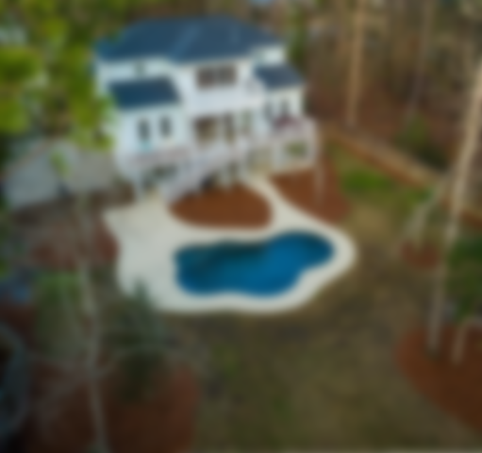
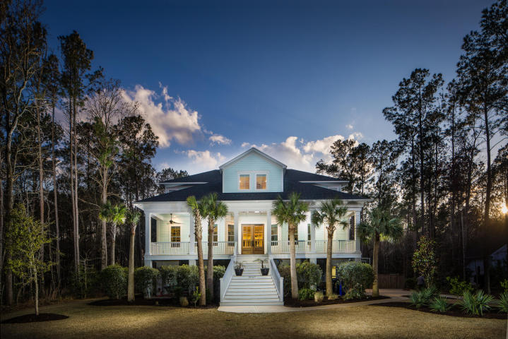
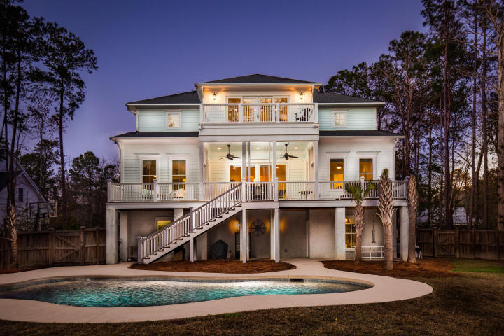
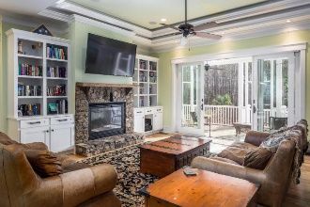
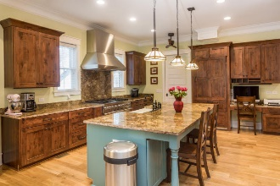
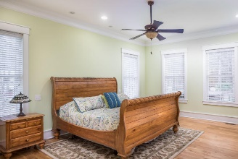
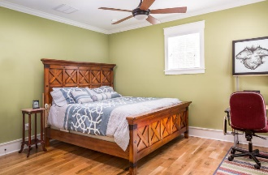
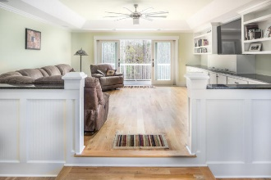
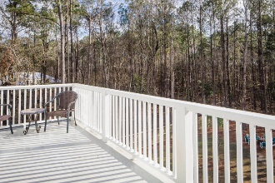
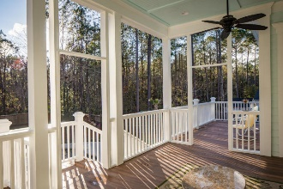
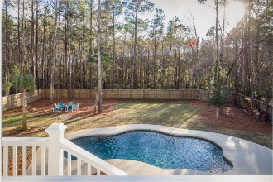
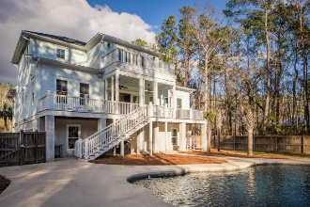
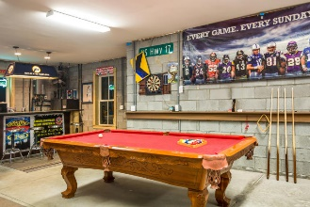
3587 Holmgren Street
Mount Pleasant · MLS# 17004751 · $940,000
Darrell Creek Elevated Home With Elevator & Salt Pool
Darrell Creek Elevated Home With Elevator & Salt Pool
Extraordinary 4 bedroom, 4 full, 2 half bath custom home with saltwater pool and tons of outdoor entertaining space. The owners designed and built this home with total attention to detail and sparing no expense.
FEATURES LIST
Tankless Rinnai water heater
Surround sound in family room and outside
3-stop elevator
Central vac whole house and small one under kitchen sink
Laundry chute
All custom lighting and plumbing fixtures
Salt water pool (new pool pump) with Pebble Tec finish, fountain, and multi-colored LED lights
6 ft privacy fence
Private back yard (nobody can build behind)
Bar with granite top on ground floor
Irrigation system
Spigots on porches
Outdoor shower
Tabby on exterior of foundation walls
Back deck is Trex material
Bottom floor can be finished (out of base flood)
Buried propane tank
Power for detached garage or workshop
30 yr architectural shingles
Custom cabinets made of alder wood
Custom made hardware from a California railroad
Granite in kitchen and all baths
Oak wood flooring throughout house (5" planks)
Stacked stone fireplace
Built-in book cases in family room and bonus/media room upstairs
Kitchen refrigerator conveys
All pool equipment conveys
Andrea Rogers
(843) 532-3010 | andrearogers1@gmail.com | www.andrearogersrealtor.com
AgentOwned Preferred Group | 1400-G Palm Blvd | Isle Of Palms, SC 29451

