Slide 1
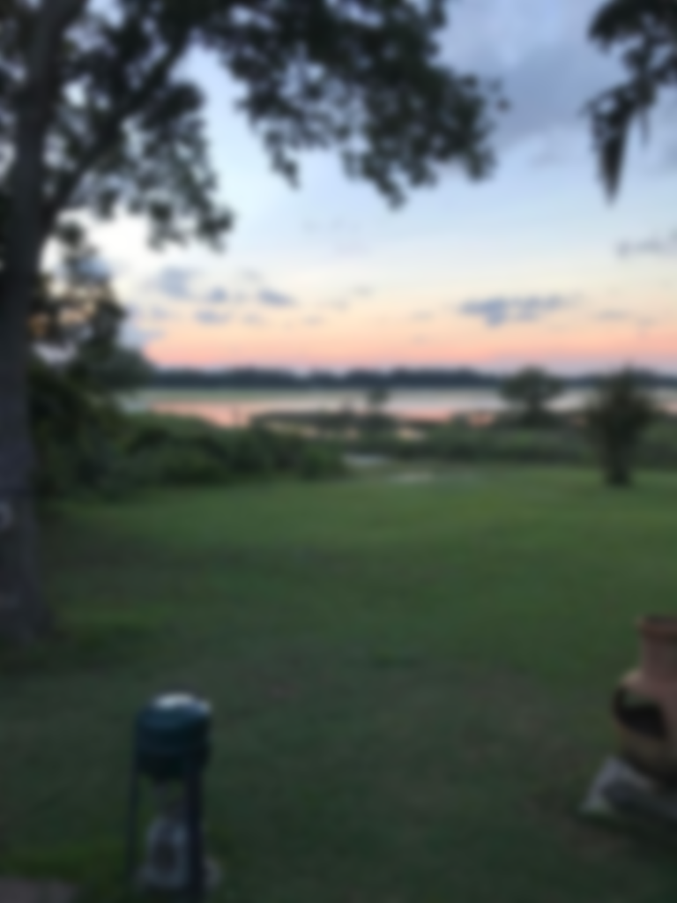
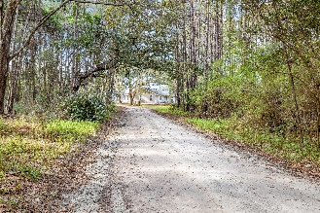
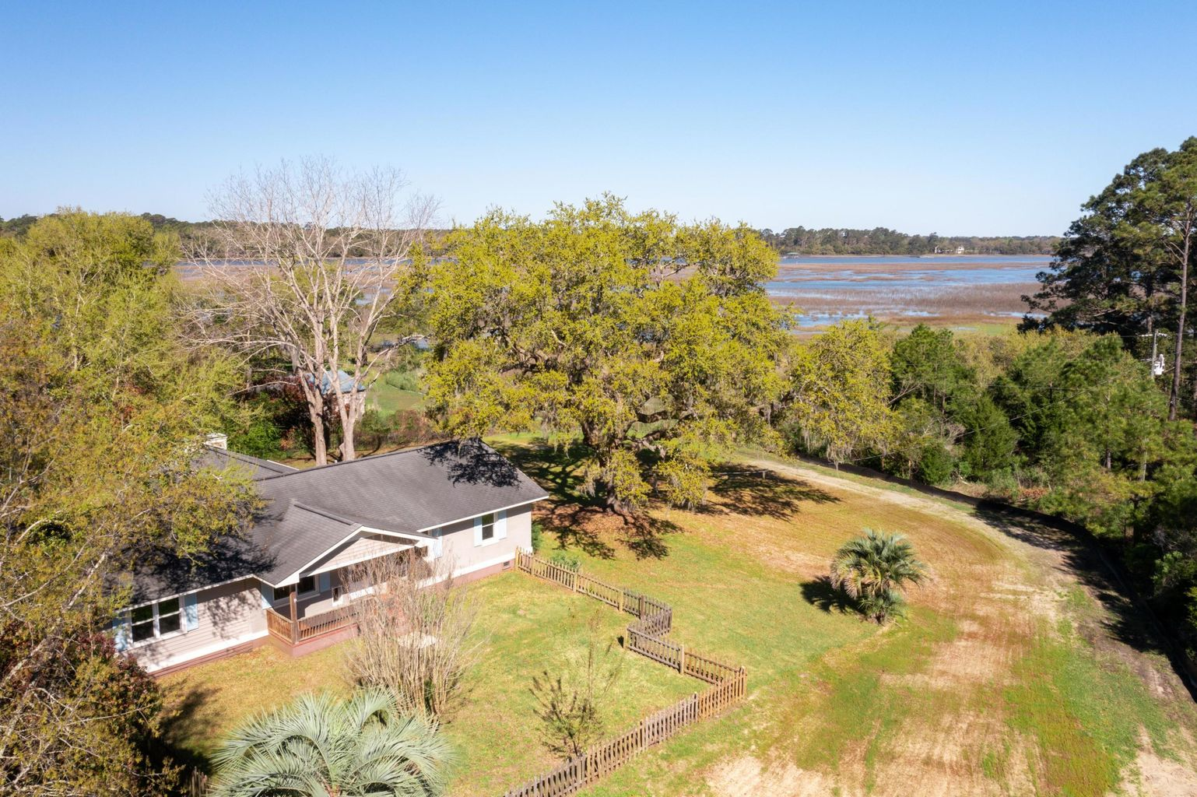
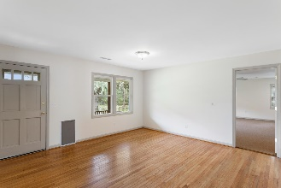
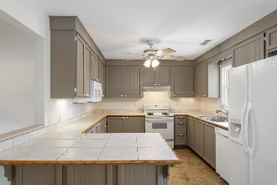
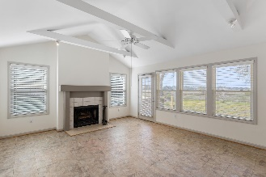
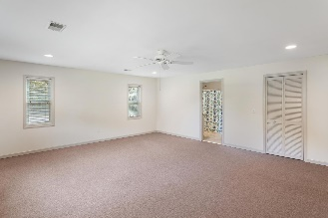
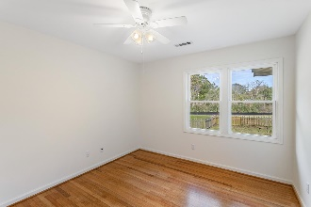
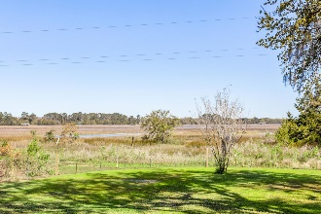
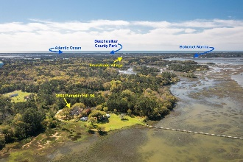


Tranquil Marsh Front Living
3590 Pumpkin Hill Road
Hopkinson | Johns Island, SC 29455
MLS# 21008309 | $549,000
This marsh front home offers quiet, tranquil living on Bohicket Creek, yet it is located only a few miles from Freshfields Village, Bohicket Marina, and Beachwalker County Park. Along with wonderful western long marsh views, the ranch home offers one-level living with a spacious master suite, wood-burning fireplace, fenced yard, and new outdoor deck. It has 4 bedrooms and 2.5 bathrooms and approximately 1900 square feet of living area on 3/4 of an acre. Enjoy the peace and quiet here as you watch the sunset and take in the gentle breeze coming off of Bohicket Creek.
Take a virtual tour: https://my.matterport.com/show/?m=1KsrTRcSUPV
Lee Lindler Cell (843) 637-0803 | lee@akersellis.com
Akers Ellis Real Estate LLC | 3730 Bohicket Road, Suite 5 | Johns Island, SC 29455 akersellis.com

