Slide 1
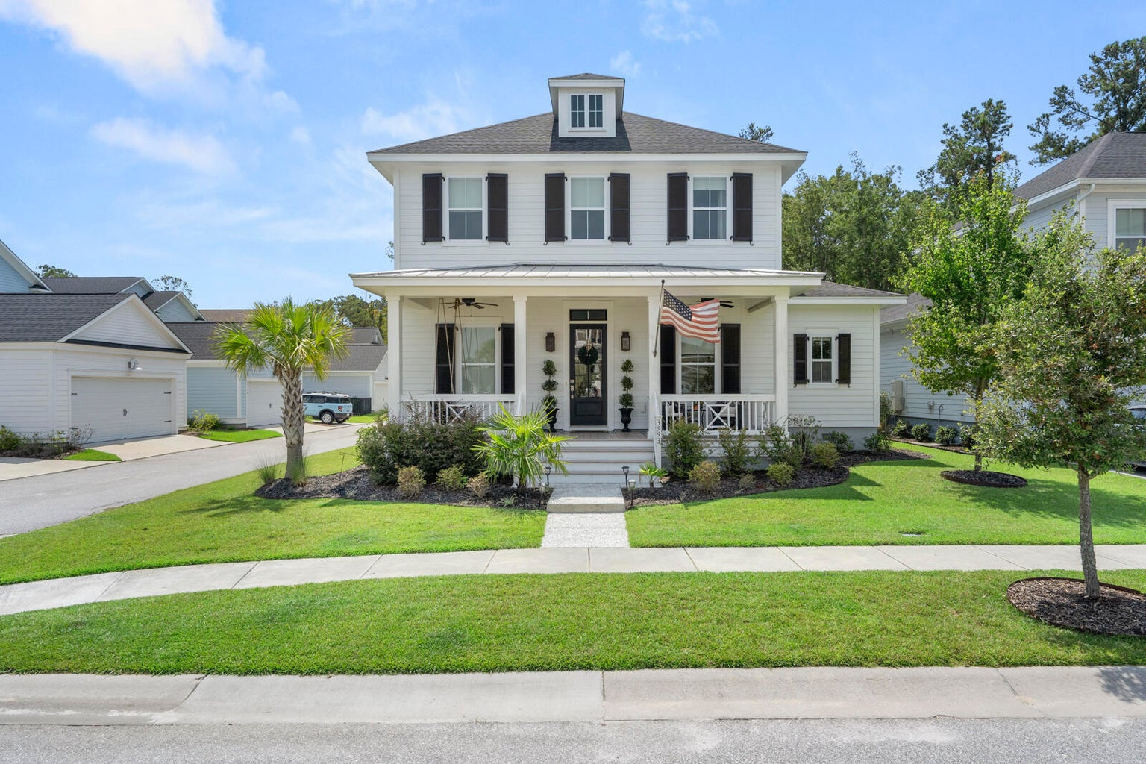
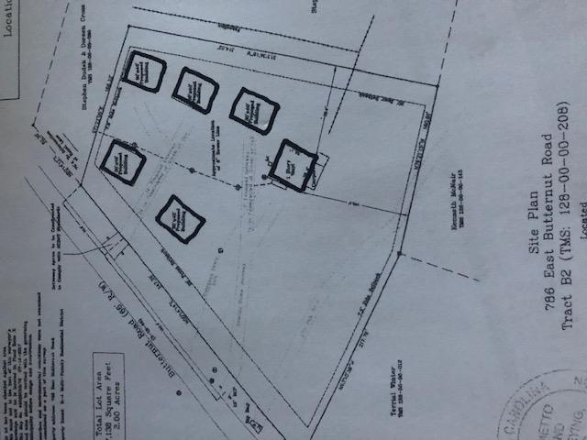
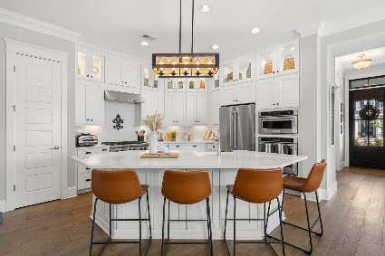
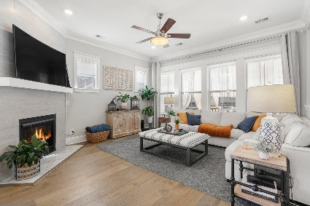
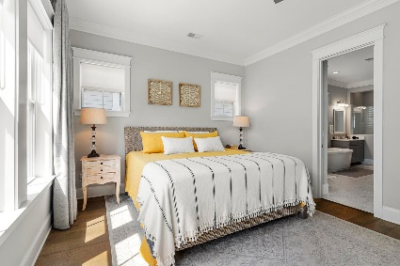
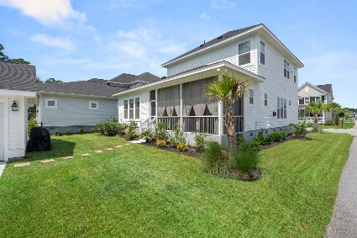
OPEN HOUSE
SUNDAY 9-17
11AM - 2PM
$40,000
Price Reduction!
DRAFT
3593 Crosstrees Lane
Carolina Park · Mount Pleasant, SC 29466 · MLS# 23019286 · $1,260,000
Better than new! You will be impressed from the moment you drive up. Enter via the tabby walkway and take in the gas lanterns on the covered front porch. It doesn't get more Charleston than that! This gorgeous David Weekley home has every upgrade that you can imagine : - wide plank wood floors, extensive lighting package, custom built-ins throughout, and so much more! Natural light floods the home making it bright and airy. You will love the floorplan and use of space in this Crawley plan. The first floor offers a flex room, dining area, family room, kitchen, and master suite with spa bath. Upstairs, you will find a cozy retreat with 3 more bedrooms and 2 additional baths.
All of this in one of Mount Pleasant's preferred neighborhoods- Carolina Park. Residents have access to pools, biking trails, tennis, dog park, ponds, and so much more. Hop on your golf cart for a trip to the library, Costco, CVS, and more. Many kids ride their bikes or are dropped off at school via golf cart. What a lifestyle! Not to mention the close proximity to Charleston, Isle of Palms, and Sullivan's Island. It's an easy commute to Boeing, Volvo, and other large companies.
2 Blocks from The Crosstown
3 Blocks from The Citadel
6 Blocks from MUSC
Rick Willis
843-327-3017 Rick@RickWillis.com The Group, LLC

