Slide 1
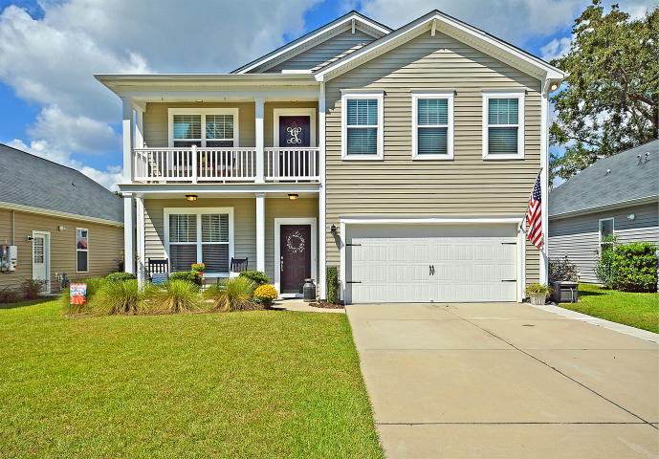
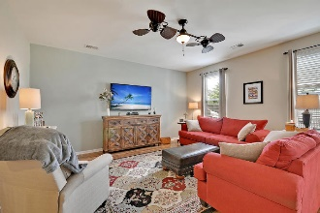
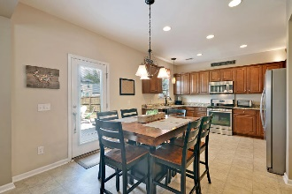
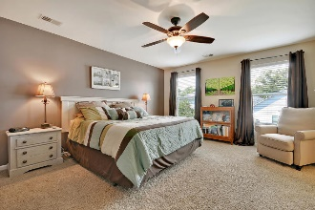
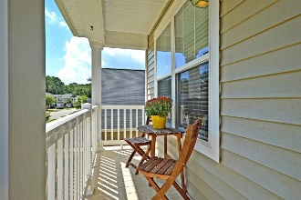
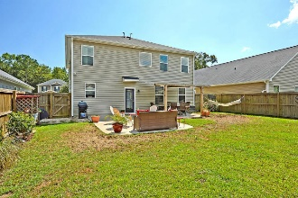


INCREDIBLE OPPORTUNITY!
$15,000 Agent Bonus
with ratified contract by 4/15/18
3594 Franklin Tower Dr
Lieben Park
Mt Pleasant, SC 29466
MLS# 18026657
$372,900
$12,100 Under
Recent Appraised Value
This Remarkable fully detached two story home is situated on a quiet tree lined street and is surrounded by a large landscaped fenced yard. This Amazing home with beautiful wood/laminate flooring and distinctive lighting and fans throughout has three large bedrooms upstairs including the spacious master bedroom suite offering a huge walk-in closet, smooth ceilings, large private master bathroom with double vanities, a separate shower and relaxing soaking tub, the large loft room is perfect for an office, game of play room.
There are several large rooms with 9 ft smooth ceilings on the main floor including the bright gathering room offering distinctive ceiling fans, huge windows that allows natural lighting to fill the room, the elegant formal dining is appointed with the selected wood/laminate flooring and is perfect for formal dining and entertaining, the large family-size eat-in kitchen with 9 ft smooth ceilings and modern plumbing fixtures offer solid granite counter tops, crafted 42 inch wood cabinets, stylish lighting, stainless appliances including the gas stove, microwave and dishwasher. There is a French door walk-out to the large, private back yard that includes an oversized patio that is perfect for relaxing and outside entertaining.
A pre-listing appraisal and pre-listing home inspection is available upon request. The location of this Awesome home allows the school age children to attend the highly recommended Carolina Park schools. Don't miss this "Beautiful Home". Opportunity Knocks, Bring Your Checkbook! Age, sqft., schools, taxes and acreage are approximate, prospective buyer is to verify any and all information deemed necessary.
William R Everett, Jr
(843) 693-8539– C
(843) 576-2701 – O
bill@theeverettgroup.net
RE/MAX Pro Realty, 9209 University Blvd, Charleston, SC 29406

