Slide 1
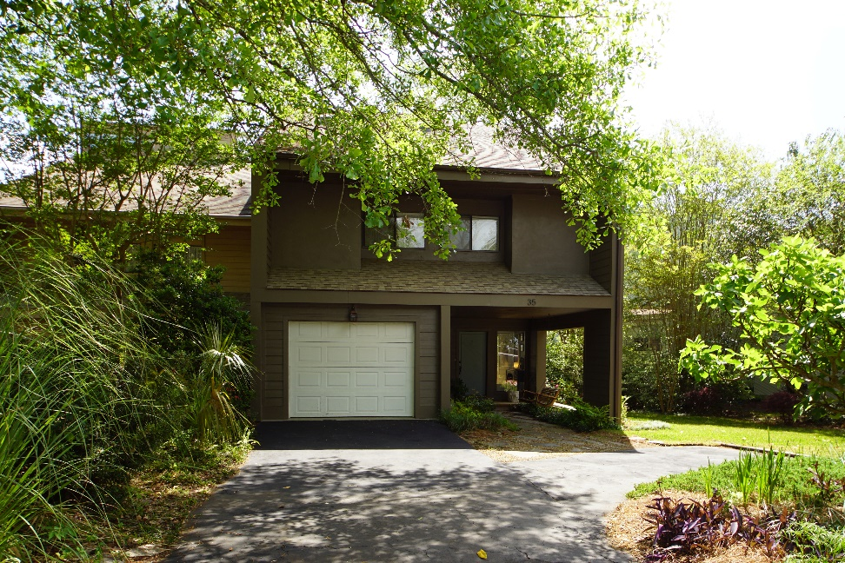
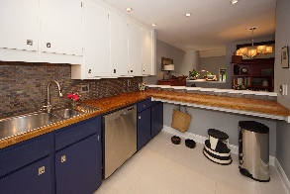
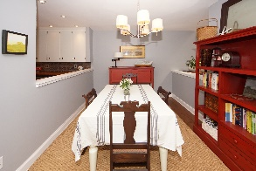
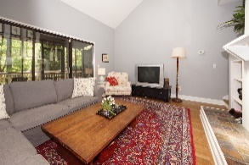
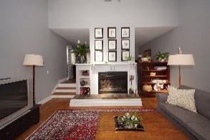
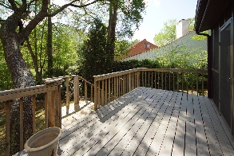
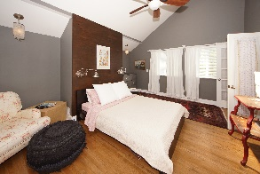
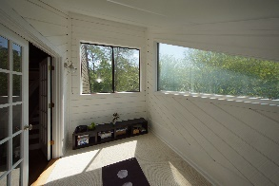
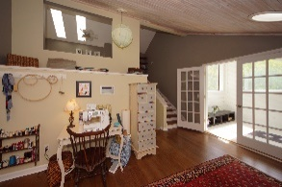
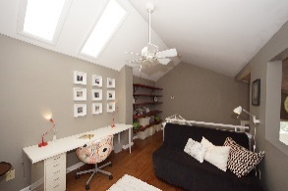
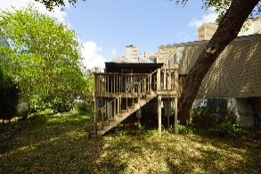

Marsh Cove Open House Sunday 2-4pm
35 Arabian Drive
Charleston, SC 29407 | MLS# 19010648 | $312,000
Chic end unit town home in West Ashley's desirable Marsh Cove. The location of these town homes are so convenient to I-26, downtown and 526, so no waiting in traffic! This beautifully updated 3-bedroom townhome (could be made into a 4 bedroom) in tree-lined Marsh Cove includes freshly painted, low maintenance hardiplank siding(a 40k upgrade), heated slate tile foyer entry, ceramic flooring in the spacious custom kitchen, butcher block counter tops, stainless steel appliances, under cabinet lighting on dimmers, and pantry. Newer HVAC with dual thermostats, newer hot water heater, Walnut-stained hardwood floors throughout the majority of the home, a sun deck and spacious screened porch, neutral paint throughout, fun laundry room, and modern light fixtures with dimmers. The master suite is private with natural light, a wonderful reading nook and a large walk-in closet. The two secondary bedrooms are good-sized with large closet The loft on the upper floors comprises three rooms currently used as a craft room, home office and yoga room. All of this in a beautifully landscaped, freshly sodded, tranquil, marsh setting. This property is perfect for entertaining! Private community amenities include a salt water pool, tennis court and basketball court.
Jennifer Robinson
(843) 442-1145
jrobinson@carolinaone.com
Carolina One Real Estate
195 W Coleman Blvd
Mt Pleasant, SC 29464

