Slide 1
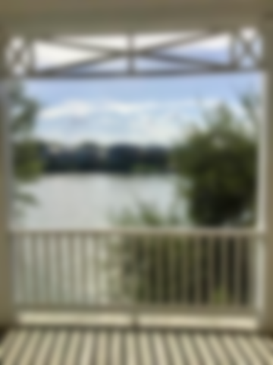
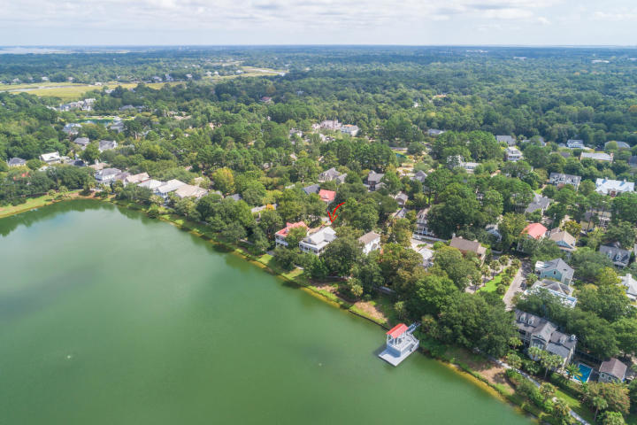
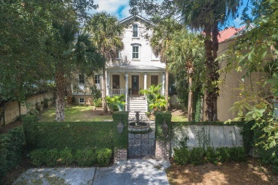
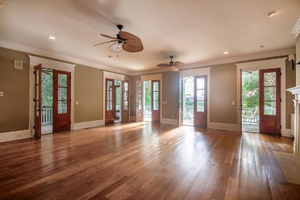
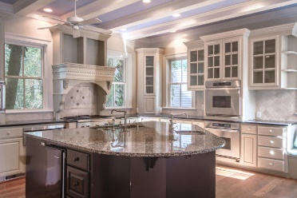
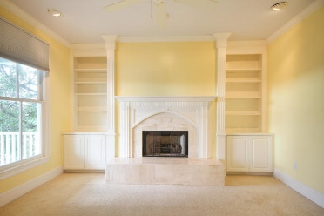
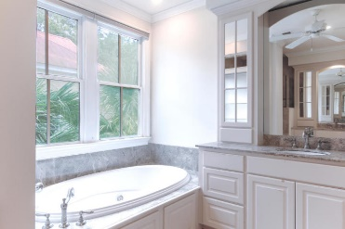

Lakefront Luxury in I’On
35 Eastlake Road
I‘On | Mount Pleasant, SC 29464
MLS# 19024548 | $1,795,000
One of a kind lakefront home available in the prestigious I'On community of Mount Pleasant. Located just minutes to downtown shopping, walking distance to restaurants and just a 15 minute drive to the airport. Upon entry, you will be greeted by a beautiful iron gate and the soothing sounds of the courtyard fountain. As you enter the home, notice the grand staircases that spam from the first floor up to the 4th floor. The chefs kitchen is equipped with a Sub Zero refrigerator, stainless steel Thermador, 4 burner gas range with & a stainless warming drawer for convenience. You'll also find Dacor double ovens, a butlers pantry, a KitchenAid ice maker, granite counters, a large kitchen island and even an inviting breakfast nook perfect for entertaining guests while you cook. There is a screened porch directly off the kitchen and off the large formal living room. A gas fireplace is the focal point of the spacious living room and is large enough for more than one sitting area and a formal dining table. The rear of the home is outlined with gorgeous wood French doors that lead out to the double porches which overlook the Lake. This home is perfect for entertaining and also provides a separate partially-finished living space for a mother-in-law, guest suite or an income producing apartment on the ground floor of the home. The third floor has 3 bedrooms including the spacious master bedroom. Each bedroom has a full ensuite bathroom and the master is equipped with his and hers walk-in closets, a spacious master bath with a steam shower, jacuzzi tub and a separate closet for a stackable washer dryer (how convenient!). There is also a gorgeous fireplace which makes the Owners suite so inviting & cozy. The 4th floor bonus room can double as a media room or possibly a 5th bedroom as it includes a half bath and a wet bar. Lastly, for the avid housekeeper, this home is equipped with a central vacuum system. This home has enormous potential and is a must see!
Andrew Tackitt
(843) 437-8726
andrew@radekopf.com
1563 Meeting Street Road
Charleston, SC 29405
Phone: (843) 579.2217
Erin Quinn Hanhauser
(843) 743-8204
erin@radekopf.com

