Slide 1
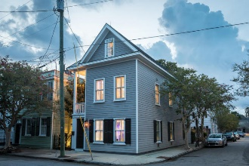
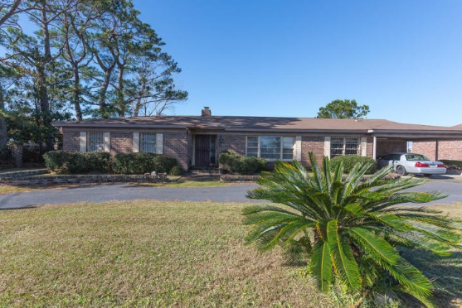
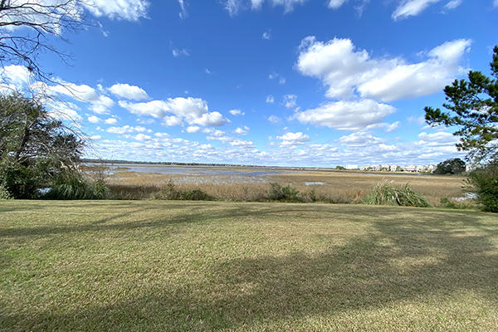
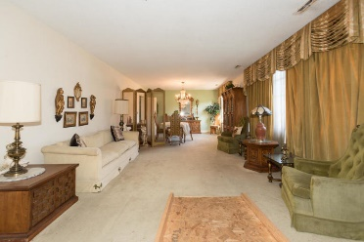
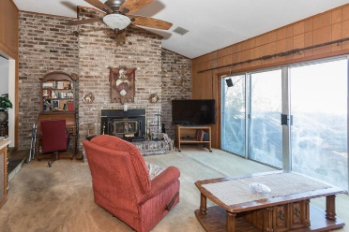
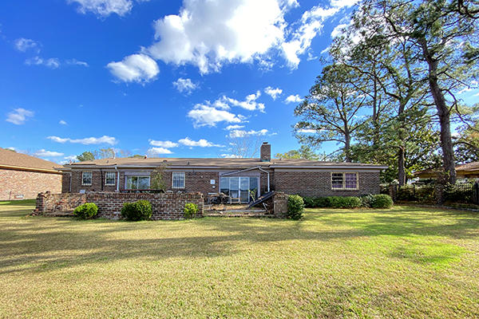
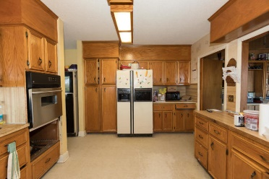


Wagener Terrace Waterfront!!!!
35 Devereaux Avenue
Charleston, SC 29403 · MLS# 20001528 · $1,250,000
Great opportunity to own in highly sought after Wagener Terrace.
3 bedroom 2.5 bath Charleston brick ranch on the Ashley River. Foyer with living/dining room combo. Large family room with wood burning brick fireplace and sliding glass doors leading to the patio and beautiful view of water. Eat in kitchen. Large master with en suite.
Fabulous location!! One owner home. In need of renovation. Roof replaced in 2016.
Michael Dew
O 843-769-5100
M 843-870-7000
michaeledew@gmail.com
www.michaeldewrealestate.com
AgentOwned Charleston Group
902 Savannah Hwy
Charleston, SC 29407
Real Estate ● Mortgage
Insurance ● Business Brokerage

