Slide 1
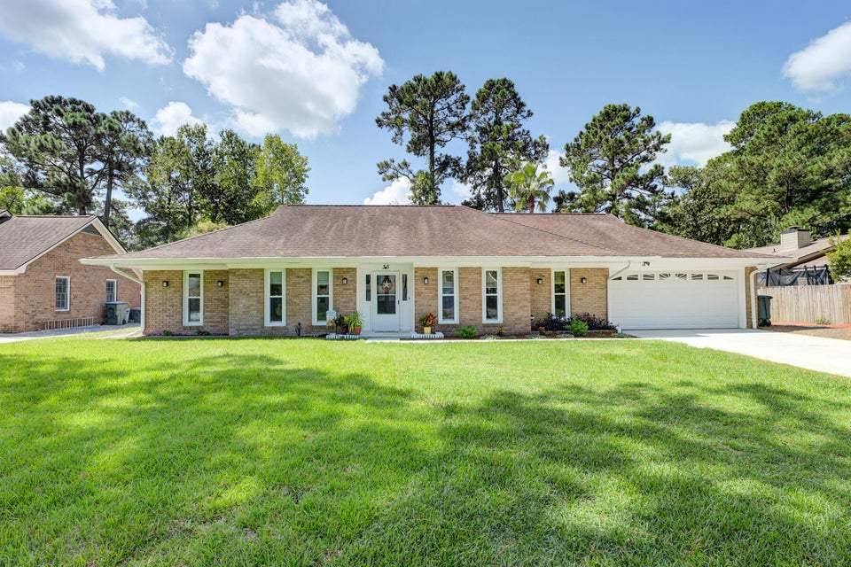
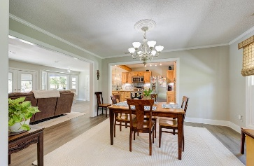
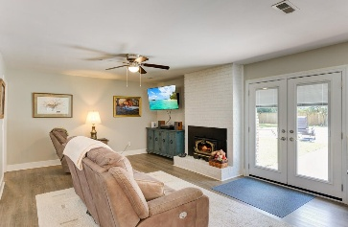
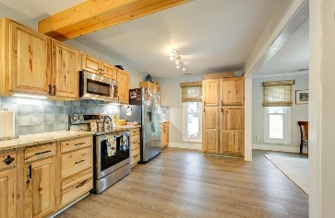
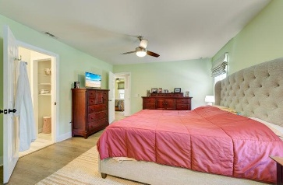
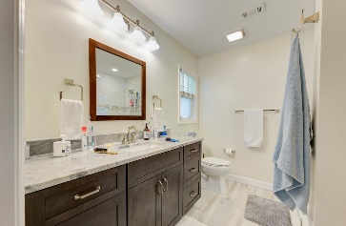
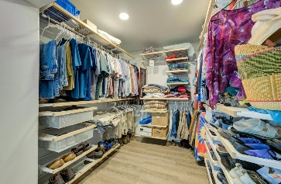
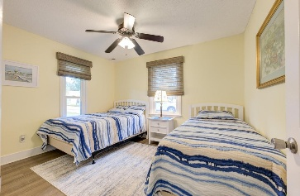
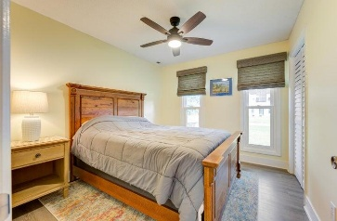
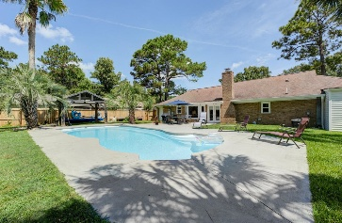
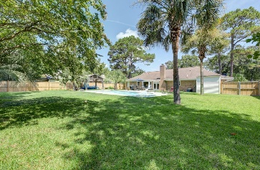



JUST LISTED! Brick Ranch with Pool!
35 Lombardi Lane
Otranto
Hanahan, SC 29410
MLS# 24031389
$450,000
3 Bed | 2 Bath | 1,506 sf
Discover the perfect blend of comfort, style, and functionality in this beautifully renovated 3-bedroom, 2-bathroom brick ranch, nestled on a quiet cul-de-sac. This home boasts an expansive fenced-in backyard adorned with gorgeous palm trees, creating a serene oasis complete with an in-ground saltwater pool—perfect for relaxing or entertaining. Inside, the home features newer windows and durable LVP flooring, complementing the cozy ambiance created by a charming wood-burning fireplace. The spacious kitchen is ready for your culinary adventures, with all appliances conveying with the sale. The 22kW backup generator offers peace of mind, ensuring uninterrupted power during any season.
Practical upgrades abound, including fully replaced, insulated plumbing pipes with individual shut-offs for added convenience. The attached two-car garage provides ample parking and storage, and a separate shed offers even more space for your needs. Best of all, this home comes with no HOA restrictions, giving you the freedom to truly make it your own. Whether you're looking to purchase or lease, this property is also available for rent at $2,500 per month. Don't miss your chance to own or rent this exceptional home! Schedule your showing today!
Nick Mazzilli
843-640-5575
nick@themazzilliteam.com
themazzilliteam.com
Maven Realty
2180 McMillan Ave
#71672
Charleston, SC 29405

