Slide 1
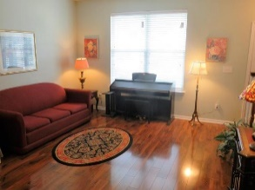
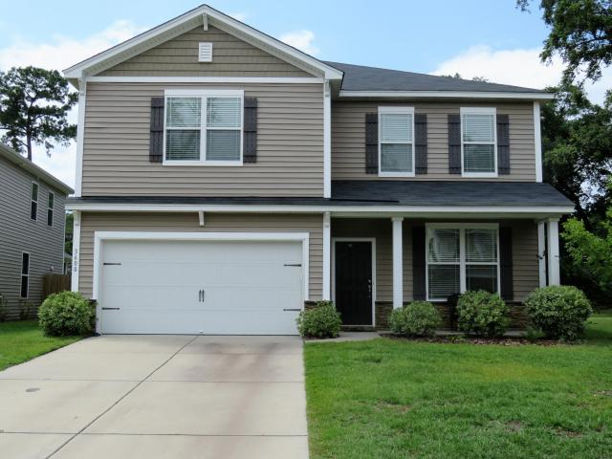
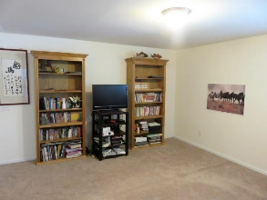
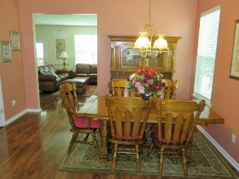
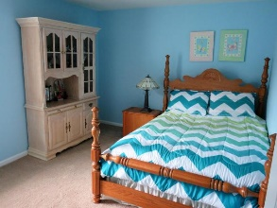
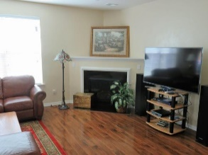
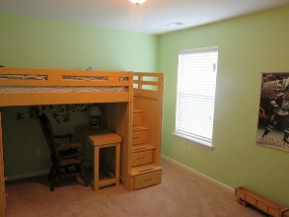
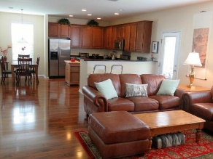
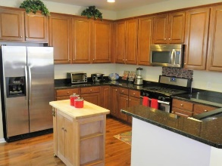
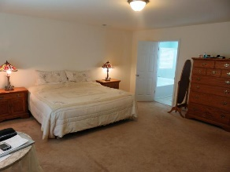
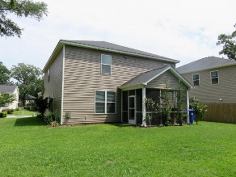
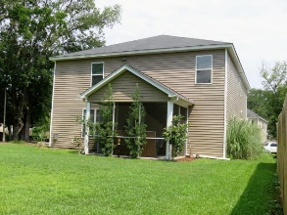


3600 Locklear Lane
Lieben Park · MLS# 17018158 · $370,000
WOW! $370,000 for 4 year old 4 br, 2.5 Ba
2633 sqft home in Mt Pleasant!!
PRICE REDUCED $$ ONE OF THE LARGEST 4BR, 2.5 BA DESIGNS INCLUDING LOFT, SCREEN PORCH AND 2 CAR GARAGE, Living Room, Dining room, Family room with gas log fireplace, large open kitchen with breakfast and huge Master Suite.
Home has lots of extras such as beautiful hardwood flooring on first level, 42" cherry cabinets, granite counter tops and stainless appliances and gas range in kitchen, deluxe master bath with garden tub and separate shower and double vanity.
Home comes with gas log fireplace, tankless hot water heater and 15 Seer HVAC system. Large lot with open areas behind property creating extended yard.
Well planned housing community located close to wonderful schools, new hospitals, shopping and beaches. A well maintained home and excellent value for Mt Pleasant. Great Opportunity!
$550,000
Tommy Lovett
Tommy - (843) 442-1276
tlovett@carolinaone.com
www.tommylovettrealestate.com
Carolina One Real Estate
628 Long Point Rd.
Mt Pleasant, SC 29464-3032

