Slide 1

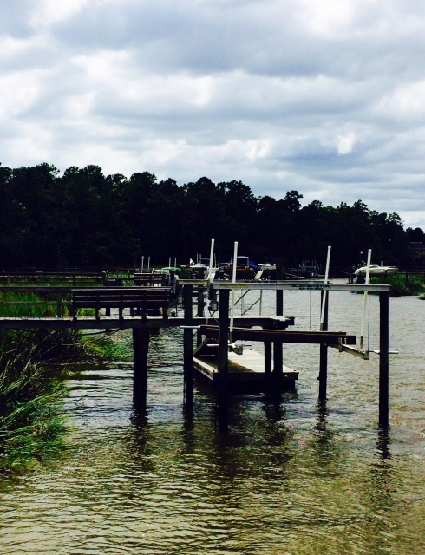
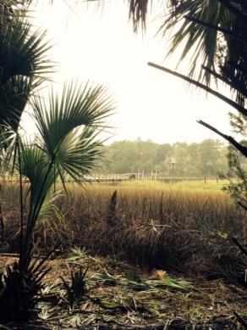
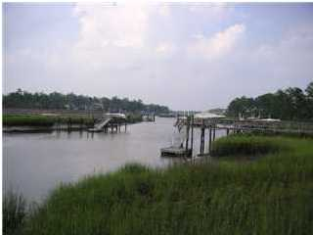
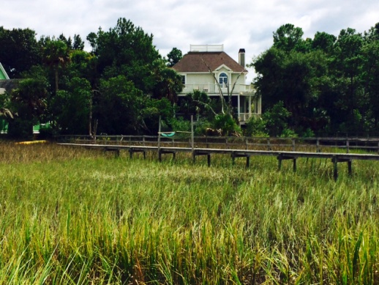



In the Spotlight…
3608 HENRIETTA HARTFORD RD, PARK WEST
Priced-to-Sell Lot with Shared Dock: $335,000
LOT HIGHLIGHTS
• Water access .34 acre lot on Toomer Creek
in Tennyson section of Park West
• Deeded easement to existing dock
• Marsh and water views
• Heavily treed level lot ready for a
custom lowcountry home
Beautiful water access lot on Toomer Creek. Shared dock is already in place and ready to enjoy. Deeded easement allows access to dock from back of lot. Buyer can enjoy the convenience of a backyard dock with the advantages of completed construction and half the future maintenance costs. Build a custom home among the palms and enjoy marsh and water views from back porches. Suggested home plan is available, if desired, along with pricing from custom builder who is already building on same street. Lot is located in the Tennyson section of Park West. Park West offers its residents swim and tennis facilities, along with recreational amenities and great Mt. Pleasant schools.
Note: Lot is heavily treed, but path has been cleared to enable better viewing. Shared dock is off back left corner of lot. Please refer to CMLS #1422917 for additional info and copy of survey.
Debbie L. Michael
Realtor
Lighthouse Realty Group, LLC
lighthouserealtygroupsc.com
Cell: 704-877-1472
dlmichaelhomes@gmail.com

