Slide 1
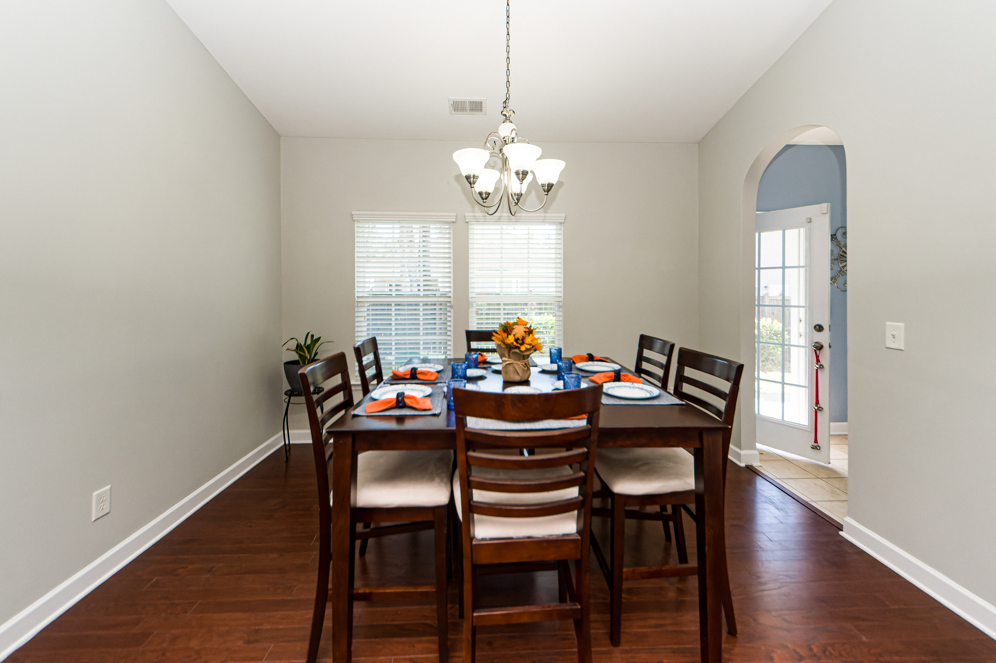
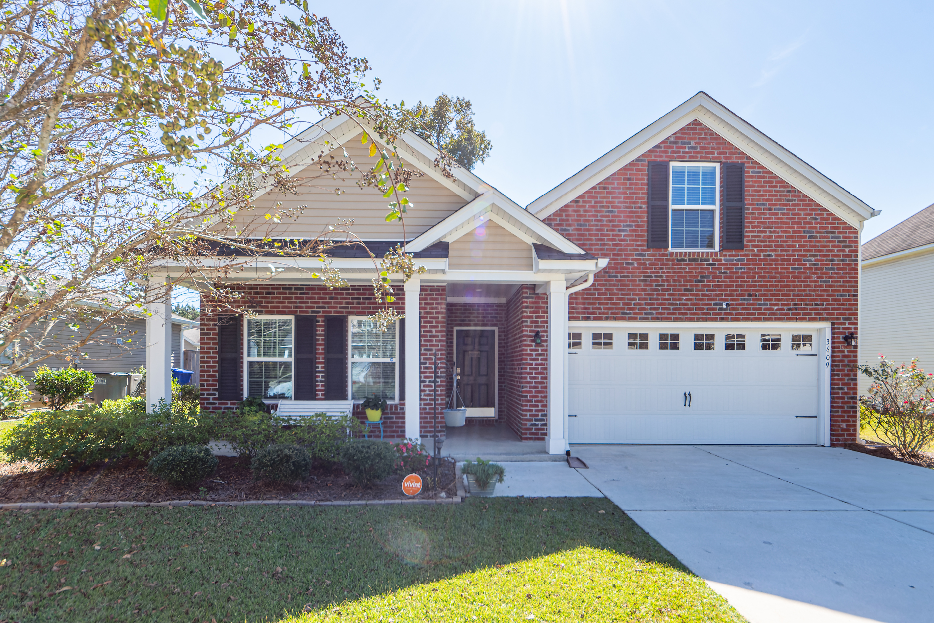
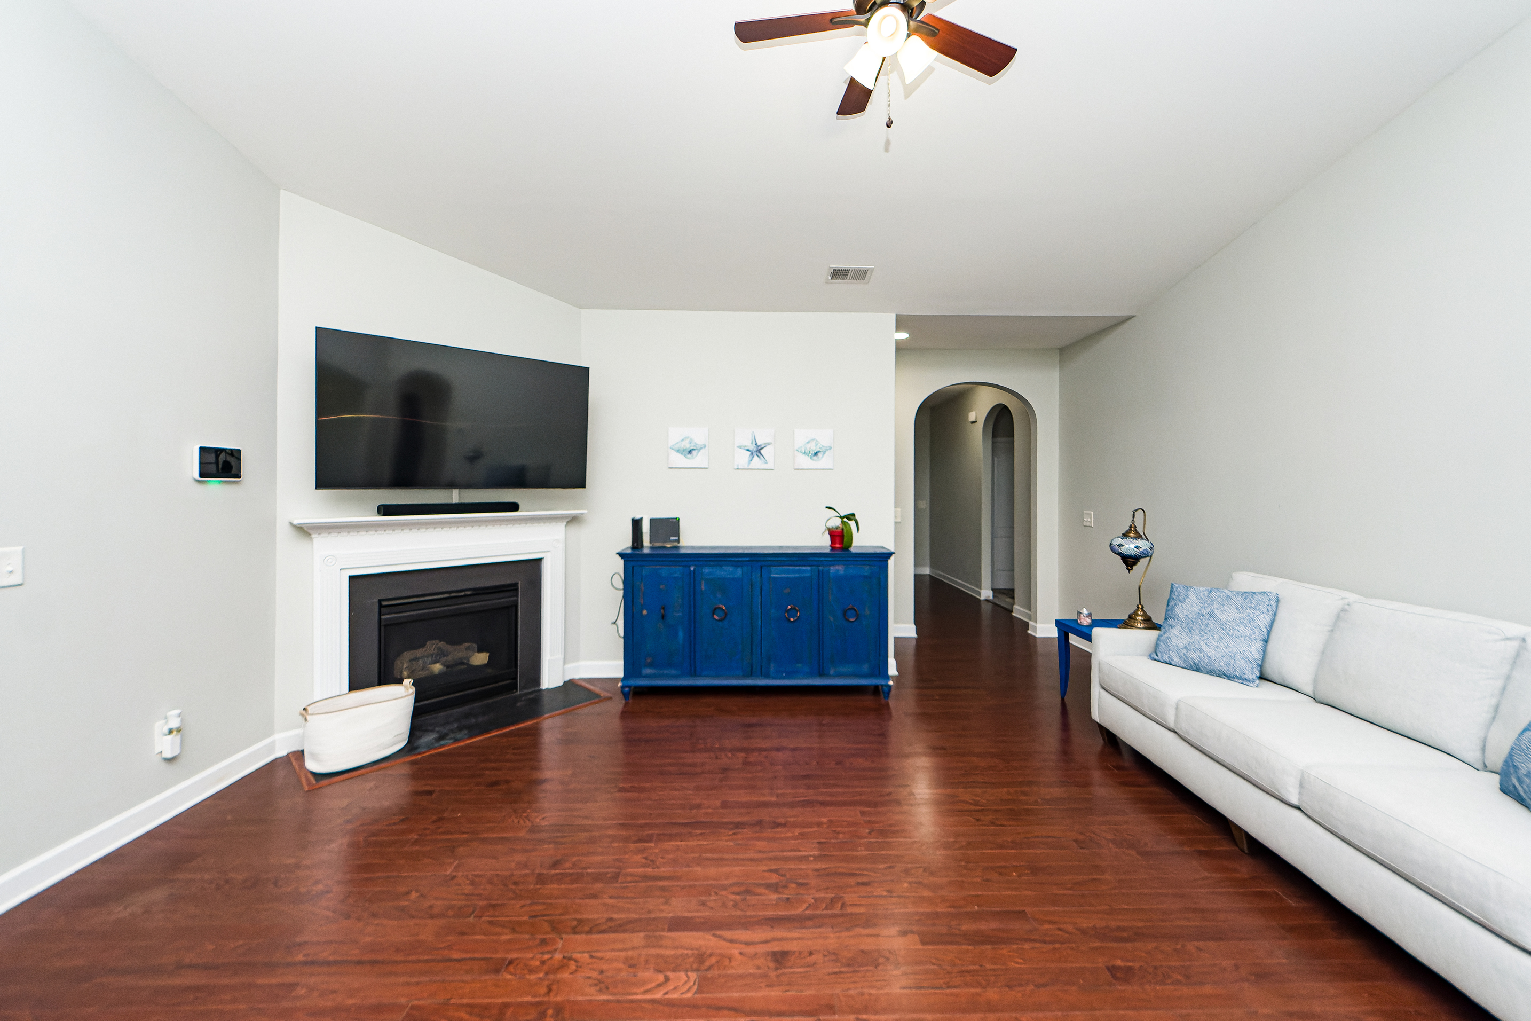
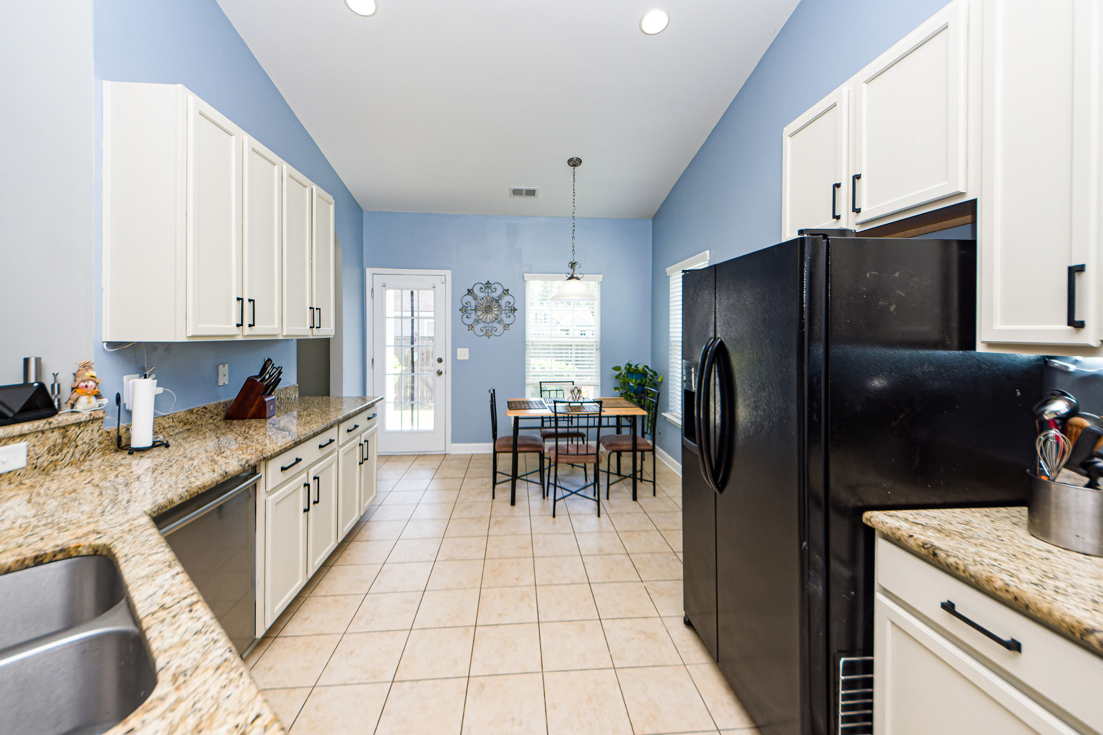
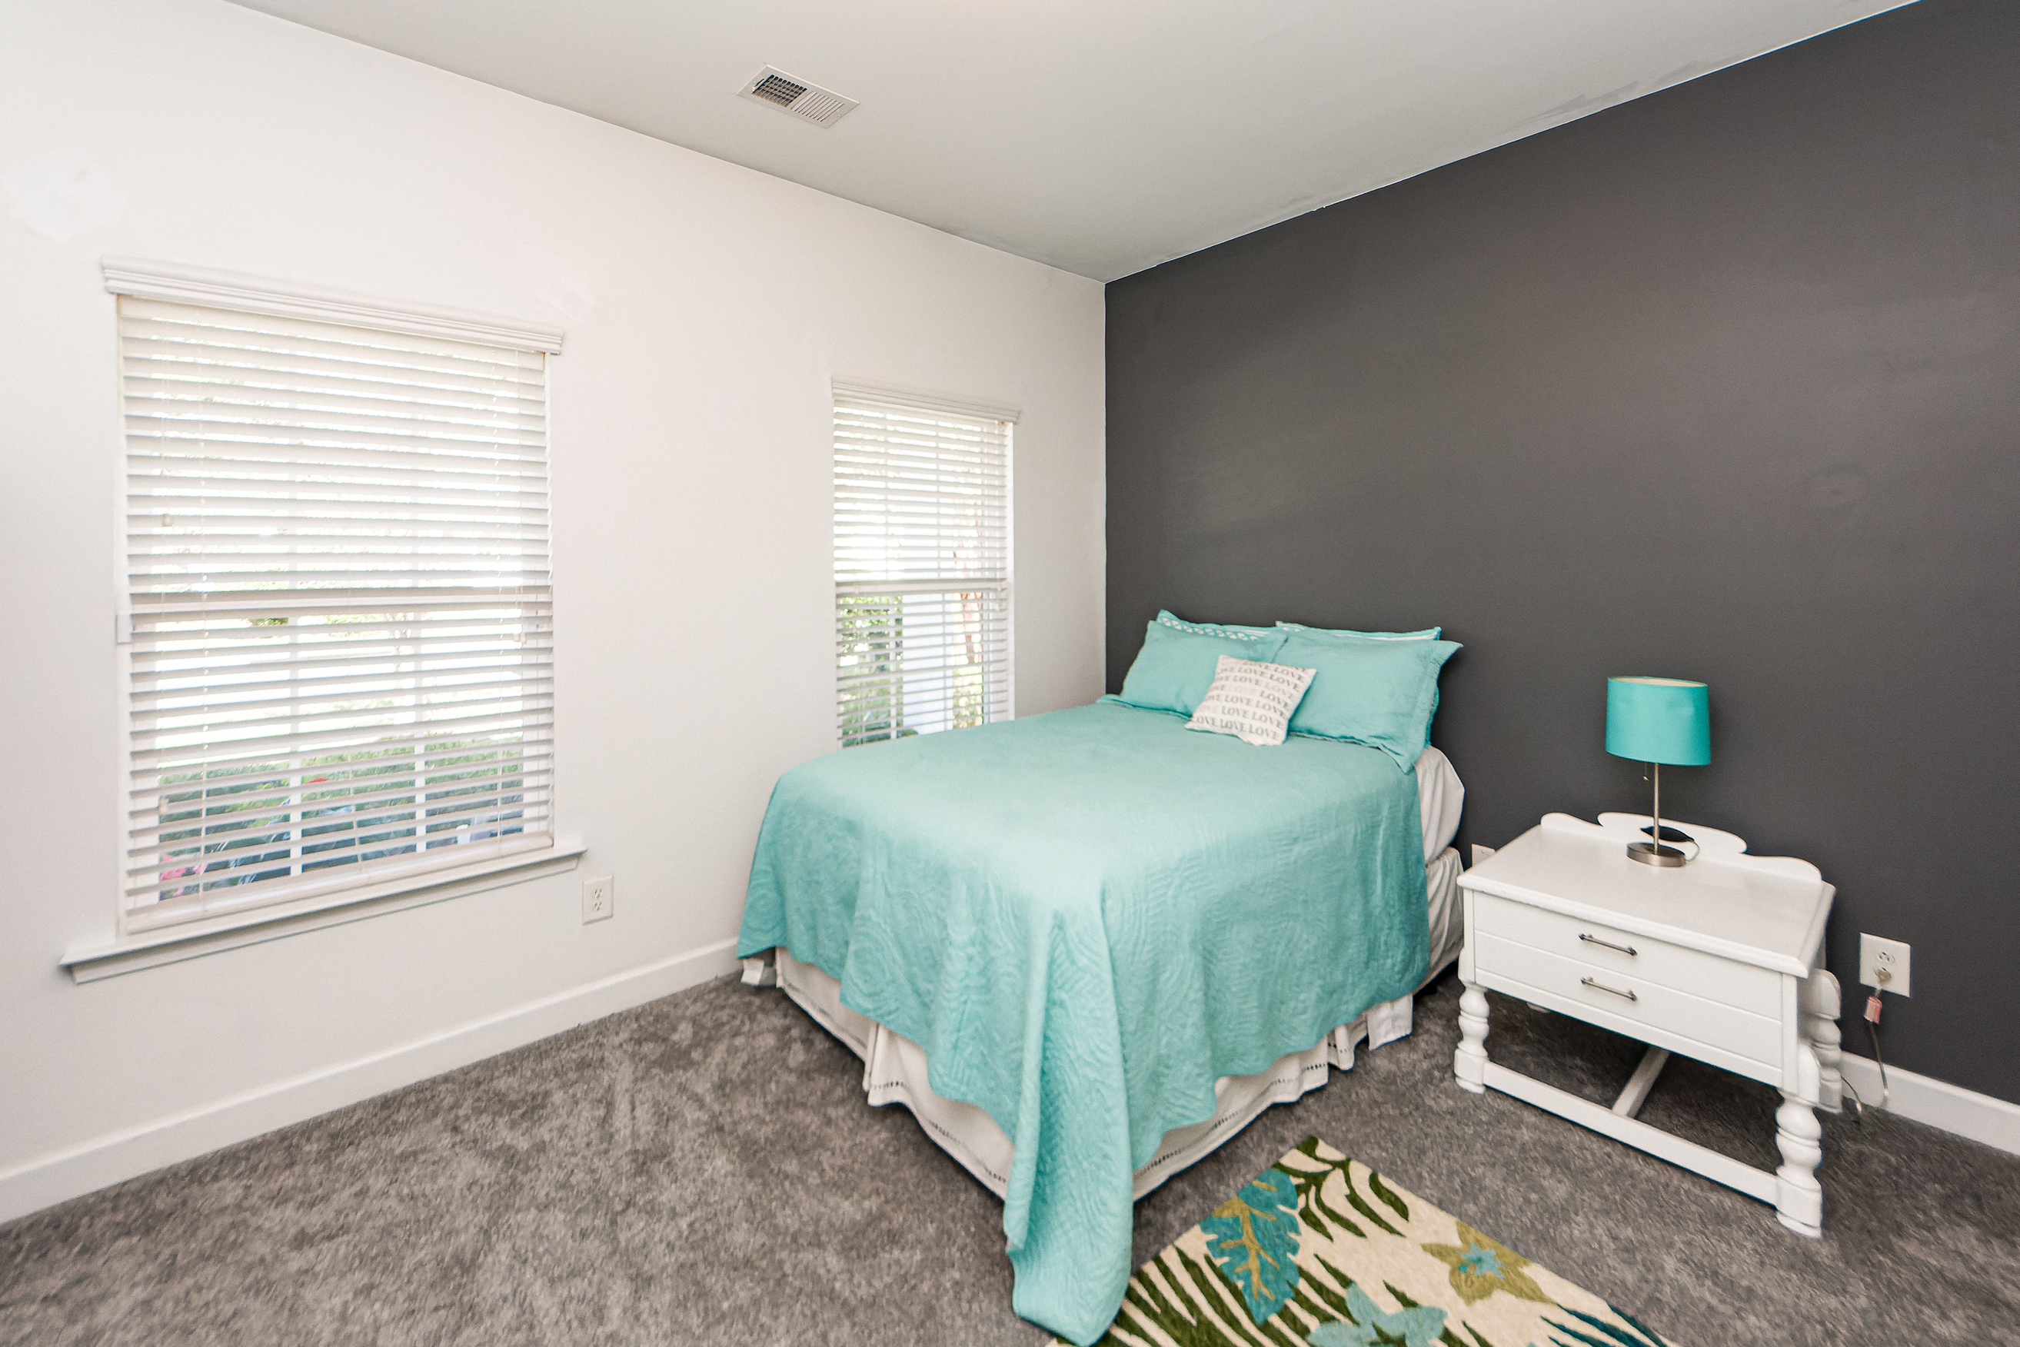
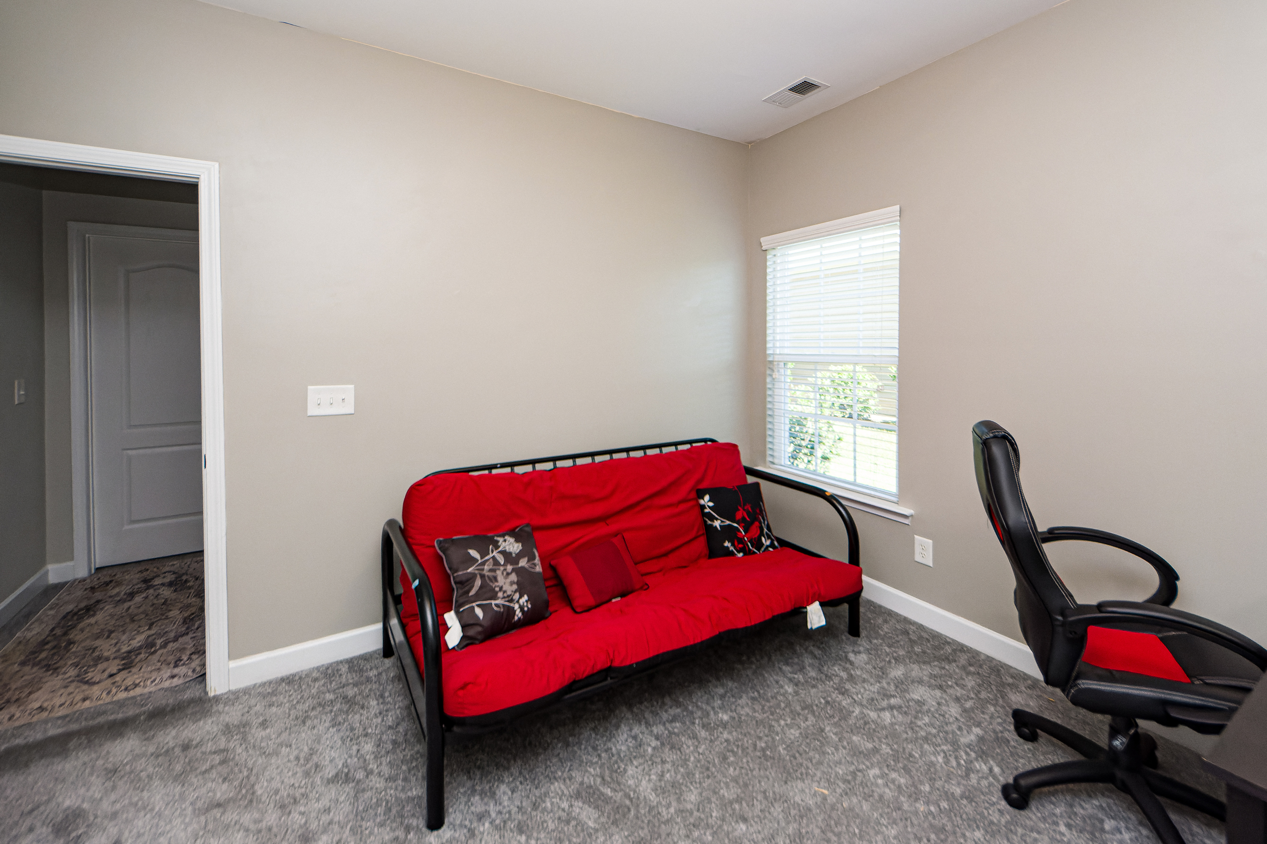
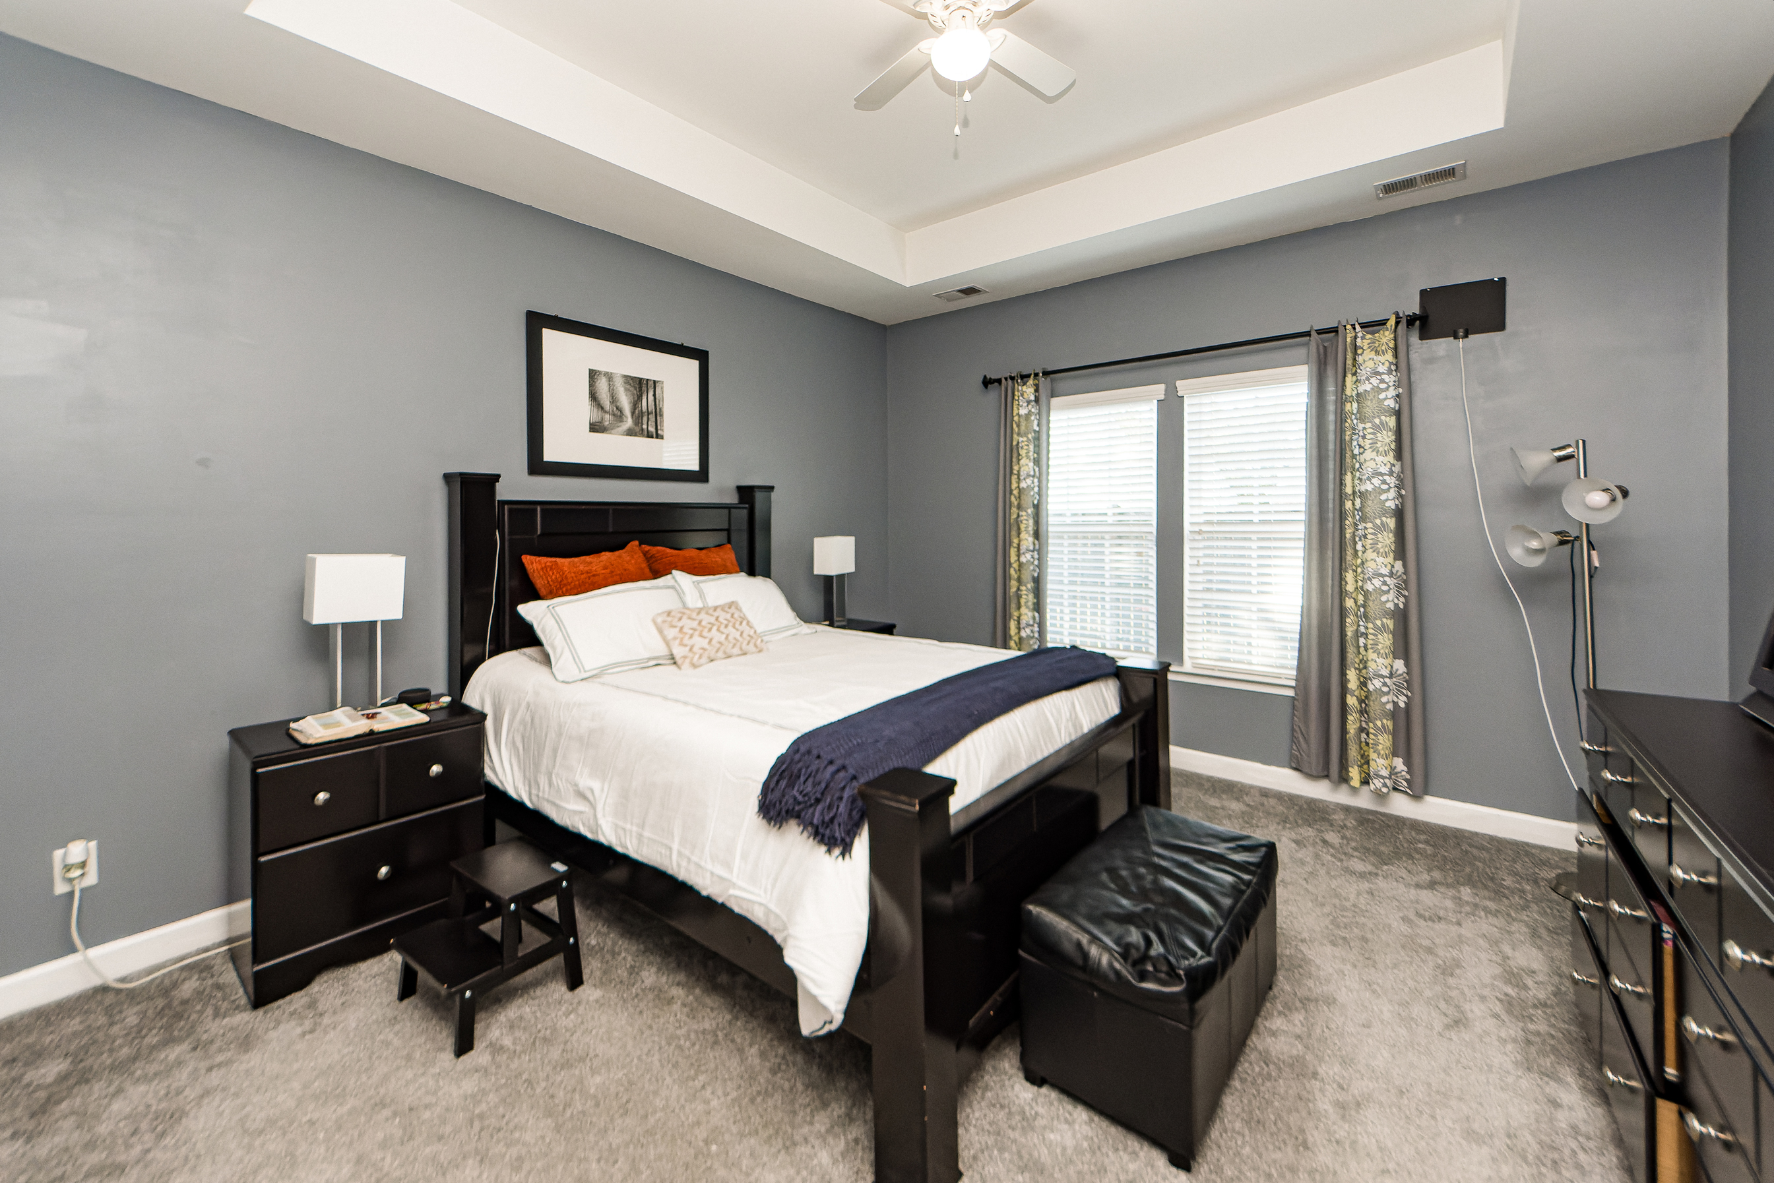
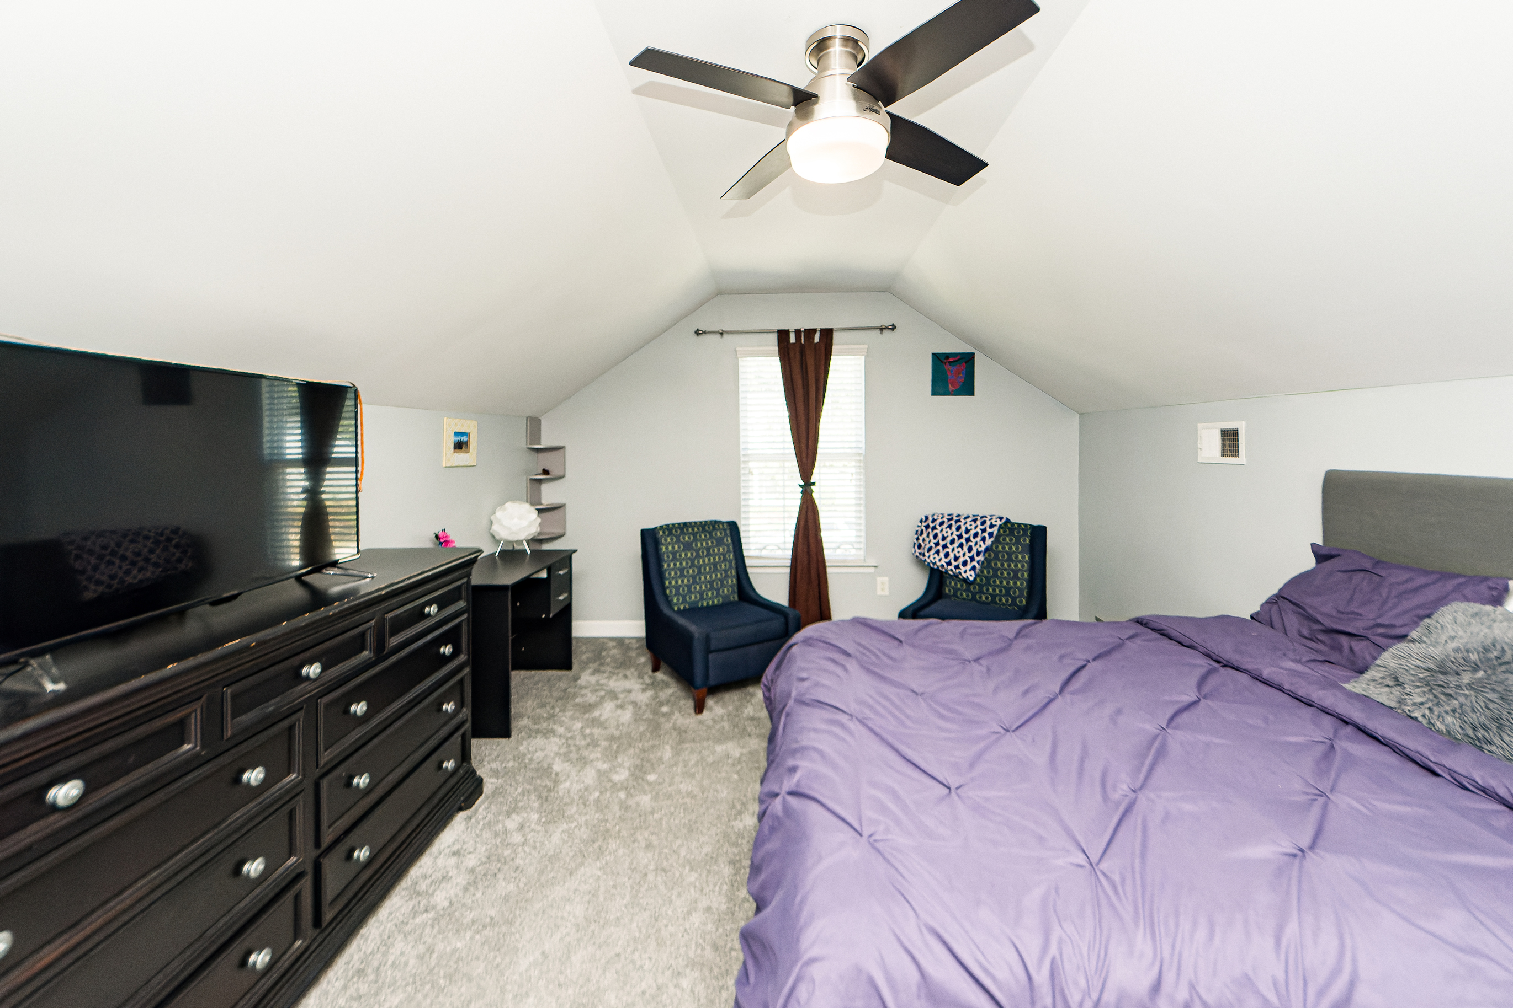
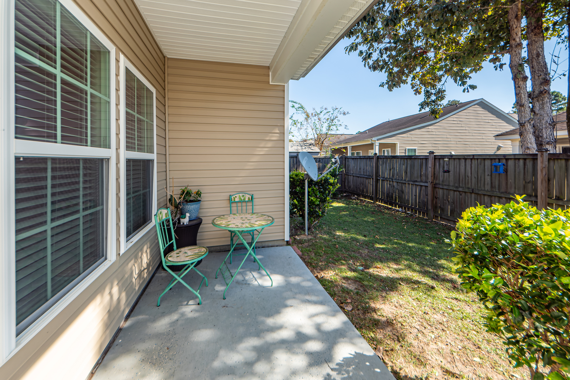

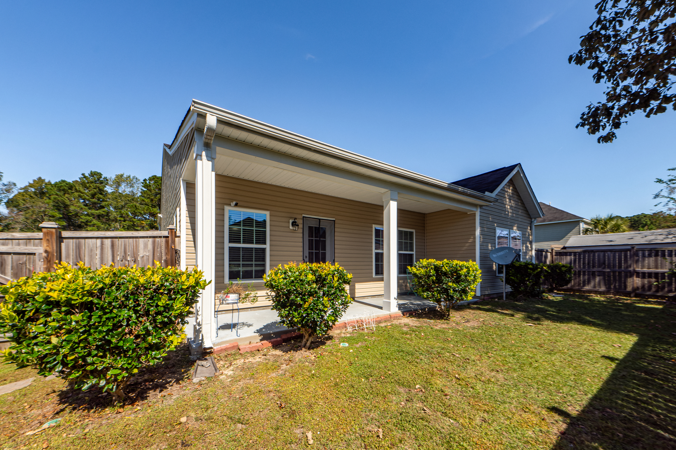

New Listing!
3609 Pimmit Place
Spencer Creek Woods | Ladson, SC 29456
MLS# 22026097 | $354,000
Beautiful four bedroom two bath home in Ladson, SC. Conveniently located 5 minutes away from I-26 and Boeing. This home has lots of character with beautiful archways and high ceilings are a definite show stopper. Brand new carpet in all bedrooms and HVAC system replaced in May 2022 and still under warranty. System comes with surge protector and air purifier throughout the entire home. This elegant home can be all yours.
Make your appointment to see this lovely home today!
Take a Virtual Tour
Whitney Edwards
843-469-2807
whitney.edwards@nacared.com
NACA | 7301 Rivers Avenue | Suite 140 | North Charleston, SC 29405

