Slide 1
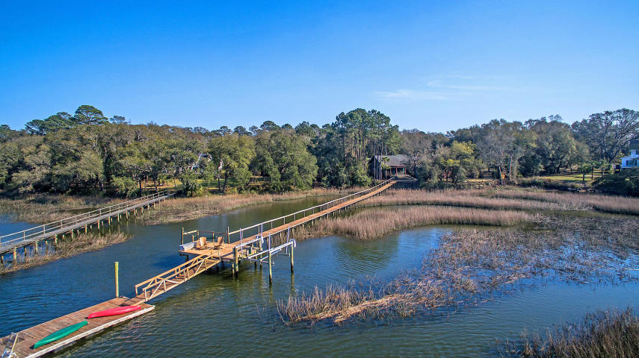


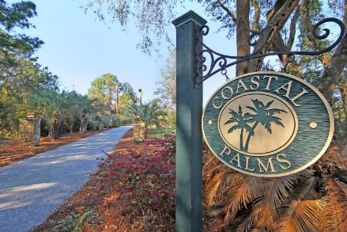
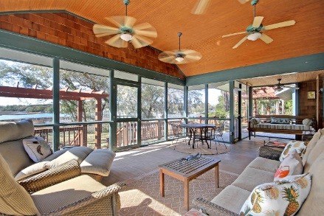
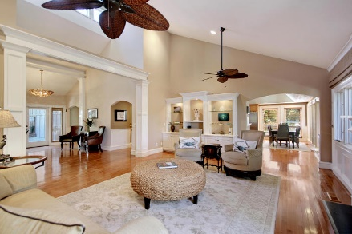
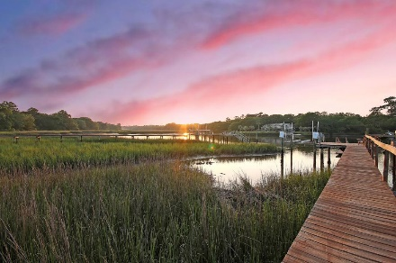
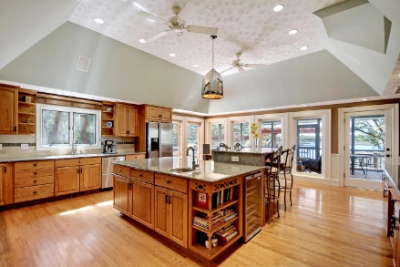
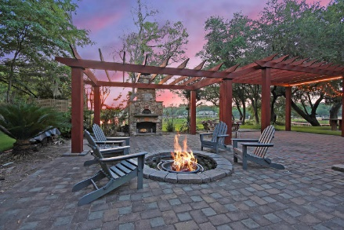
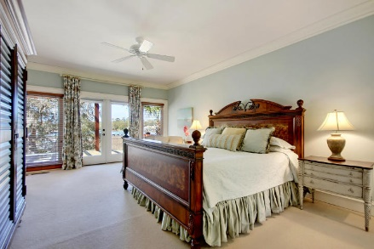
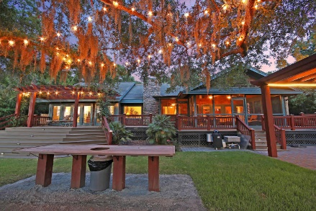
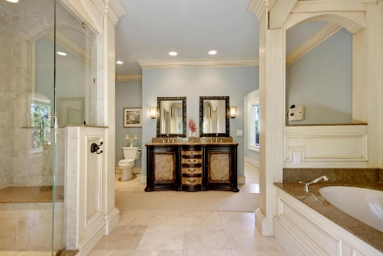
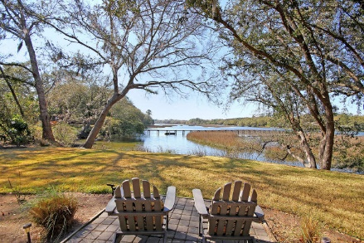
Parkshore Marshfront
Unique Waterfront Opportunity
3610 Legareville Road
Matthews ~ Johns Island, SC 29455 ~ MLS# 18014445 ~ $2,280,000
Two Homes, live in the Main house while earning 70k+ per year from vacation rentals in the Cottage house. Nestled among the Majestic Grand Oaks of Johns Island on the banks of the picturesque Abbapoola Creek is a beautiful, serene sanctuary, known as "Coastal Palms". Enter past the lighted pillars and palm trees to the gated entrance, down the fence lined driveway, past the Classic Car Barn and gorgeous gardens to the stunning custom home and guest house. This private sanctuary has something for everyone in the family, unbelievable water views, gourmet kitchen, large living areas and bedrooms, beautiful gardens, large decks and patio areas, fire pit, pizza oven, large dock with boatlift and a car enthusiast dream garage with lift.
And just when you think you've seen everything you find out there is a gorgeous, coastal style guest house that is modeled after the main house. Inside the four bedroom/three and one half bath main home, is a large gourmet kitchen with granite counter tops, Thermador 48" stainless gas range, double ovens, grill, griddle, and heating lamps. Throughout you will experience oversize moldings, large rooms, lots of storage, motion lighting, built in TV, intercom system and a Master Suite with full window water views, large Master Bath with steam shower, custom walk in closet, and office.
The screened-in porch, large decks, oversize patio, fire pit, fountains, stone fireplace/pizza oven and pergolas, all lining the Abbapoola, are perfect for family events and oyster roasts.
The guest house is a complete two bedroom/two bath custom home with kitchen, laundry room and handicap accessible. It also has its own outdoor decks, seating and grilling areas, and beautiful gardens and fountains. The guest house is currently generating 70K a year VRBO income.
Lastly is the dock where you can launch kayaks from the floating dock, use the boat lift to raise your vessel out of the water or simply sit on the dock or lay in the hammock and enjoy the wildlife and sunshine. With 2 feet of water at low tide and 6 feet of water at high tide, you'll love the waterfront lifestyle.
Plan on spending a good amount of time viewing this stunning, one of a kind, Johns Island residence because there is SO MUCH to see.
This property is a MUST SEE!
Christopher Smith christopher@mattoneillteam.com 843-267-0735

