Slide 1
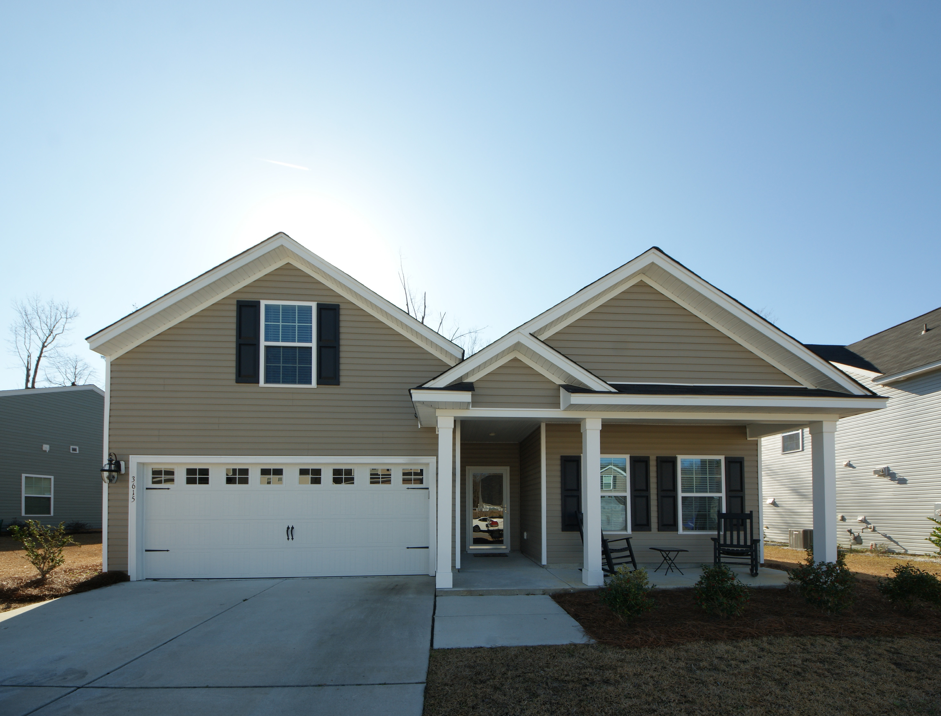
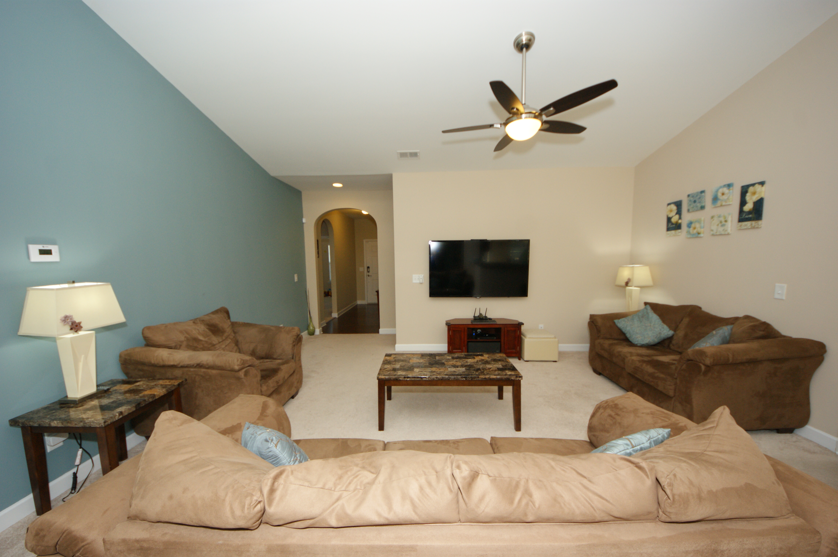
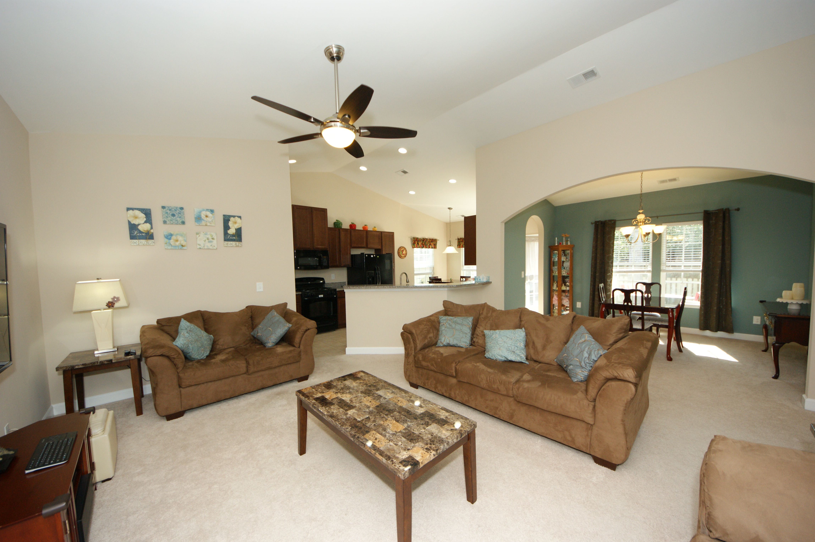
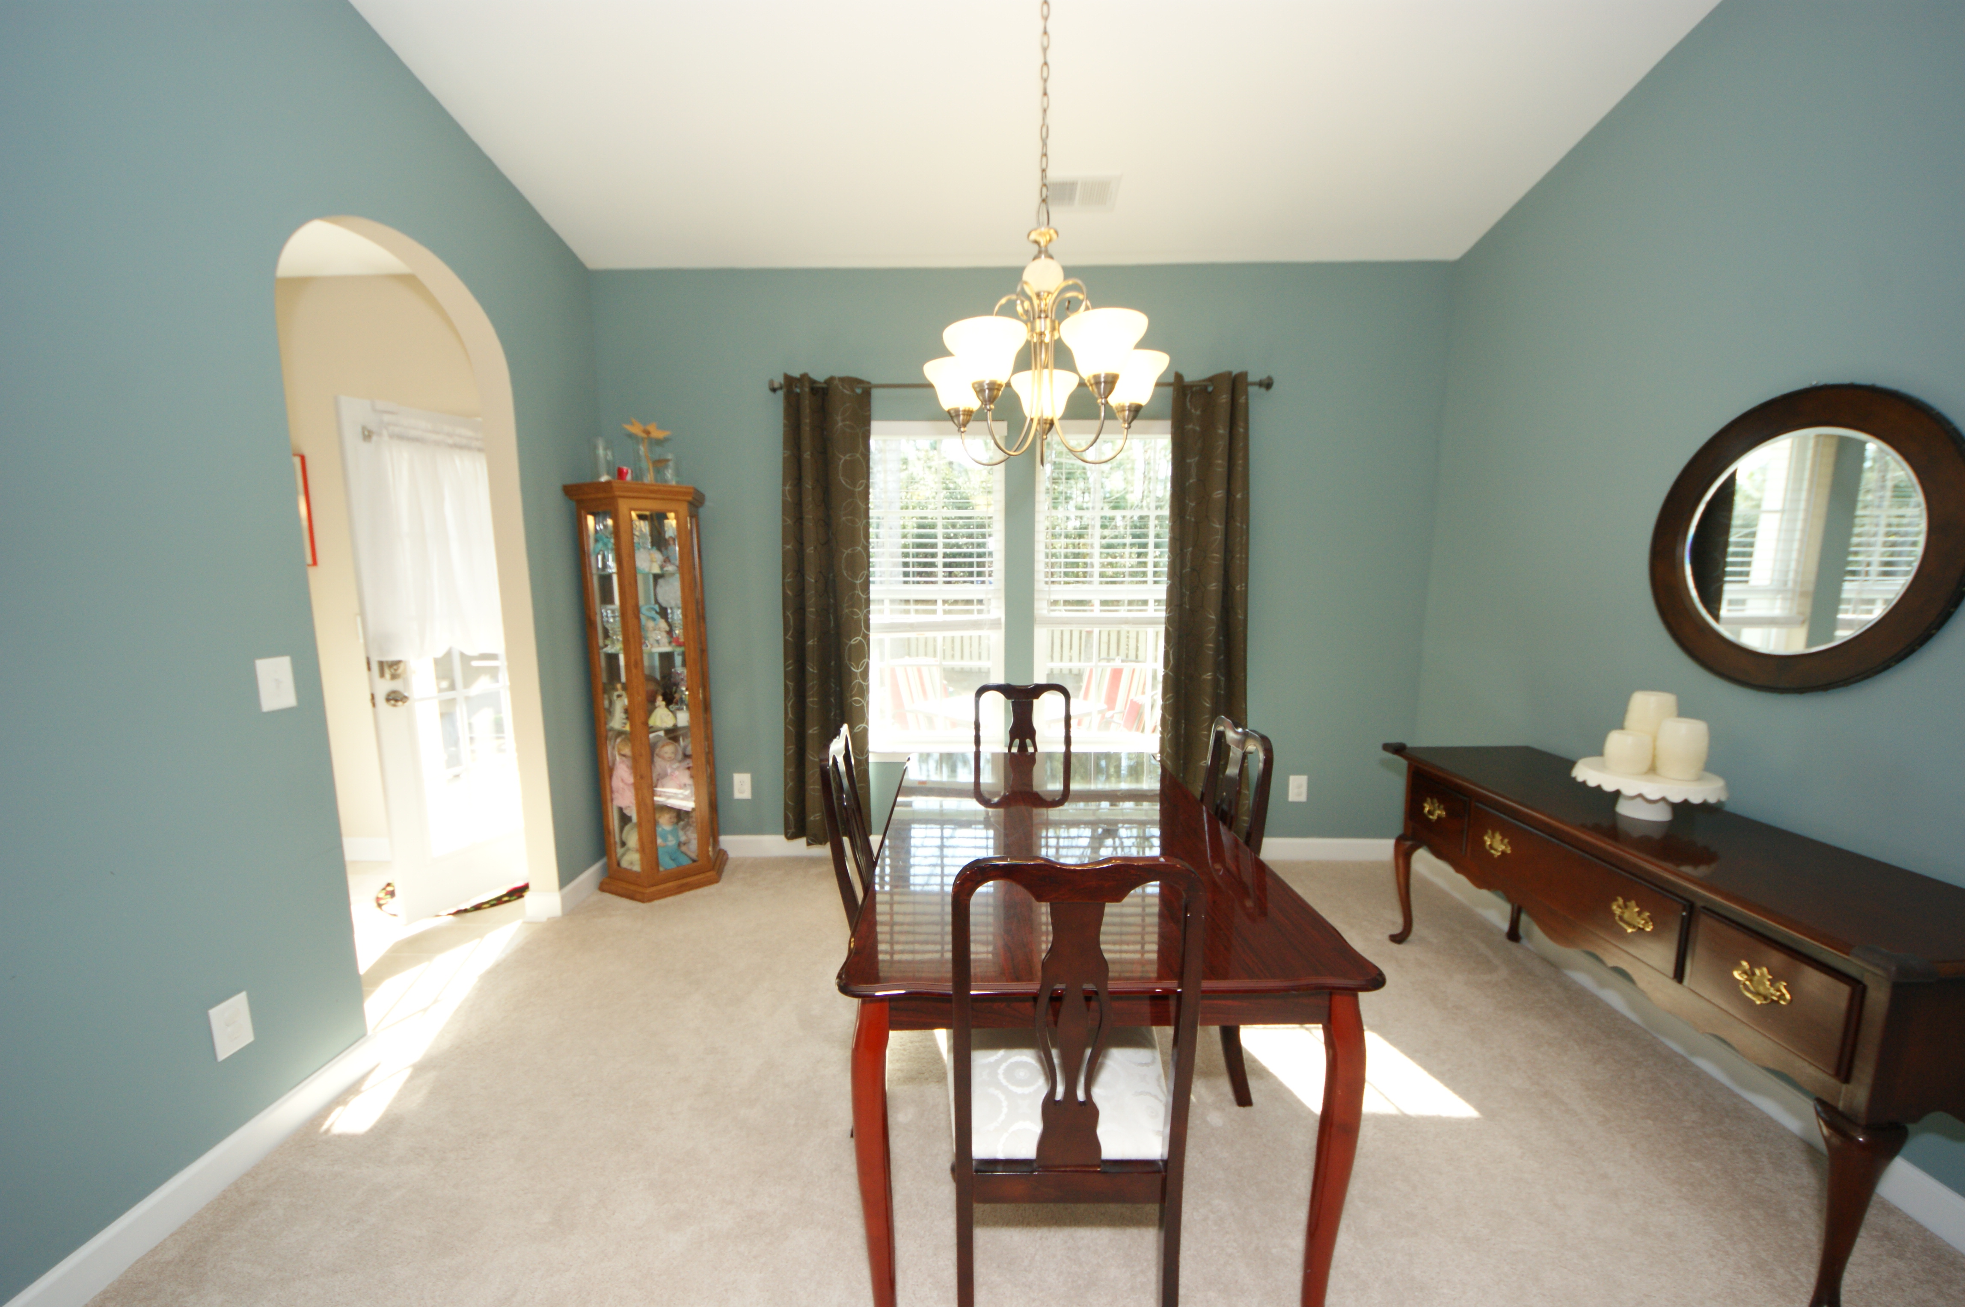
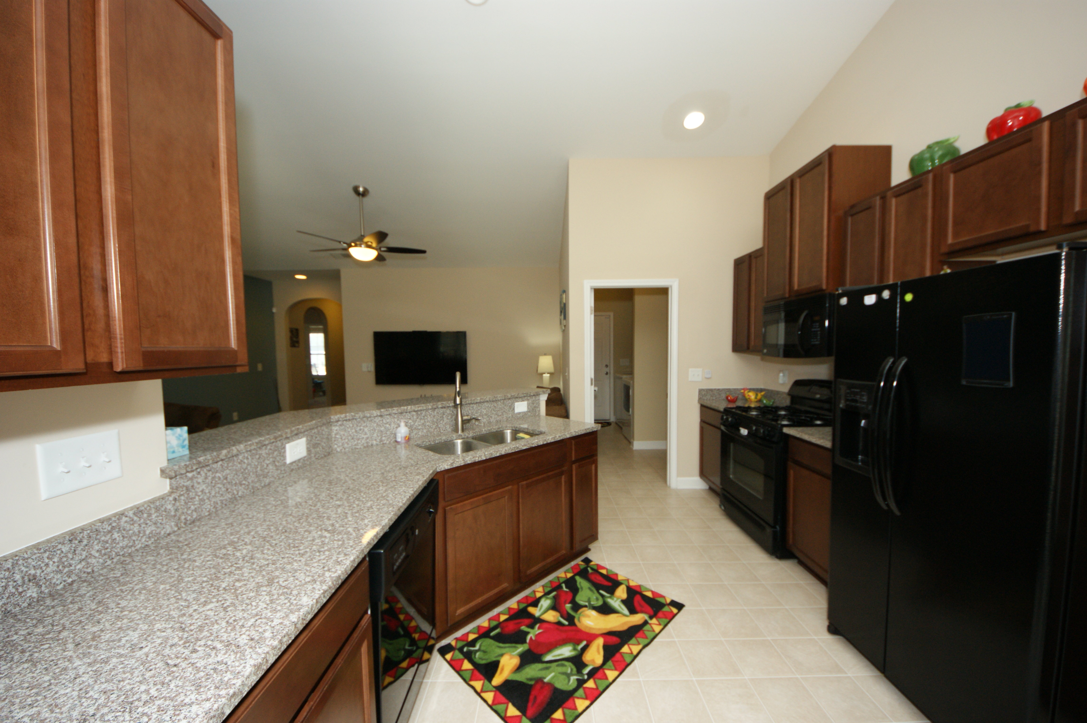
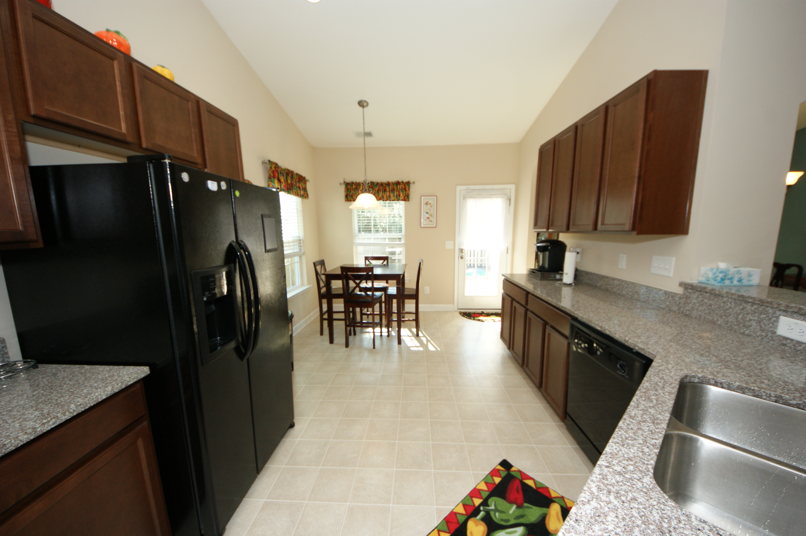
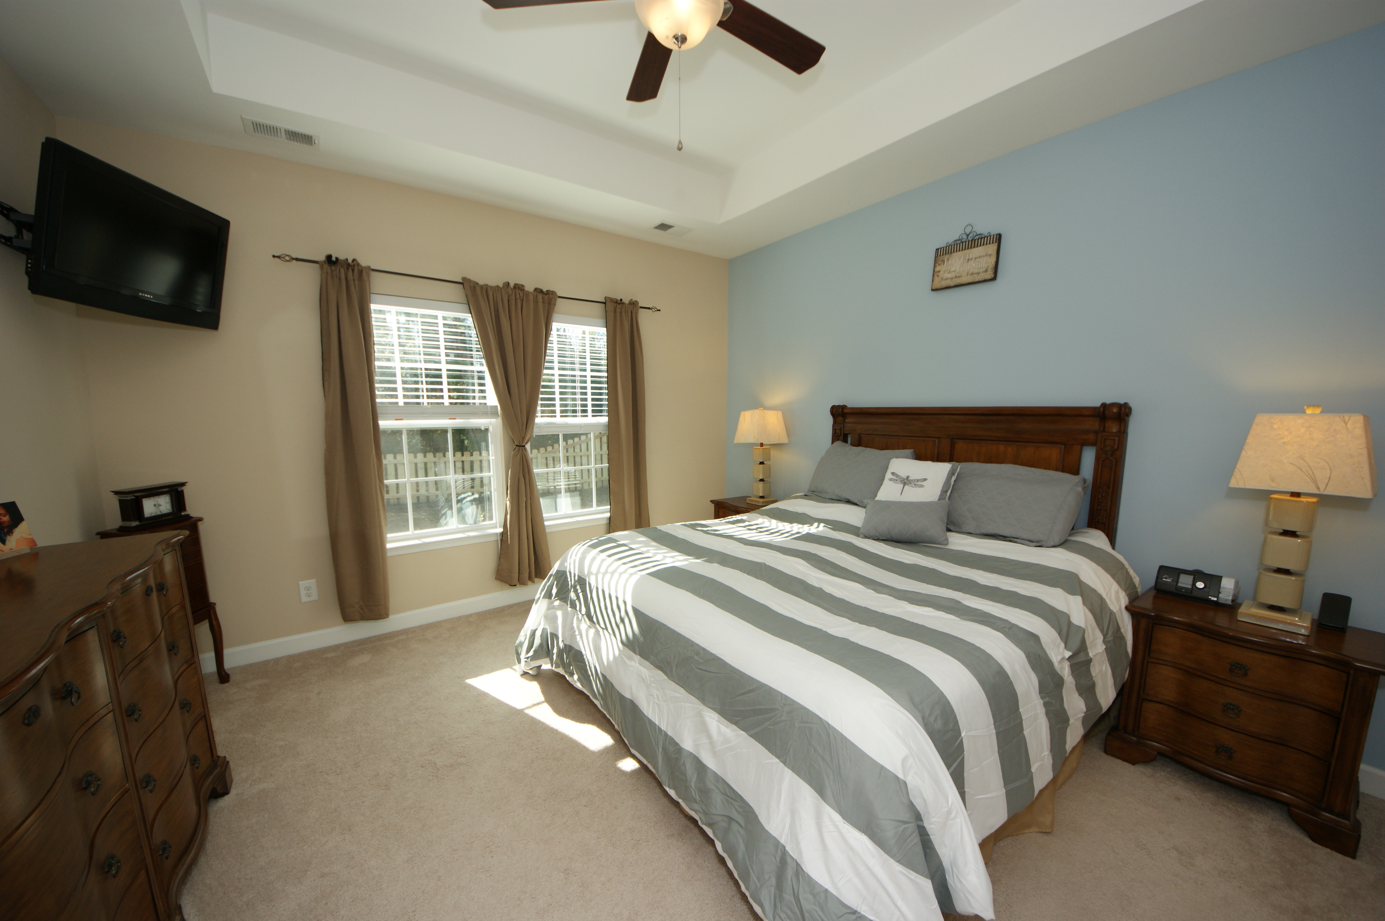
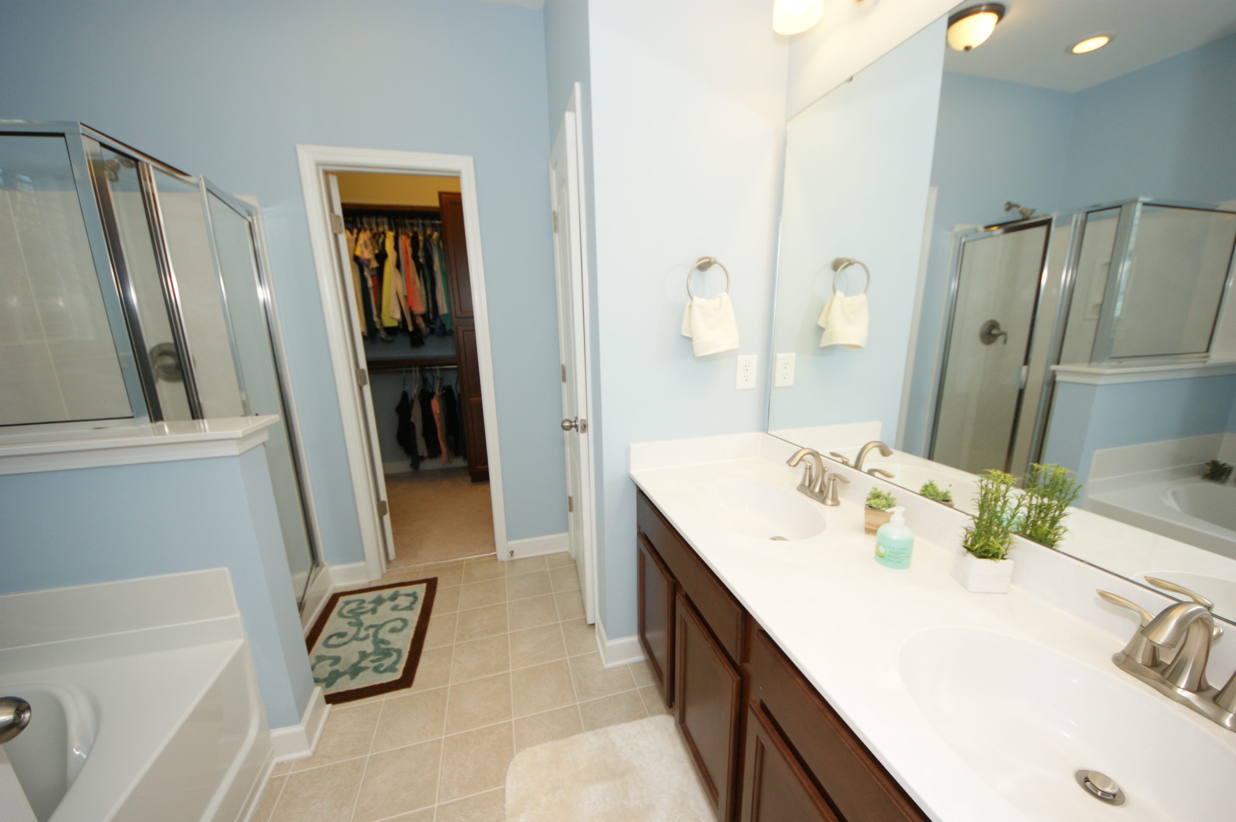
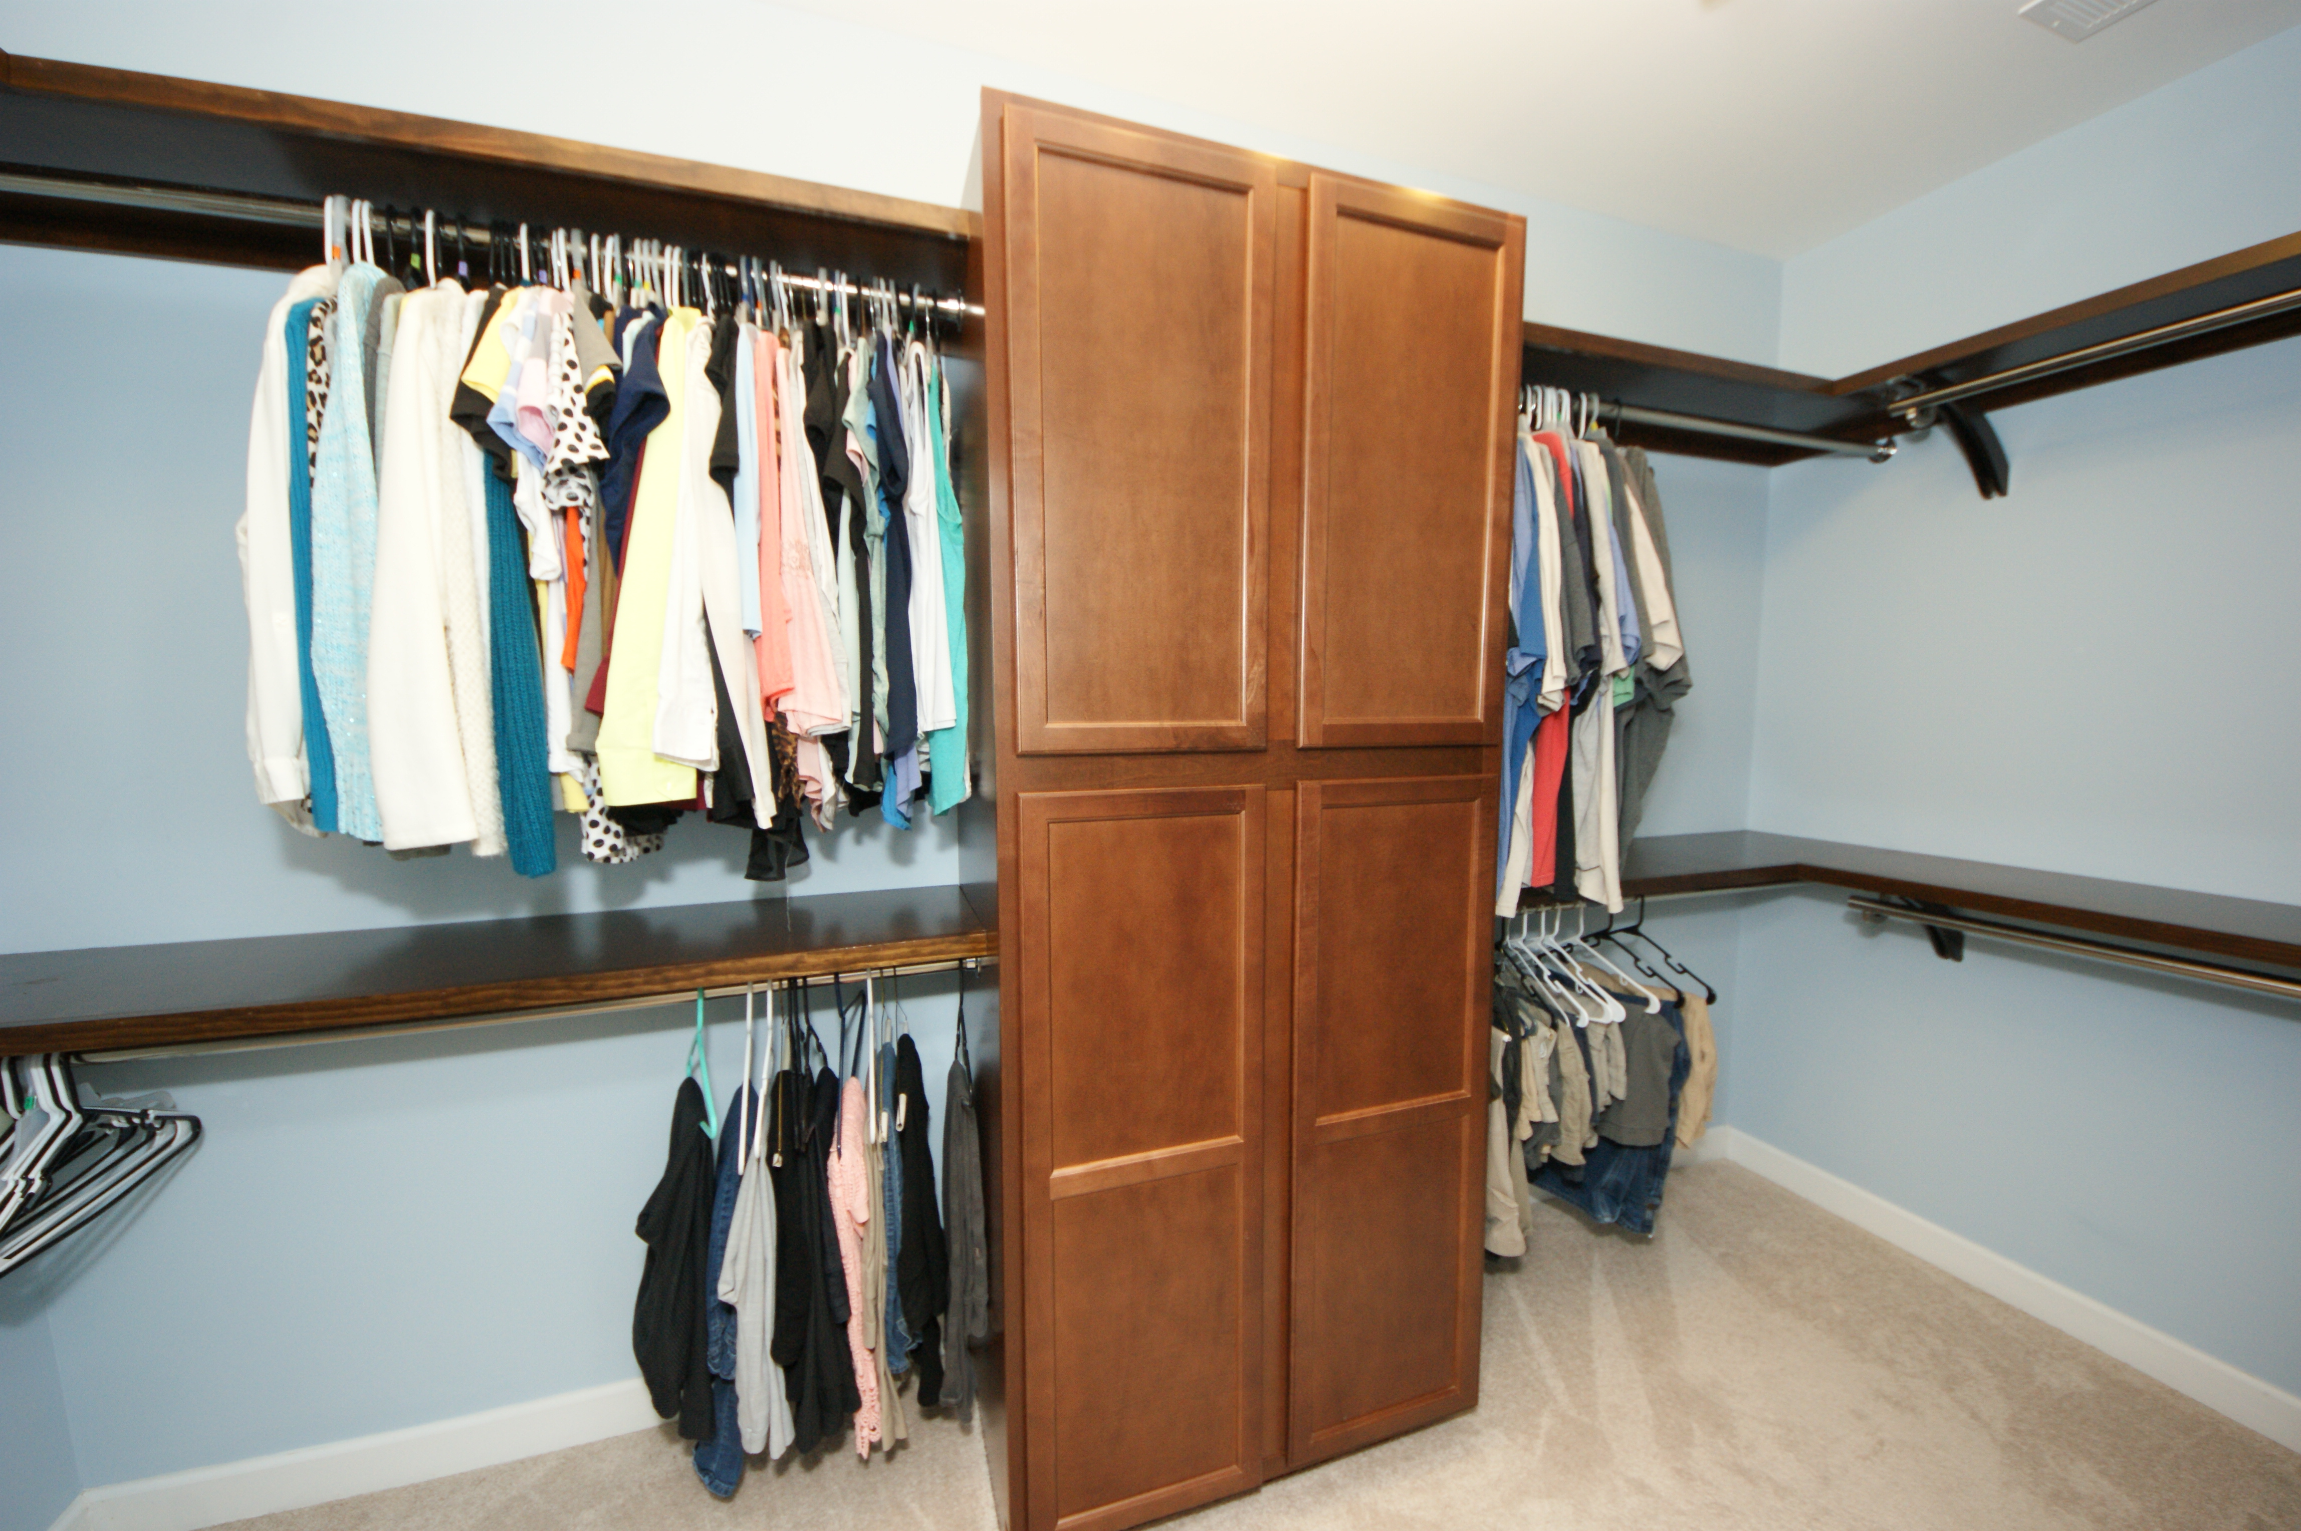
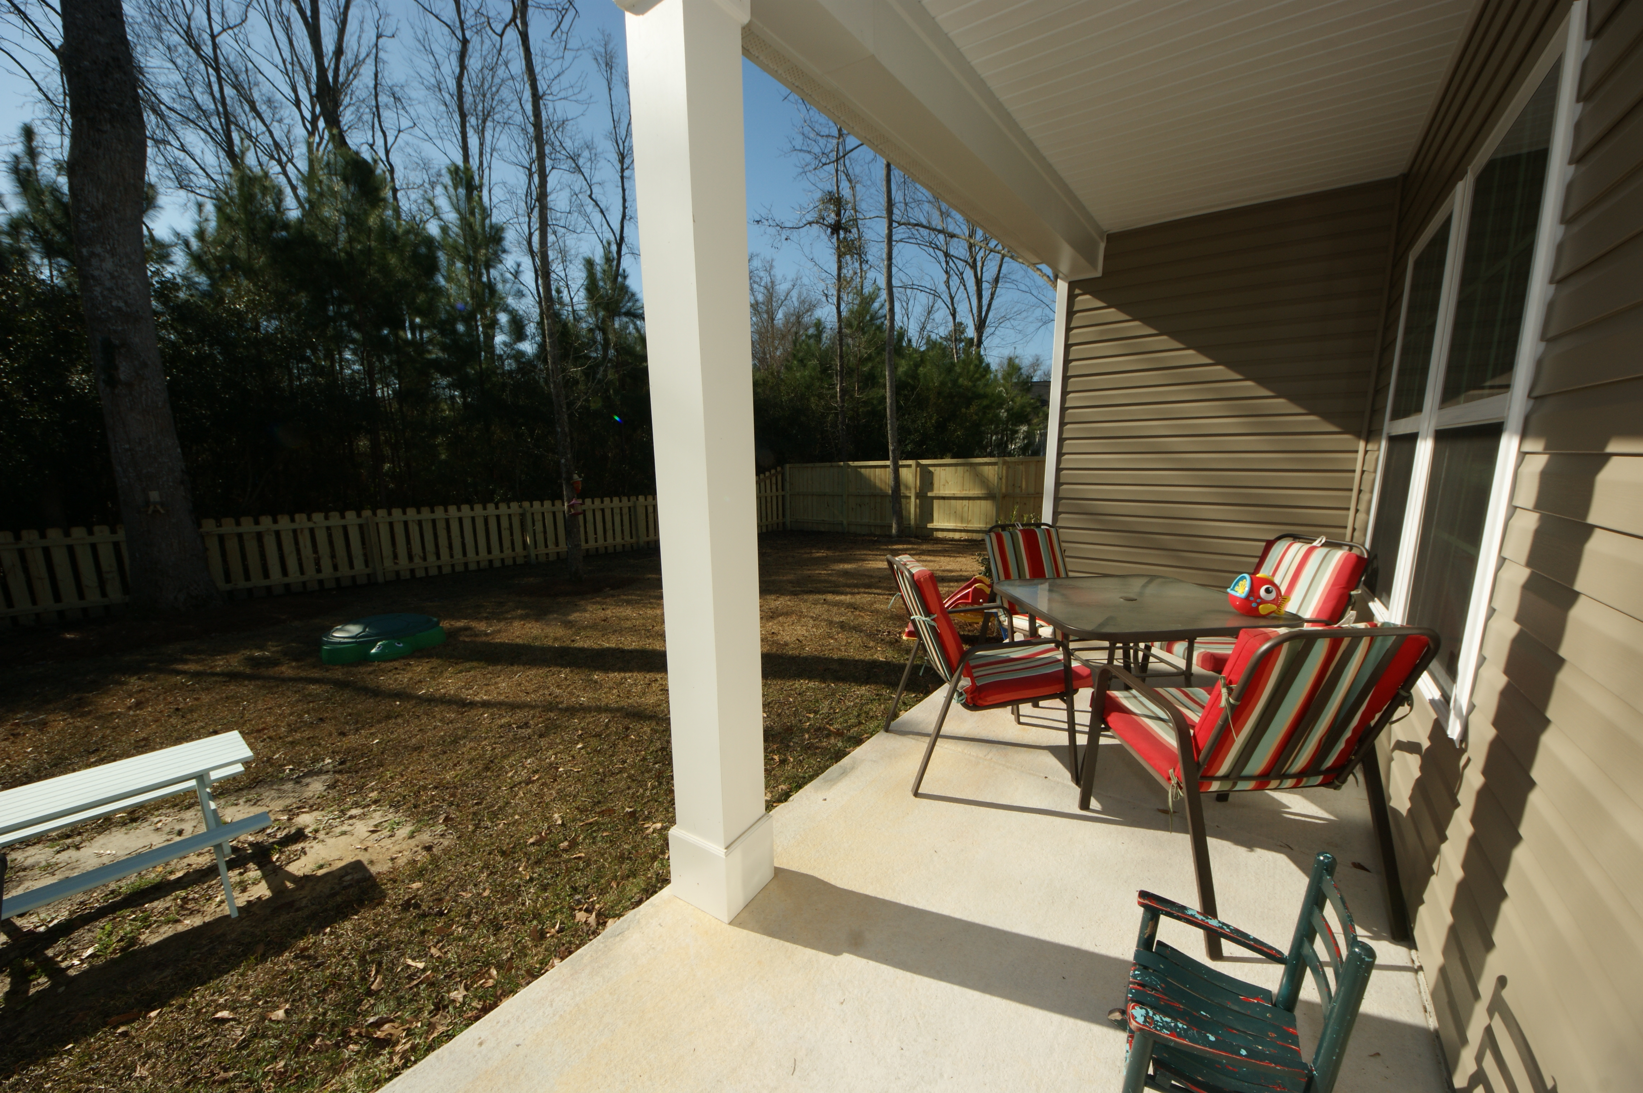
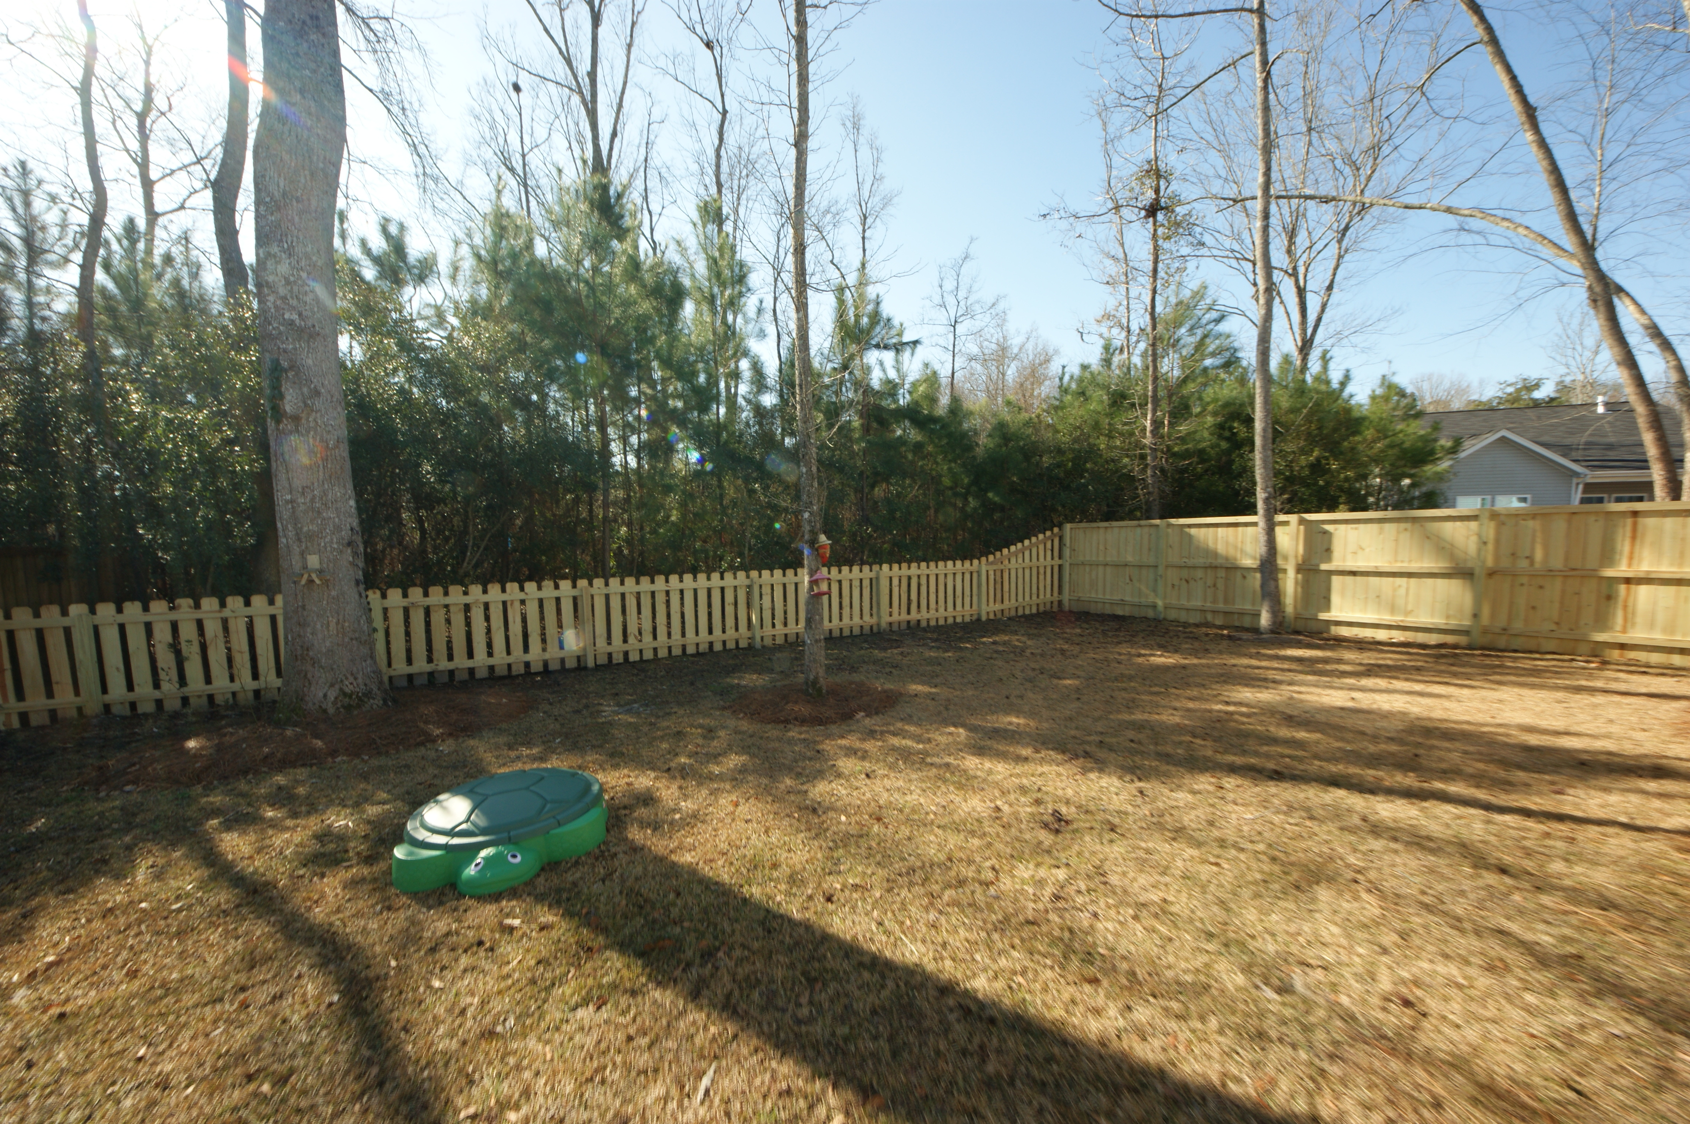
Move In Ready In Spencer Creek Woods
3615 Haymont Lane
Ladson, SC 29456
MLS# 16004391
$208,000
Popular Cypress floorplan w/upgrades, including granite counters, blinds throughout the home, added fridge end pantry cabinet, custom built in shelves in the pantry, upper cabinets w/shelves in laundry room, added storage closet, master walk in closet features custom cabinets w/dbl hung rods, finished garage w/cabinets & shelves. WOODED BACKYARD w 6' PRIVACY FENCE on the sides and 4’ fence along the back. Gorgeous cathedral ceiling in the living room and into the kitchen. Huge covered back porch, perfect for entertaining or just enjoying the peaceful neighborhood.
Jennifer Spangler
(305) 505-9927
jennyspangler@brockbuilt.com
Brock Built Homes of South Carolina, LLC | 669 Marina Drive Suite B1 | Charleston, SC 29492

