Slide 1
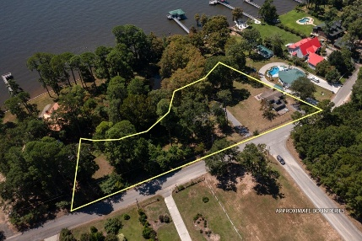
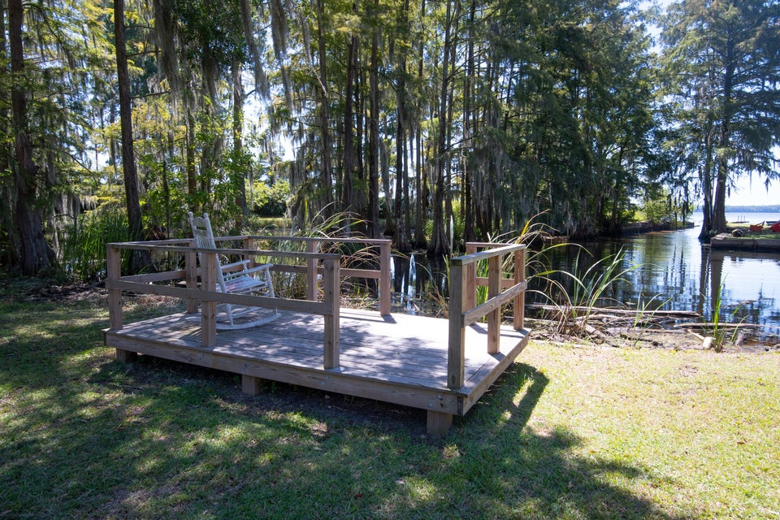
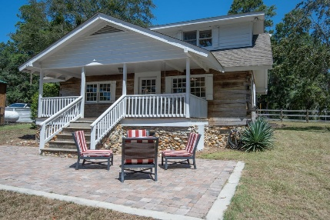
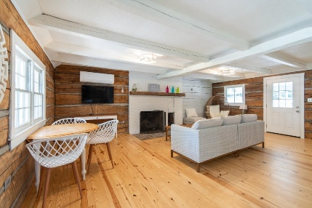
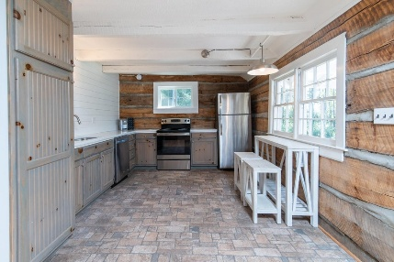
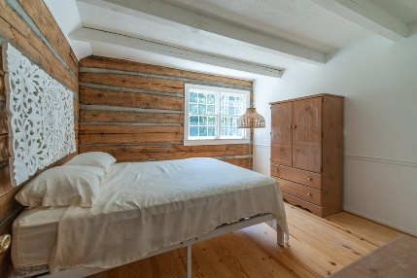
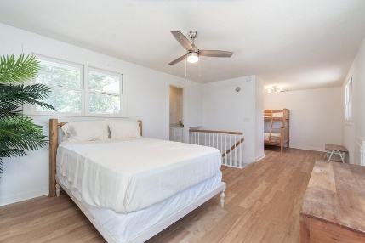
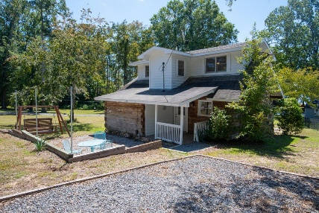


Log Cabin on a Pond
3616 Princess Pond Road
Princess Pond | Summerton, SC 29148 | MLS# 25024263 | $449,000
SPECIAL FINANCING AVAILABLE !!
Pond/Lake Marion Retreat & nestled in the community of Princess Pond in Summerton, South Carolina. This Log Cabin offers a well-appointed retreat with ample space and modern updates. This residence is set on approx. 0.72 acres, offering direct pond/lake access. The main level of the home features an inviting open floor plan that integrates the living spaces. The living room, complete with a cozy fireplace, creates a warm atmosphere, while the dining area is perfect for hosting family or intimate dinners.
Additional features: new pine flooring, exposed ceiling beams, a renovated kitchen that offers picturesque views of the backyard and access to a fishing dock for outdoor entertainment. The main level also includes the owner's bedroom and a renovated bathroom. The upper level ensures ample space for family and guests and accommodates two-bedroom sets and an additional bathroom. With the convenience of the laundry room on the main level, the cabin is designed for ease of living. The exterior is equally impressive, featuring a welcoming front & rear porch, boat ramp, and a parking pad located at the front of the property. This beautiful cabin provides a unique blend of comfort, style, and natural beauty, making it a perfect place to call home year-round or as a seasonal retreat, and although you are off the beaten path and secluded from the hustle and bustle of everyday life you are conveniently located just minutes to the I-95, and approximately 10 minutes to Santee. If you are simply looking for a private escape, this exceptional property offers the perfect blend of nature and functionality. To top it all off, the seller is making the furniture available, enhancing your lifestyle with direct access to Lake Marion, golfing, dinning and shopping experience. Quick Settlement Available! Come see this magnificent home today! Call your Realtor and reserve your showing appointment.
Gil Aviles
843-697-5535
gil@aviles-realestate.com
www.Aviles-RealEstate.com
Aviles Real Estate Brokerage
Charleston, SC / Miami, FL

