Slide 1
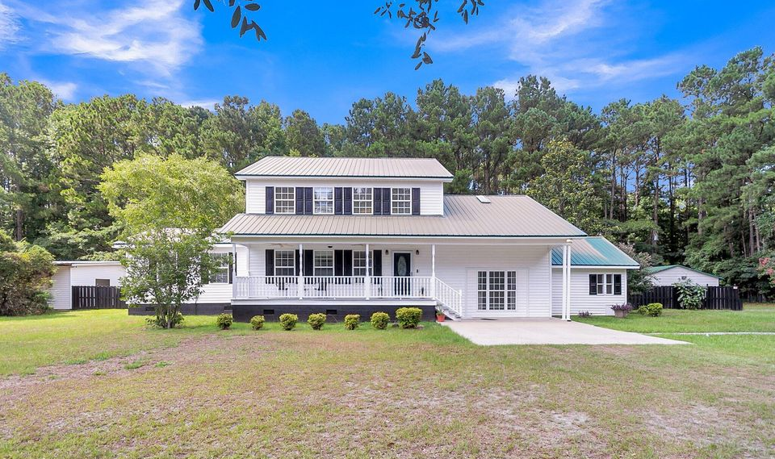
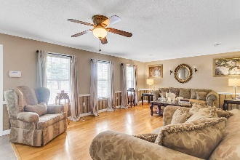
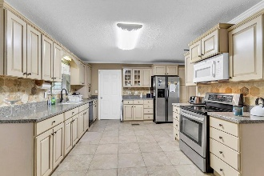
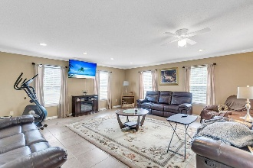
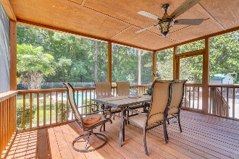
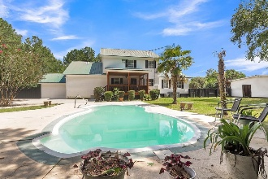


Cozy Comfort And Southern Charm Await!
$15,000 Agent Bonus
with ratified contract by 4/15/18
361 Kelly Bay Road
Walterboro, SC 29488
MLS# 25028156
$564,000
$12,100 Under
Recent Appraised Value
Walterboro, known as the "Front Porch of the Lowcountry", presents this roomy, 4 BR, 3.5 Bath home. 361 Kelly Bay offers wide porches, large 1 acre yard, open living spaces — perfect for growing families, low-country lovers or anyone who has been looking for just the right amount of space and want more land for less. Imagine morning coffee on the back, screened in porch, wildlife/ birding trips to ACE Basin or Great Swamp Sanctuary, weekend antiquing & small local events in downtown Walterboro, and occasional drives to Charleston for restaurants/culture. I can't forget to mention, weekends by the in-ground pool and outdoor hobbies (kayaking, fishing, hiking) are huge selling points! With easy highway access, the commute is stunning with oak tree lined streets and small-town charm not to be missed!
Homesteaders, get yourself some chickens or maybe plant a garden!
Located only ~35 miles to Summerville, 50 miles to Charleston, this beautiful home is perfect for hybrid workers with ample nature and close to the ACE Basin & downtown Walterboro's shops & artisans!
Here are some special features we love:
There is a pool house, complete with a single bathroom and kitchen, perfect for family get-togethers or parties!
Take a dip in the in-ground pool!
The backyard is beautiful, serene, and private, complete with wildlife and if you are an avid bird-watcher, chef's kiss!
Grab your favorite beverage, sit on the back screened-in porch, and enjoy some fresh air!
There are TWO primary rooms, one can be used as a separate apartment for your college kid or MIL suite
The upstairs bathroom has heated floors, perfect for guests or family, on those cold Fall mornings!
There are so many things that make this home so incredible!
A home with this quality does NOT come along often! This is the home YOU have been waiting for!
William R Everett, Jr
(843) 693-8539– C (843) 576-2701 – O
bill@theeverettgroup.net
RE/MAX Southern Shores
9209 University Blvd, Charleston, SC 29406

