Slide 1
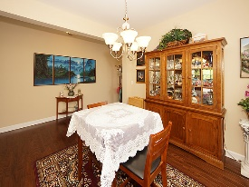
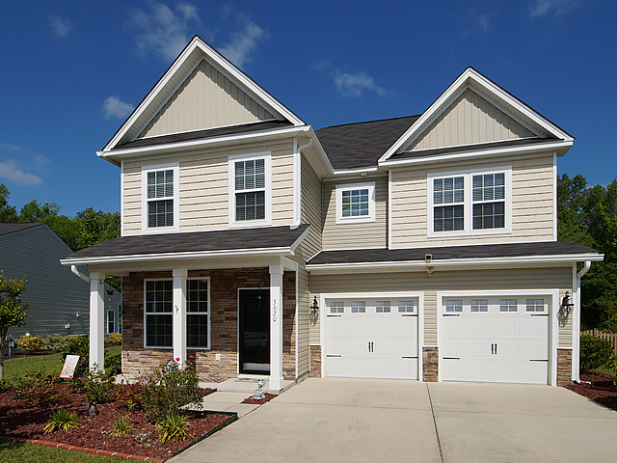
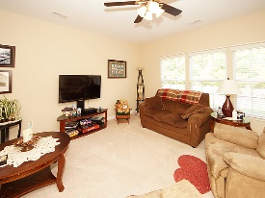
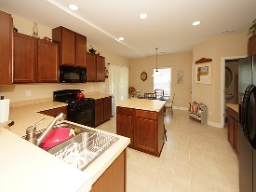
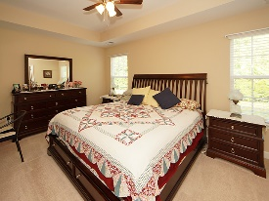
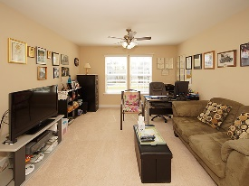
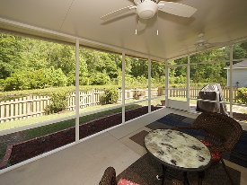
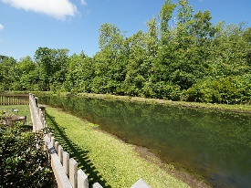


Open House: Thursday, Friday, Saturday
11a-2p each day ~ Stop by and receive a Starbucks gift card!
3620 Pimmit Place
Spencer Creek Woods
Ladson, SC 29456
Open House Canceled!
Under Contract In 3 Days!
MLS# 17010912 | $229,000
3 Bed / 2½ Bath
Centrally located to Boeing! Spencer Woods Creek subdivision is a hidden treasure!
Close to I 26, Boeing and Summerville, this home features upgraded elevation, gorgeous kitchen cabinets with island, professional painting, 3 spacious bedrooms up stairs and a spacious loft. Down stairs is an office, formal dining, and formal living.
Over sized screen porch and picket fenced back yard on a pond lot completes this very well maintained home.
Connie White, Broker
C: 843-532-3356
conniesyouragent@gmail.com
Charleston Homes
597 Old Mt. Holly Road
Suite 301
Goose Creek, SC 29445

