Slide 1
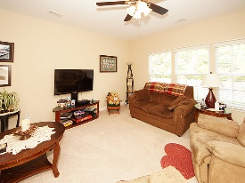
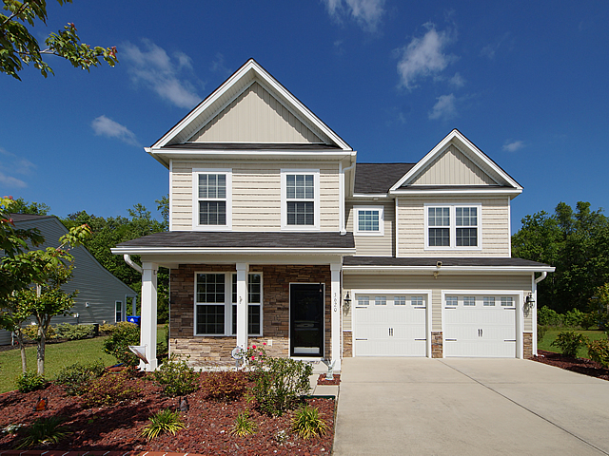
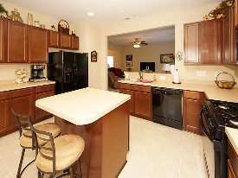
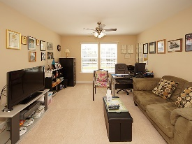
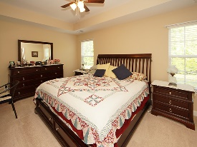
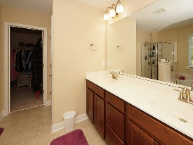
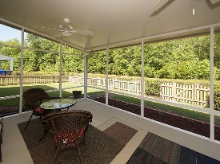
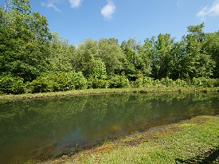


$2,000 Agent Bonus
3620 Pimmit Place
Spencer Creek Woods
Ladson, SC 29456
Open House Canceled!
Under Contract In 3 Days!
MLS# 17010912 | $234,900
3 Bed / 2½ Bath
Great opportunity to live in Spencer Creek Woods!
This home features upgraded elevation, gorgeous kitchen cabinets with island, professional painting, 3 spacious bedrooms up stairs and a spacious loft. Down stairs is an office, formal dining, and formal living. Over sized screen porch and picket fenced back yard on a pond lot completes this very well maintained home. Spencer Creek Woods is located off of Ladson Road and is a convenient location to Summerville and Charleston.
Connie White, Broker
C: 843-532-3356
conniesyouragent@gmail.com
Charleston Homes
597 Old Mt. Holly Road
Suite 301
Goose Creek, SC 29445

