Slide 1
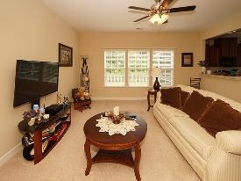
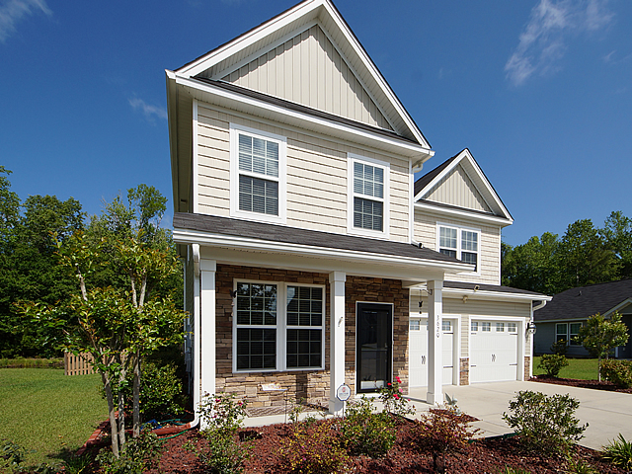
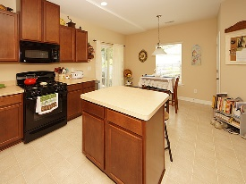
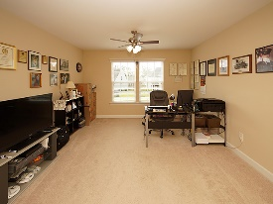
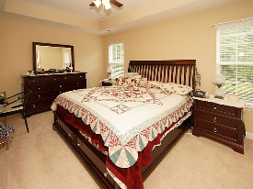
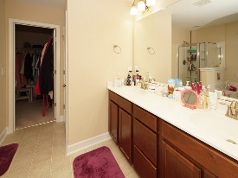
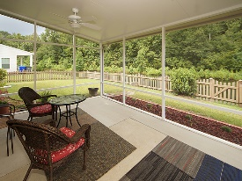
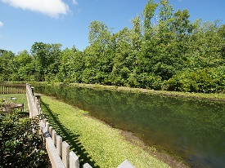


New Price ~ Centrally Located
3620 Pimmit Place
Spencer Creek Woods
Ladson, SC 29456
Open House Canceled!
Under Contract In 3 Days!
MLS# 17010912 | Now $224,995
3 Bed / 2½ Bath
Upgraded elevation, gorgeous kitchen cabinets with island, professional painting, 3 spacious bedrooms and an over sized loft.
Down stairs is an office, formal dining, formal living and eat in kitchen with a view of the pond.
Over sized screen porch and picket fenced back yard on a pond lot completes this very well maintained home.
Connie White, Broker
C: 843-532-3356
conniesyouragent@gmail.com
Charleston Homes
597 Old Mt. Holly Road
Suite 301
Goose Creek, SC 29445

