Slide 1
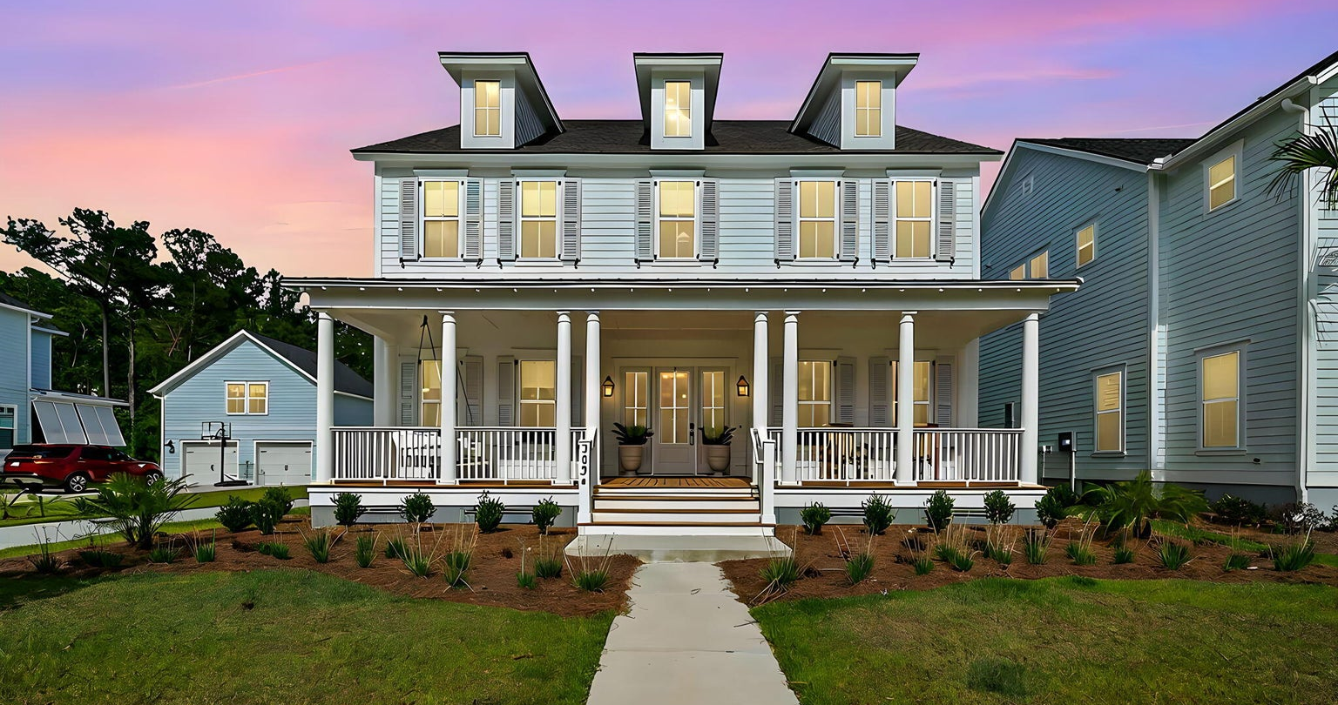
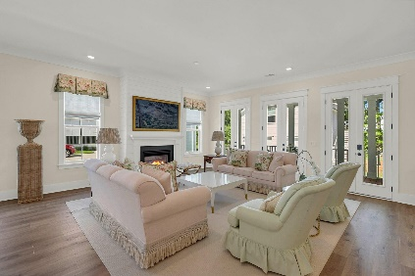
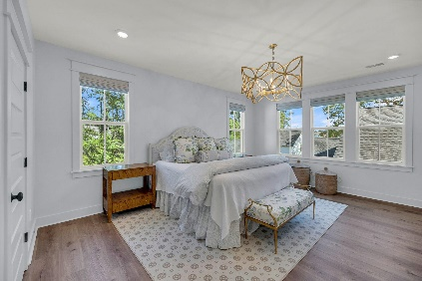
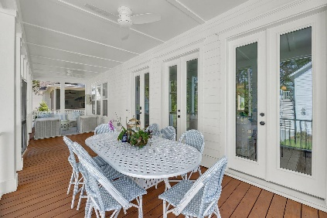
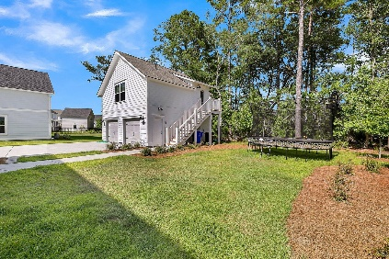

Carolina Park Showhome
$75K PRICE REDUCTION
3624 Goodwater Street Carolina Park | Mount Pleasant, SC 29466
MLS# 24015837 | $1,650,000
*TOTAL SQUARE FEET 4,390*
Prepare to be wowed the minute you step inside this beautifully appointed Lowcountry style home in the sought after Riverside section of Carolina Park - one of Charleston's most coveted neighborhoods! This 6 bed, 5.5 bath home features custom upgrades throughout and has been meticulously maintained. Built in 2023, this home features open concept living, custom woodwork and cabinetry, designer lighting, and custom window treatments and wallpaper. The gourmet kitchen features stainless steel appliances, a large kitchen island, double ovens, and a custom scullery/butler's pantry with roll out drawers, a beverage fridge and a built-in microwave. Boasting a 600-SF detached FROG with a full bath, large storage closet and bar with sink and beverage fridge - your guests may not want to leave! All of the bedrooms feature large closets with professionally installed custom closet systems. The oversized second floor owner's suite features two walk-in closets and a luxurious ensuite bath with dual vanities, a soaking tub and a separate shower. Upstairs also features a large flex space - perfect for a media room, home gym or kid's playroom. The downstairs office has a Murphy Bed with side tables and a built-in desk. Enjoy your morning coffee or glass of wine in the evening on the large screened in back porch or on the front porch which features a custom bed swing and gas lanterns. This wooded lot has been equipped with an electronic fence for pets and has room for a pool. 3624 Goodwater must be seen in person to truly appreciate all it has to offer! All Riverside homeowners have access to the Lake Club, a resort-style pool, pavilion, and fire pit, with views of Bolden Lake. Residents also can enjoy the playground, tennis courts, open-air pavilion, dog park, and miles of walking and biking trails throughout the neighborhood. Carolina Park is perfectly located minutes from great dining, shopping, beaches and historic downtown Charleston.
Video Tour | Virtual Tour
Paige Rhodes
843-830-3281
paige.rhodes@carolinaoneplus.com
Jacquie Dinsmore
973-886-0357
jacqueline.dinsmore@carolinaone.com

