Slide 1
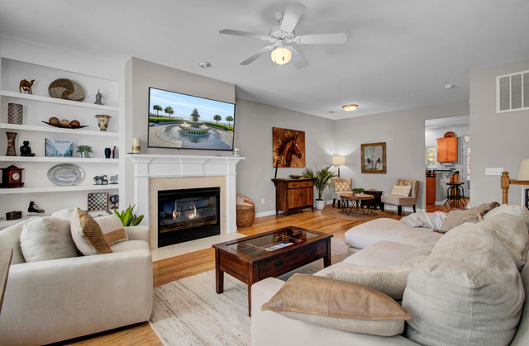
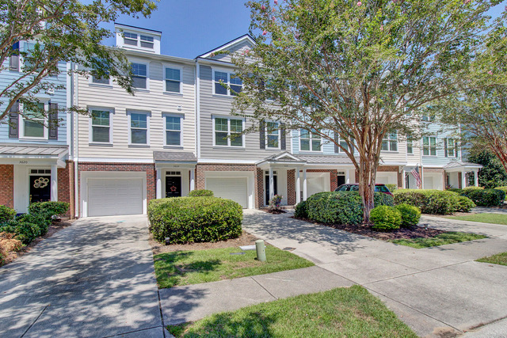
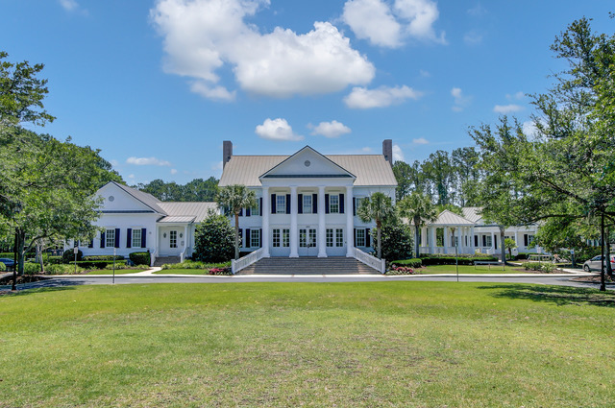
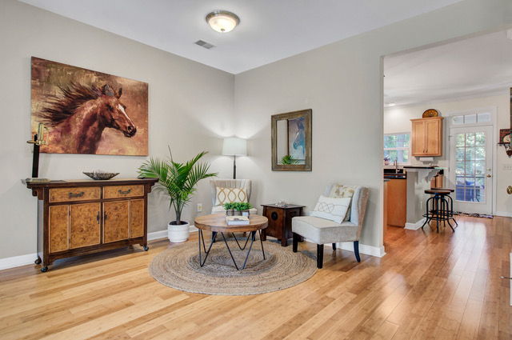
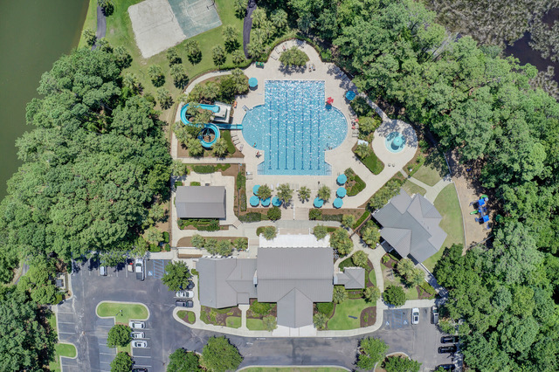
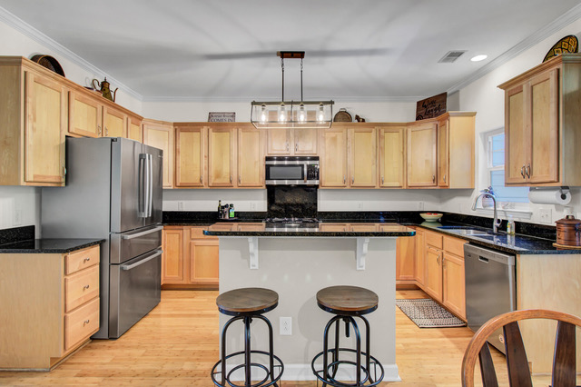
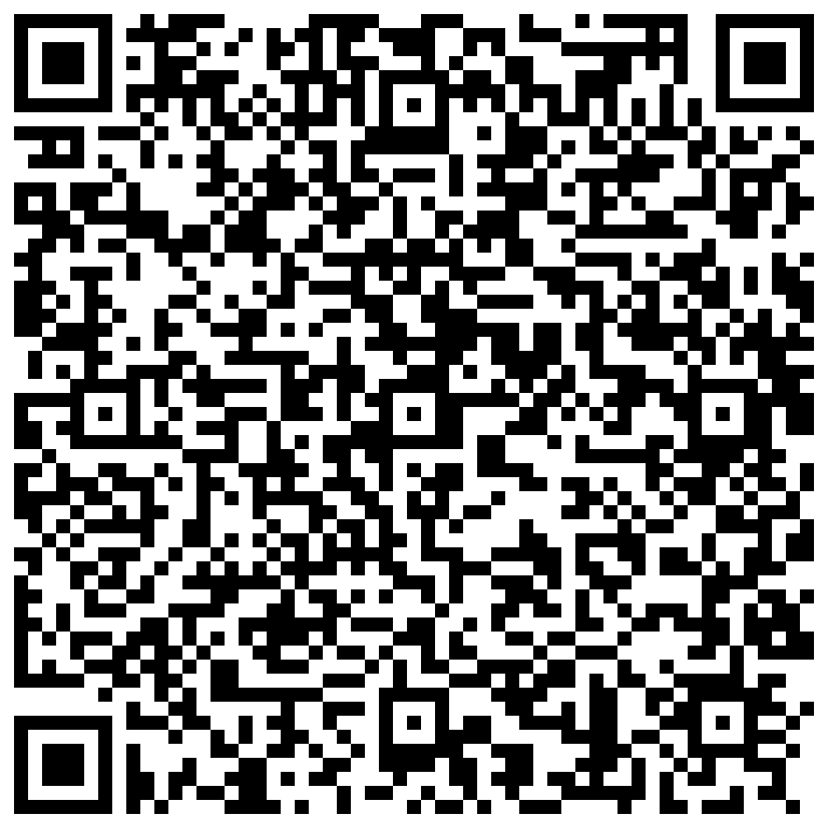


New Listing Hamlin Plantation Townhome
3628 Billings Street
Mount Pleasant, SC 29466
MLS# 23015840
$549,000
Hot New Listing- Townhome in Hamlin Plantation in Mt. Pleasant with garage and storage galore!
Hamlin Plantation offers a lifestyle for those who like to live as though they are on vacation! Top notch amenities, proximity to the beach and located in an amazing school zone with access to every type of shopping, restaurants and medical care you could ever want or need. Are you having trouble finding a turn key townhome or condo that has plenty of space for your storage needs? Well check out 3628 Billings Street. It has a 2 car garage with additional storage on the first level. The entire exterior was recently renovated- new roof, gutters, windows, and cement board siding! This 2 bedroom townhome has bamboo flooring throughout- no wall to wall carpet here! Every room is generous in size including a huge family room and spacious kitchen with abundant cabinets. A lush wooded lot is a view you will love as it creates a super private vibe. Swimming, tennis, walking and jogging paths, a stunning clubhouse all make this the lifestyle you can’t resist.
Schedule tours in Showingtime!
Take a video tour of the property!
Ellen O'Neil
Broker/Owner, ABR, e-PRO, CNE
Charleston Realtor of Distinction
(843) 300-8530
www.EllenONeilProperties.com

