Slide 1
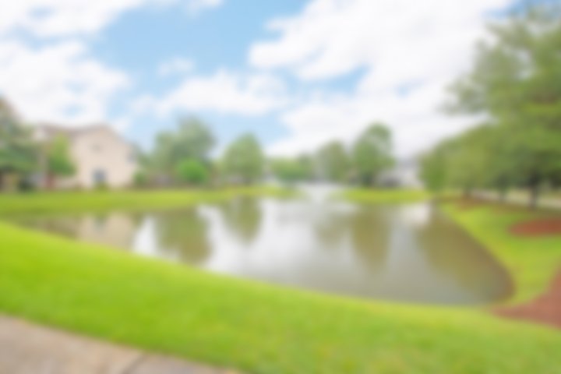
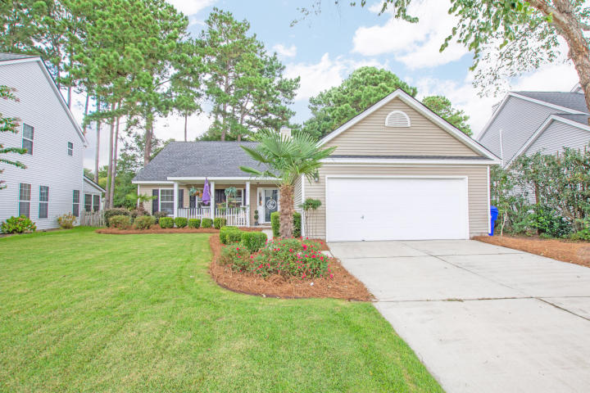
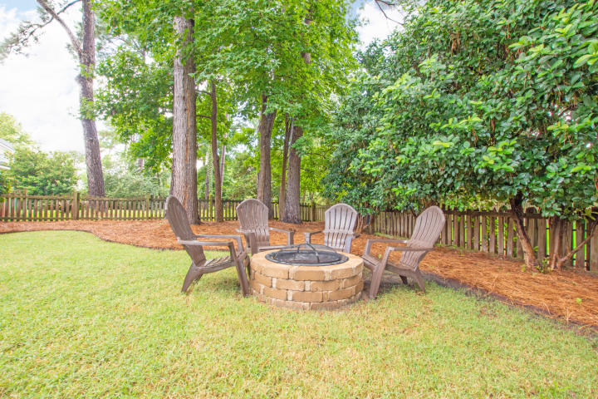
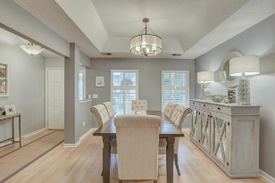
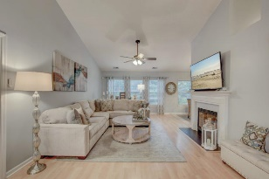
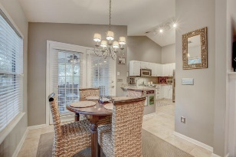
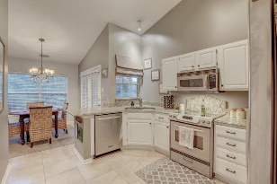
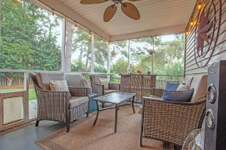
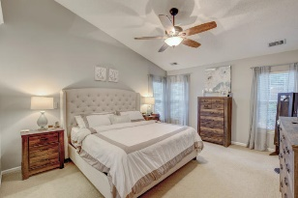
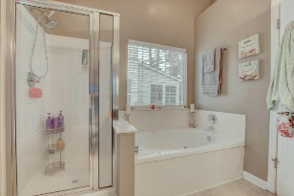
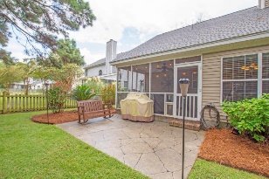
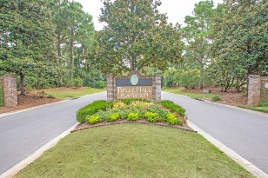
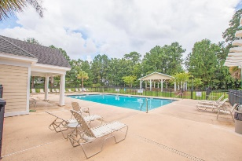

Gorgeous One Story Bell Hall Home
Inspection Has Been Done!
Low Maintenance Property! Bring All Offers!
362 Jardinere Walk
Belle Hall | Mount Pleasant, SC 29464 | MLS# 18027061 | $422,000
Charming, spacious home in Mount Pleasant in highly desirable Belle Hall. Great open floor plan with vaulted ceilings in the family room, kitchen, master bedroom and bath. This beautiful home is perfect for entertaining with the open floor plan and wood burning fireplace! Spacious dining room with wood floors and eat in kitchen. Custom paint through out - no detail overlooked! Granite in the kitchen with stainless steal appliances. Master bedroom has his & hers closets and large bathroom with garden tub. Both bathrooms have granite and separate laundry room. Large screened in porch with fenced in backyard and fire pit! Lawn has irrigation system and new HVAC 2015. This home is a MUST SEE! Close to area beaches, shopping, and historic downtown Charleston.
Marthe Teixeira
(917) 325-8033
marthe@agentownedrealty.com
AgentOwned Preferred Group
824 Johnnie Dodds Blvd
Mt Pleasant, SC 29464

