Slide 1
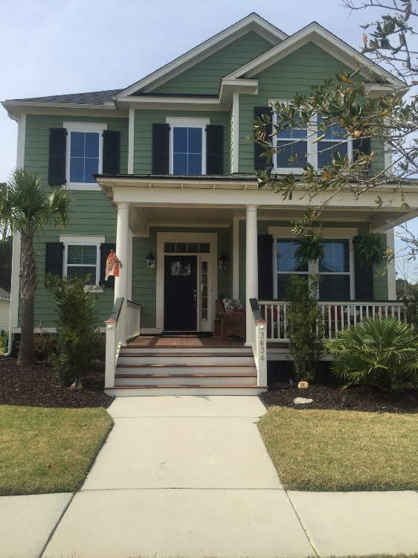
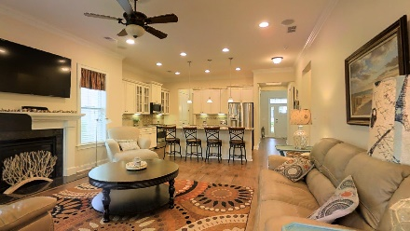
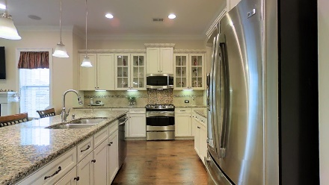
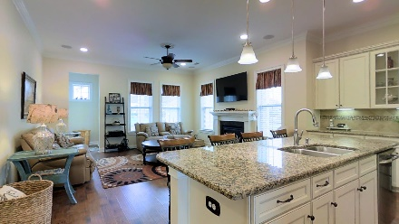
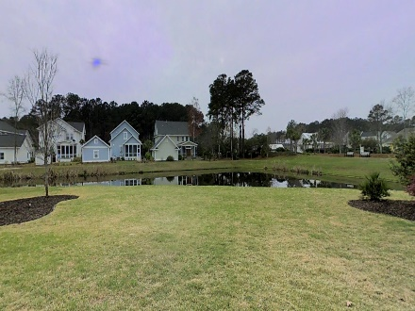


Carolina Park Beauty!
3634 Shutesbury Street
Mount Pleasant, SC 29466
MLS# 16007248 | $529,000
Price Reduced
This beautifully maintained 4 bedroom 3.5 bath home has it all! The open floor plan is perfect for families and entertaining. There are upgrades throughout the home, which sits on a hard-to-find large lot with beautiful pond views. You will be impressed with the hardwood floors, beautiful granite counters and stainless steel appliances. The popular St. Helena floor plan features the master bedroom downstairs with three additional bedrooms upstairs, one with its own full bath perfect for guests. There is a second family room upstairs in addition to a loft. The owner's suite has a luxurious bathroom with a gorgeous tiled shower and double sinks. An irrigation system will keep the yard looking lush throughout the warm summer months so you can enjoy the pond views and large yard with extensive landscaping all done for you! It's an easy walk to the beautiful pool and playground. Simply move right in and start enjoying everything that this growing neighborhood has to offer!
COME SEE IT FOR YOURSELF DURING OUR OPEN HOUSES SCHEDULED SATURDAY AND SUNDAY (APRIL 2 AND 3) FROM 12-3 PM!
For more details and to use the 3D Walk Through Tour Click Here:
http://ellenoneilrealty.com/property/3634-shutesbury-st-mt-pleasant-sc
Ellen O'Neil
843-300-8530
ellen@ellenoneilrealty.com
www.EllenONeilRealty.com
Ellen O'Neil Realty | Mt. Pleasant, SC 29466

