Slide 1
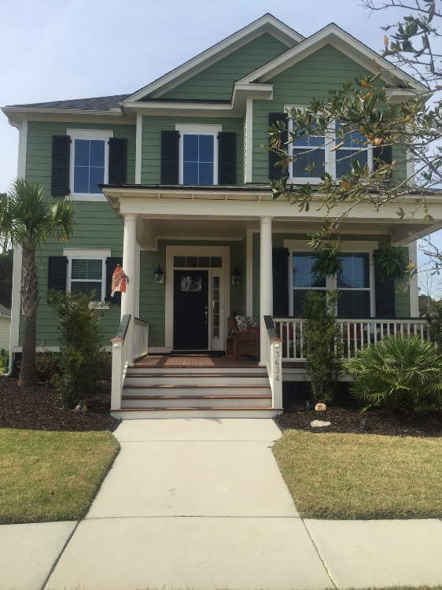
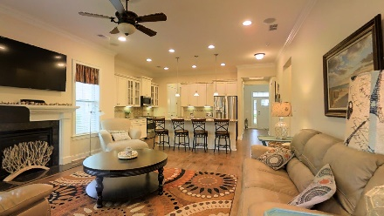
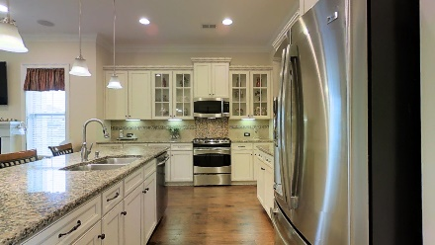
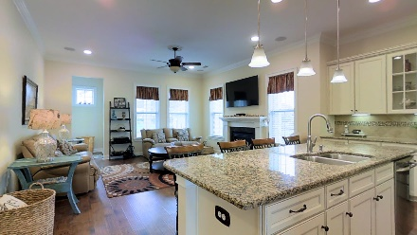
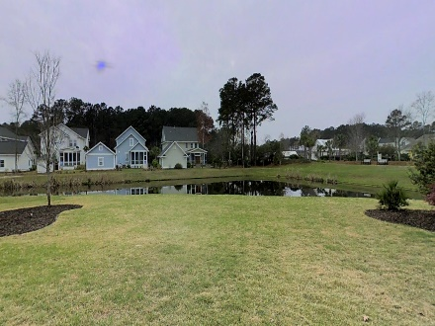


Carolina Park Beauty!
3634 Shutesbury Street
Mount Pleasant, SC 29466
MLS# 16007248 | $524,900
Price Reduced
NEW PRICE for this awesome home on a uniquely large pond lot within walking distance to the amenity center! The time is right to make this your home! The owners spared no expense when choosing their upgrades in this fantastic four bedroom 3.5 bath home with an open floor plan perfect for families and entertaining. The cook will LOVE this kitchen with its gas range, gorgeous granite, numerous cabinets and a large pantry! The master bedroom is DOWNSTAIRS and overlooks the huge back yard and pond! There is over 2800 square feet of living space to enjoy- including a large loft and second family room upstairs! This is a premium lot with great privacy- a rare find! Carolina Park will offer residents a truly all inclusive lifestyle. The time is right to make this your new home!
SCHEDULE A TOUR TODAY OR COME CHECK IT OUT DURING THE OPEN HOUSE EVENTS ON SATURDAY AND SUNDAY, APRIL 16 AND 17, FROM 12-3!
For more details and to use the 3D Walk Through Tour Click Here:
http://ellenoneilrealty.com/property/3634-shutesbury-st-mt-pleasant-sc
Ellen O'Neil
843-300-8530
ellen@ellenoneilrealty.com
www.EllenONeilRealty.com
Ellen O'Neil Realty | Mt. Pleasant, SC 29466

