Slide 1
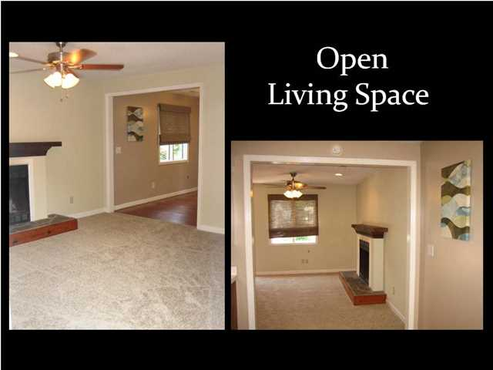
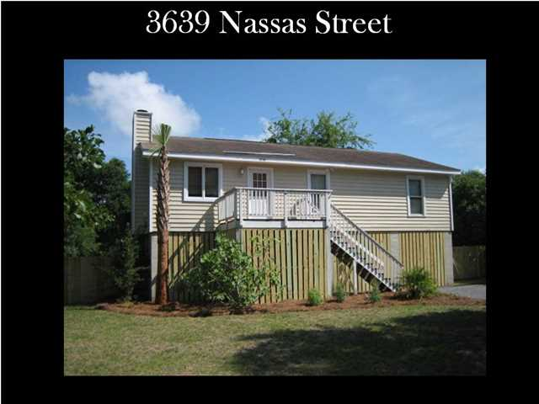

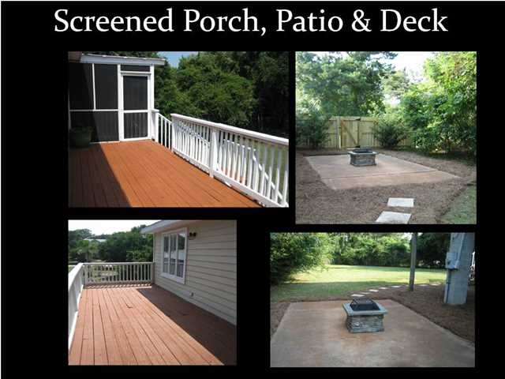
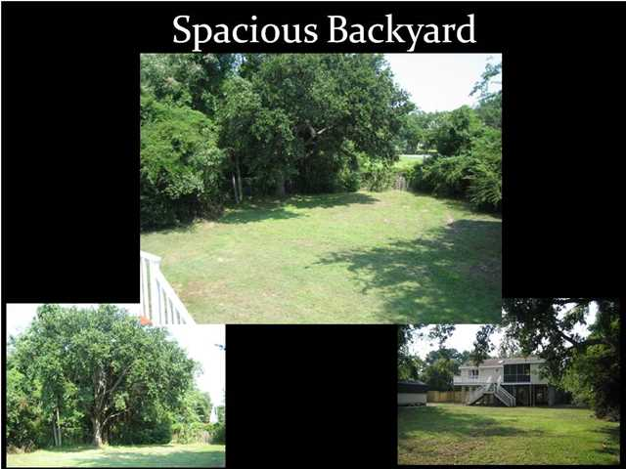
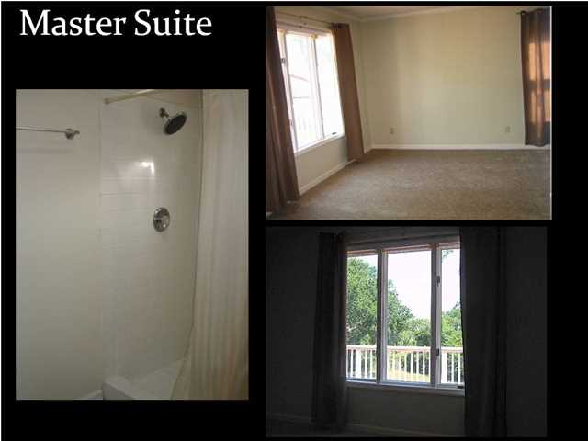
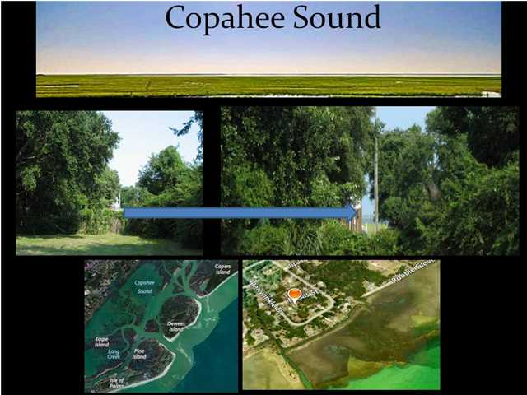
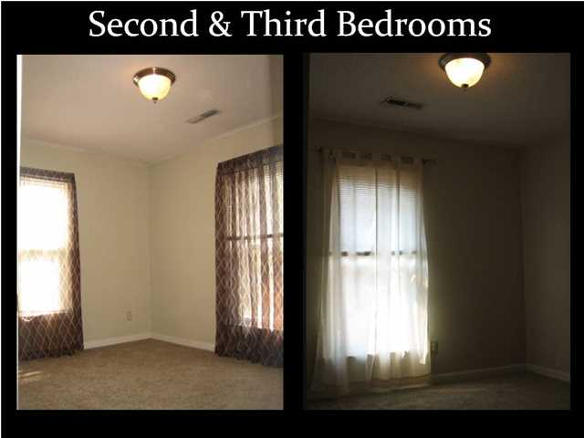
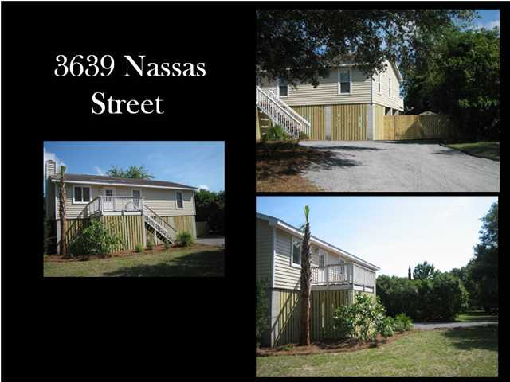
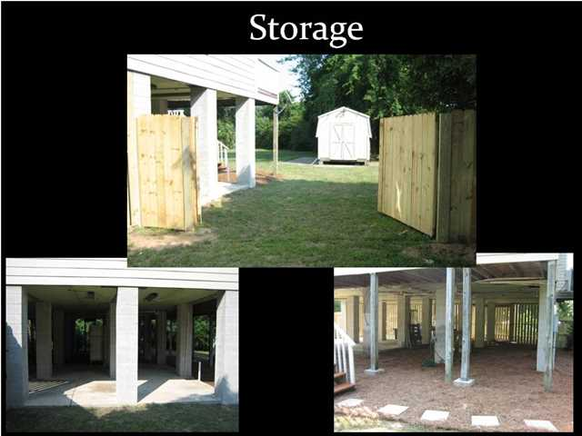
Purchase in Mt. Pleasant for under $200K
Copahee View ~ MLS# 1418786 ~ $199,900
Enjoy the serenity and space of "the country" while still in Mt. Pleasant. Come enjoy the water views and neighborhood boat landing on the north end of Mount Pleasant. Copahee View is a quaint, community consisting of approximately 100 homeowners. This nostalgic neighborhood lays adjacent to the majestic waters of the Copahee Sound, located behind the Intracoastal Waterway and Capers and Dewees Islands. This unique community allows you to park your boat, trailer and other toys in your own yard alleviating expensive monthly storage fees. This 3 bedroom/2 bath home has a wood burning fireplace, large deck, fire pit and screened porch. This is not a modular home. It is a sturdy "stick built" home with heart pine flooring, brand new stainless steel Samsung kitchen appliances, and new carpeting throughout the bedrooms and open living space. On this large, almost half acre, lot you will find a patio with firepit, shed with electricity, lots of secure storage underneath the house and a large fenced in backyard with double gates at the driveway to securely store your boat. Located close to The Market at Oakland Plantation you are close to great shopping and restaurants as well as the new hospital and award winning schools. Copahee View is one of only a few neighborhoods outside of Park West that will continue to attend the award winning Park West schools after rezoning that will begin in 2015/16 school year. The optional HOA is $35 a year and includes access to neighborhood boat landing! Live in Mt. Pleasant but feel like you're more in the country surrounded by a quiet, peaceful setting with no strict HOA rules and regulations that you must follow or neighbor's homes being right on top of you. Build a rooftop deck or second story on this lot for fantastic water views. Properties like this are few and far between. You will not get another lot like this in Mount Pleasant for this price. Don't miss this opportunity! Seller will be installing new roof by end of September 2014.
Mia Rooks
843-637-9728
kwrealtormia@gmail.com
Keller Williams Realty Charleston | 496 Bramson Ct Ste 200 | Mt. Pleasant, SC 29464

