Slide 1
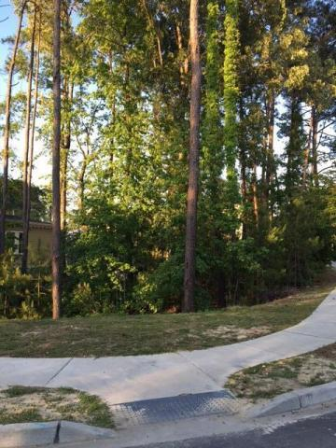
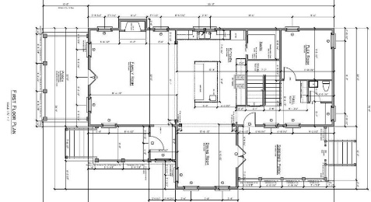
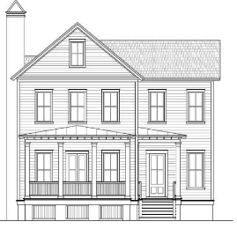
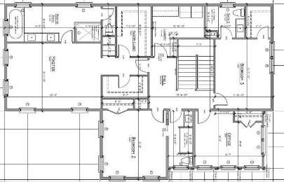

Great corner lot available in the much sought-after Hibben subdivision within Belle Hall. This lot also has approximately 3,100 sq ft (4/5 bedroom) house plans designed by Phil Clarke that have been preliminary reviewed and ready to be submitted for approval. Plans also have an option for a third floor. The lot is situated on a corner lot with a beautiful protected marsh view across the street as well as a private alley in the back.
Corner Lot in Hibben @ Belle Hall
363 Bridgetown
Belle Hall ~ Mount Pleasant
MLS# 16012401 ~ $205,000
Kent Jordan
(843) 375-2222
kenteastshore@yahoo.com

