Slide 1

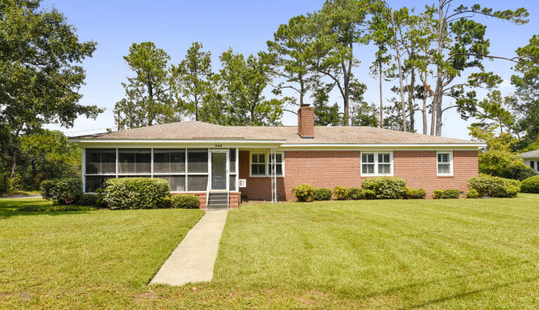
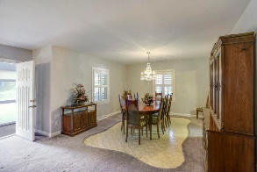
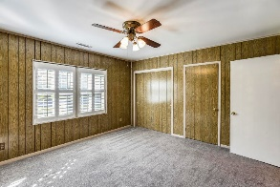
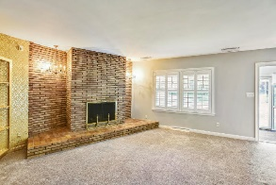
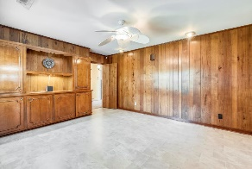
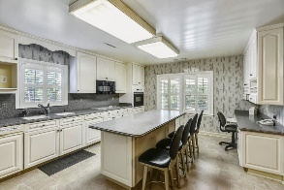
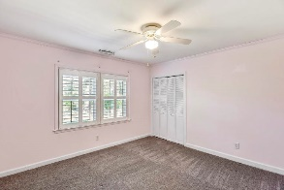
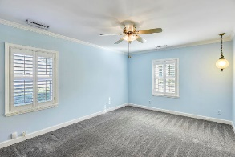
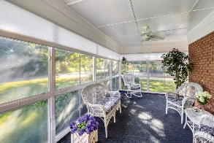
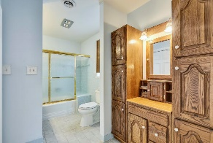
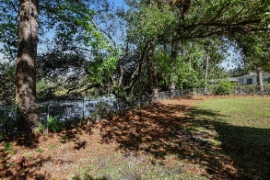

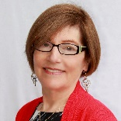
Agent Open House Tuesday, Nov 19th ~ 10:00-12:00
363 Confederate Circle South Windermere • Charleston • MLS# 19030652 • $790,000
3 drawings for gift cards to 3 Little Birds.
This 3BR, 2.5 bath ranch on large corner lot with marsh has been very well cared for by owners of 40 years. The all season sun room has AC/Heat and easily removable panels can convert to a grand screened porch.
Spacious living room, separate dining room and well-equipped kitchen, electric lift and much more will suit many of your buyers.
Near St. Andrews Elementary School for Math & Science, County Library and S. Windermere Shopping Center.
Susan Garfinkel
843-696-5838 | susanrealtor44@gmail.com
Elaine Brabham and Associates, LLC • 1890 Sam Rittenberg Boulevard, Suite 217 • Charleston, SC 29407

