Slide 1

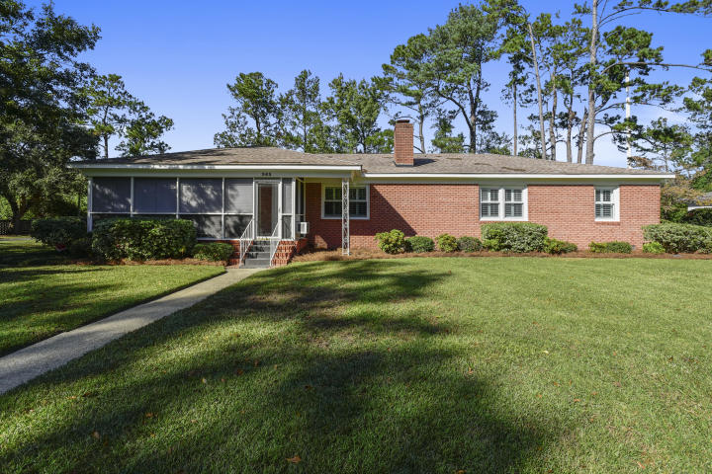
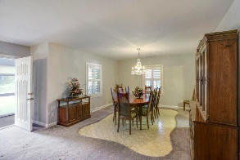
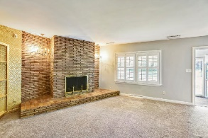
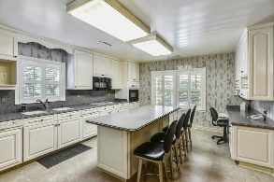
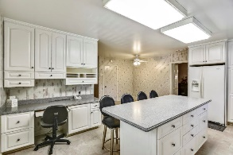
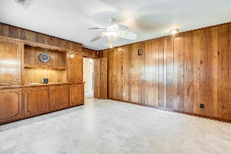
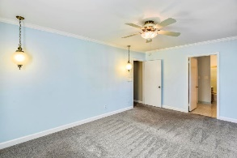
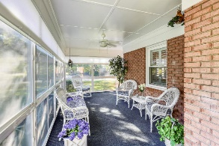
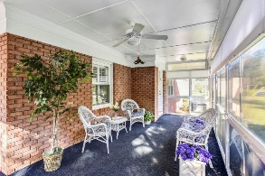
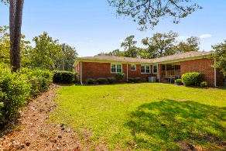
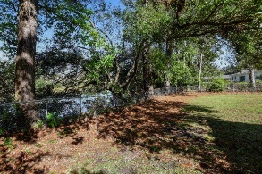


363 Confederate Circle South Windermere • Charleston • MLS# 19030652 • $619,500
Motivated Seller!!
The Brick Ranch Style Home in South Windermere at 363 Confederate Circle may be the place for you. Egrets, Herons and other wildlife frequent the tidal creeks on each side of the approach to Confederate Circle. This special home was lovingly cared for by its owners of 40 years. You will begin to sense the comfortable "at home" feel as you enter the 308 sq.ft year round climate controlled sun room, perfect for enjoying the view or relaxing with a favorite book and refreshing snack. The sun room opens to a very spacious living room featuring a sandstone fireplace with gas logs. A custom built corner wall unit is perfect to display your special decorative pieces. The separate dining room leads to a fully equipped eat-in kitchen including 2 stainless steel dishwashers, Profile glass cook top and built in microwave oven, Kitchen Aid wall oven, an Artica side-by-side refrigerator/freezer and instant hot water tap. These are among the many features that family and friends will enjoy.
Susan Garfinkel
843-696-5838 | susanrealtor44@gmail.com
Elaine Brabham and Associates, LLC • 1890 Sam Rittenberg Boulevard, Suite 217 • Charleston, SC 29407

