Slide 1
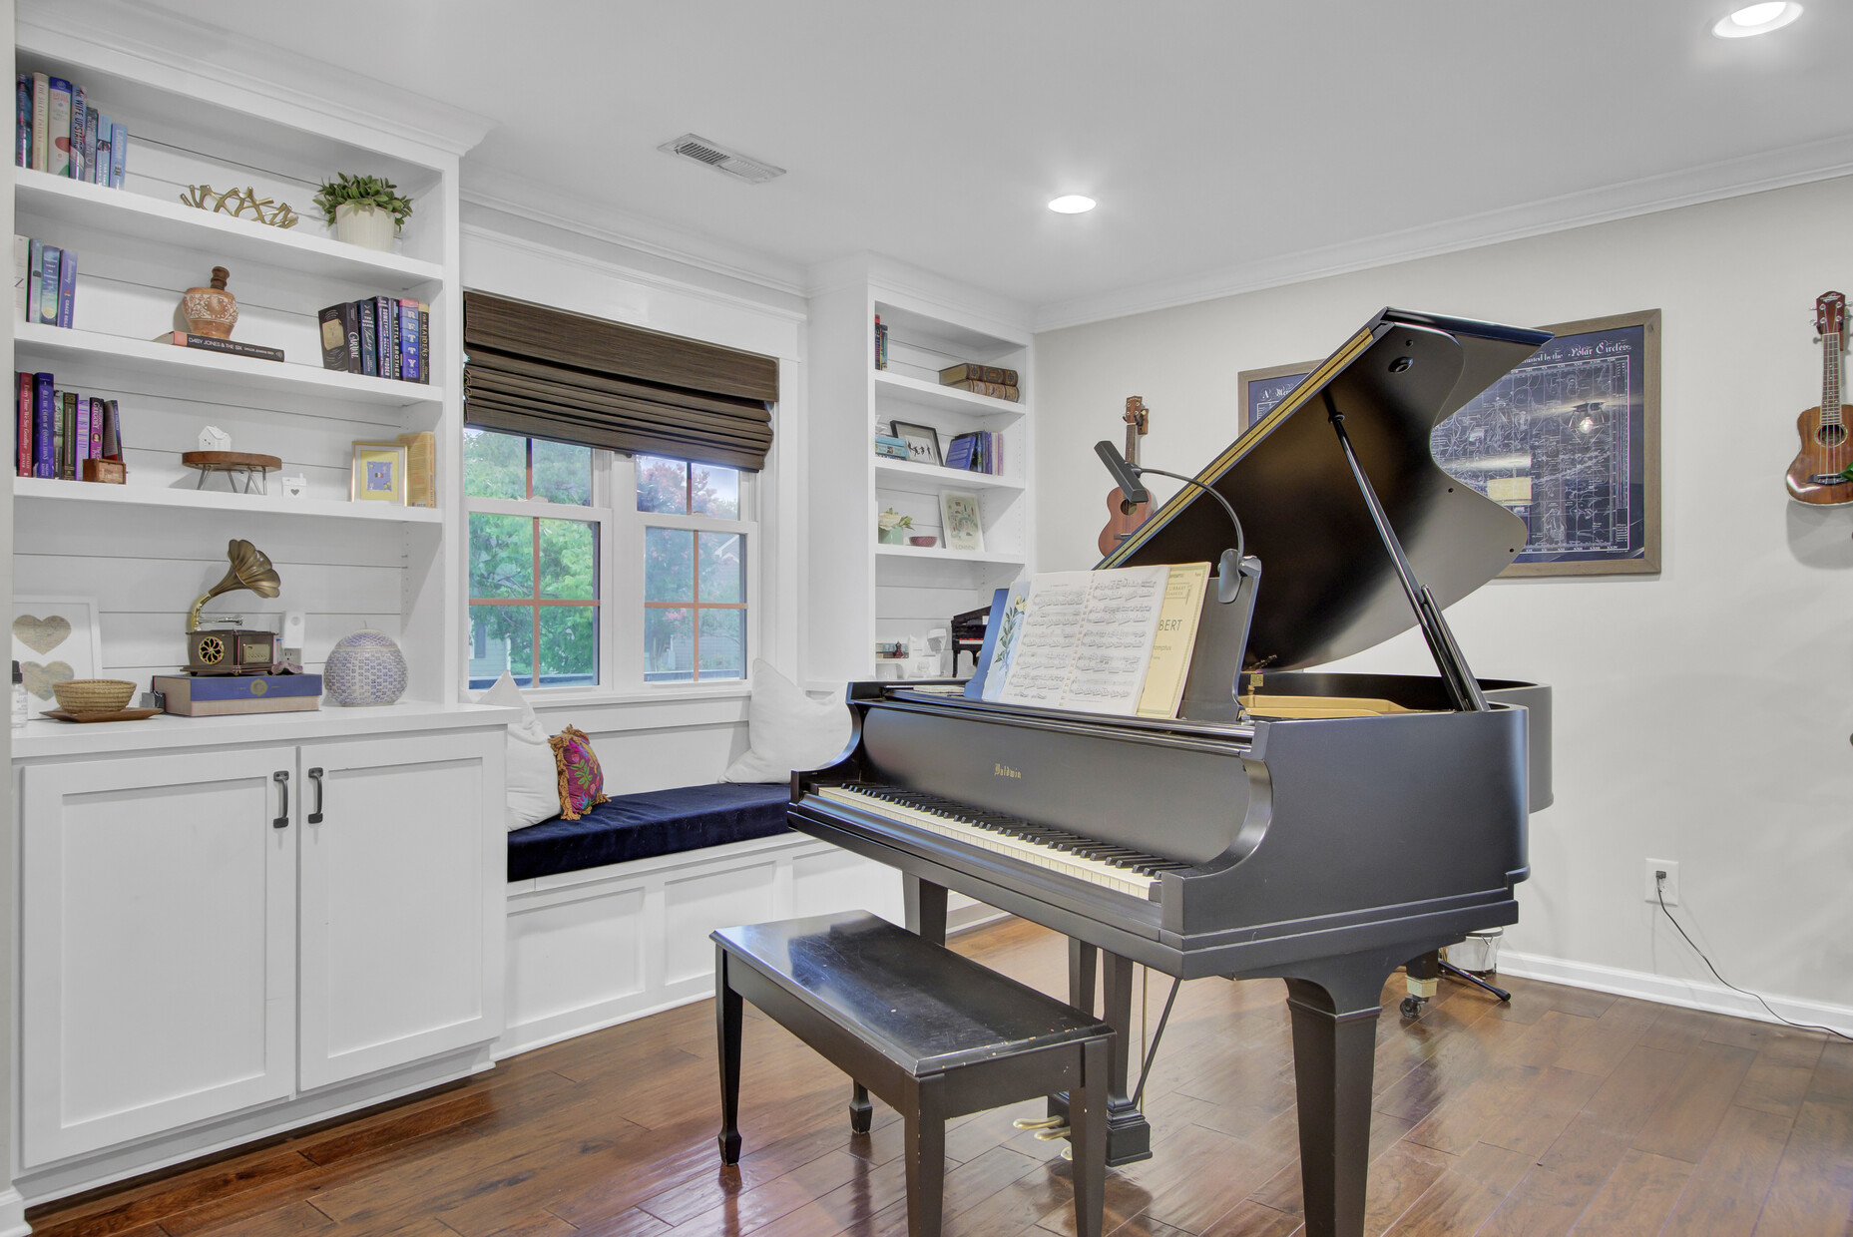
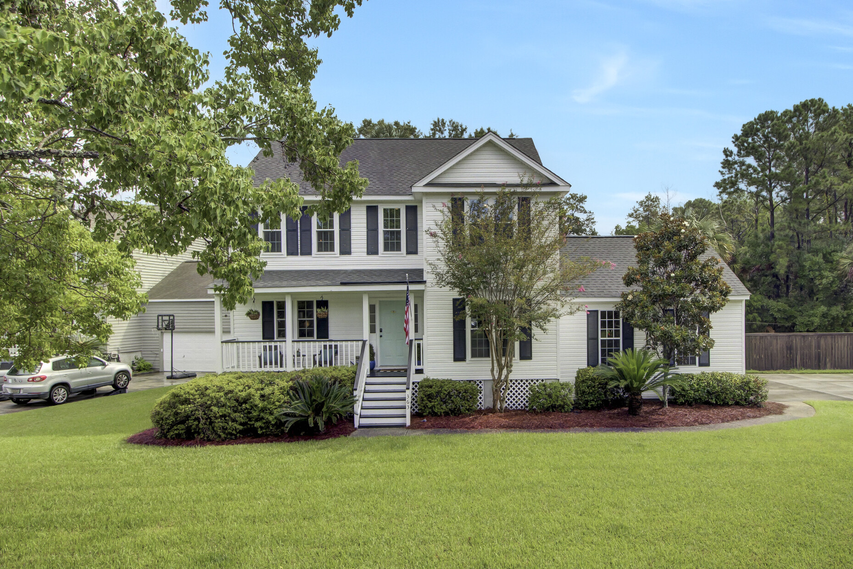
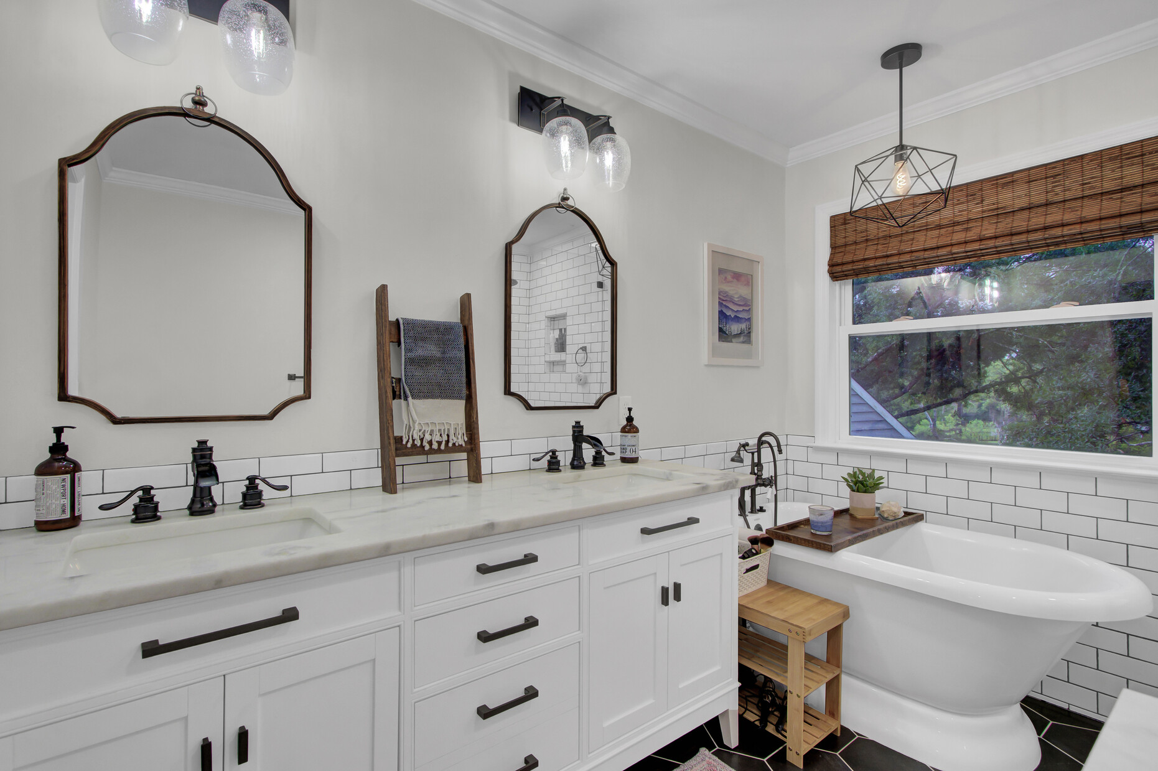
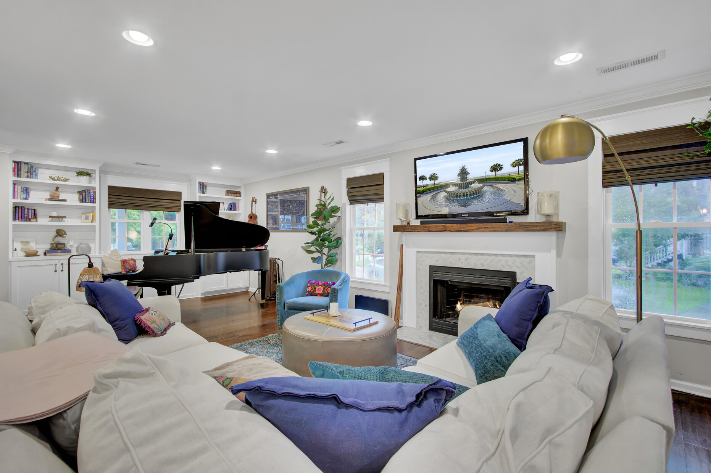
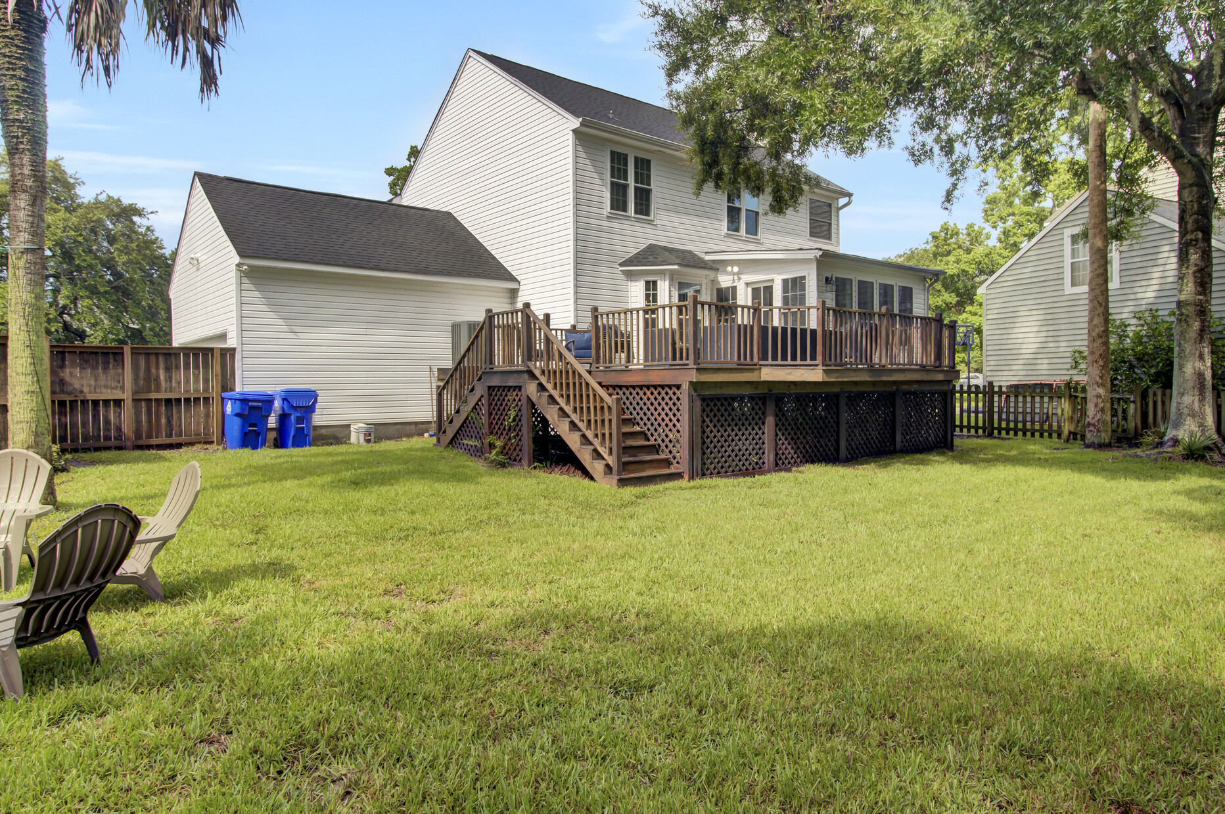
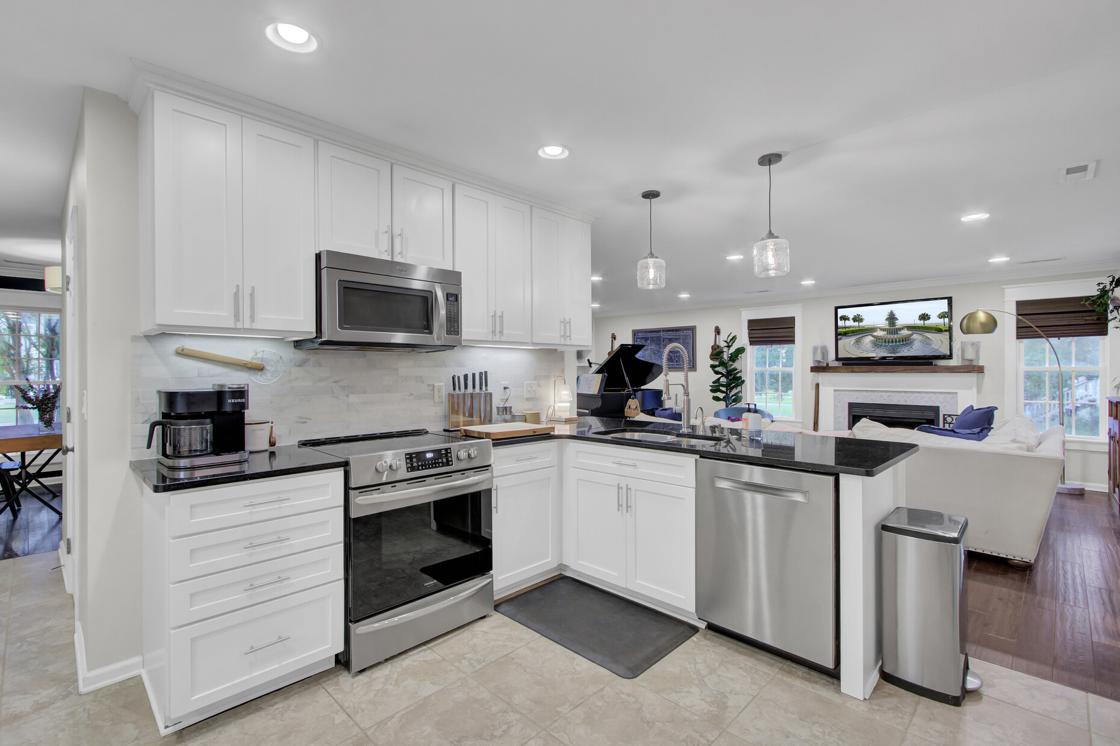
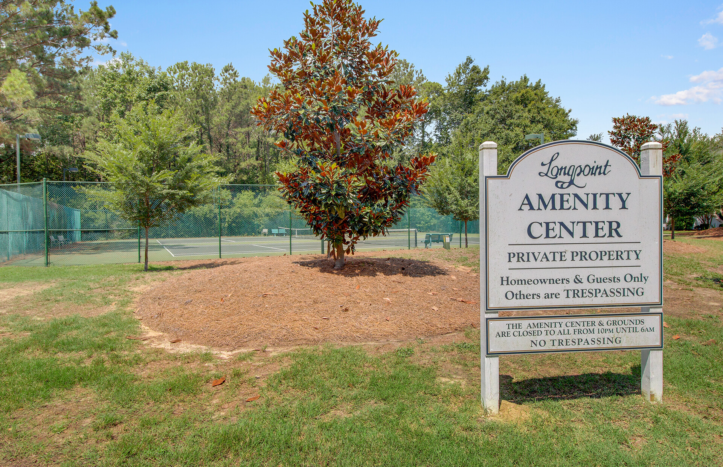
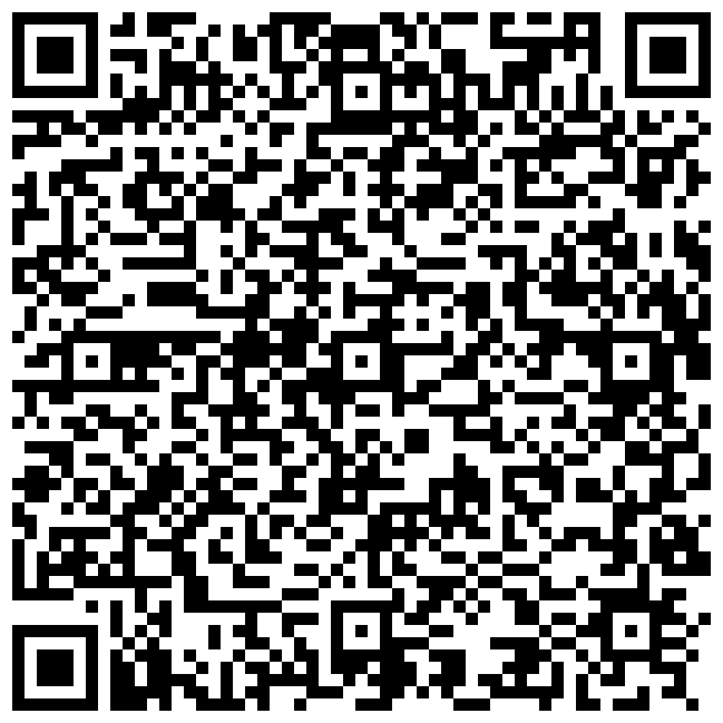


New Listing and Open House
Sunday, July 28 from 11 AM - 2 PM
363 Mt Royall Drive
Longpoint
Mount Pleasant, SC 29464
MLS# 24018207 | $874,900
Video Tour
There are so many things to love at 363 Mount Royall! Located in popular Longpoint Subdivision, this 4 bedroom home sits on a massive corner lot with marsh views and an ultra private wooded lot. With a side loading garage and front porch you could not ask for better curb appeal! The current owners have lovingly maintained and made numerous renovations to this home. The open floor plan is a winner! Talk about a spacious living area...The kitchen has been remodeled and you can enjoy views of the ultra private backyard through the bay window while eating. The screened porch has been converted to a stunning sun-filled heated and cooled living space with views galore. Upstairs the primary bath has been renovated into a spa- like retreat, and the guest bathroom has also been remodeled. So whether you are indoors spending time with friends and family, or out on the huge deck enjoying the massive yard, there is plenty of room to live your best life at 363 Mount Royall! Longpoint offers wonderful amenities for the enjoyment of its residents. Swimming, a playground, soccer fields and food truck nights are all great gathering places for neighbors. This central location puts you in the heart of all that Mt. Pleasant has to offer- minutes to shopping at Belle Hall or Towne Center, be at the beach in ten minutes or Historic Downtown Charleston in 20! It is a stones throw to Palmetto Island County Park and commuters love easy access to Hwy 17 and Hwy 526. Don't delay - see this stunner of a home before it's too late!
Video Tour
Ellen O'Neil
Broker/Owner, ABR, e-PRO, CNE
Charleston Realtor of Distinction
(843) 300-8530
www.EllenONeilProperties.com

