Slide 1
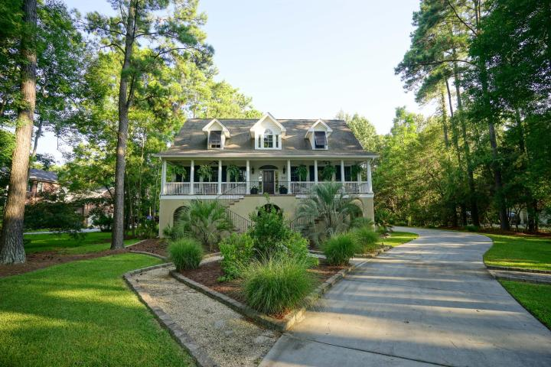
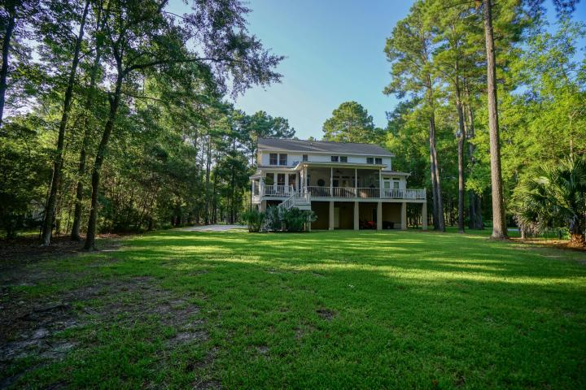
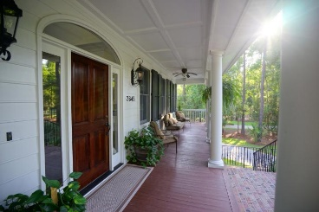
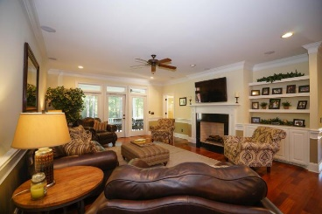
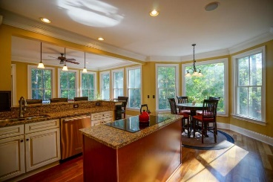
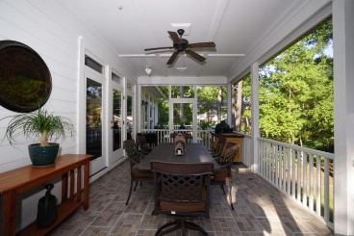
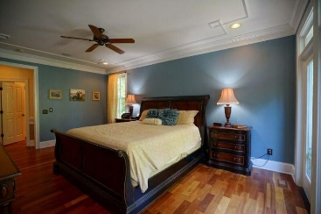
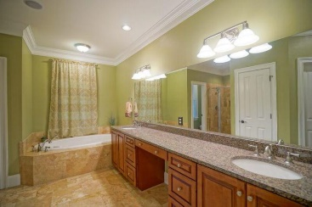
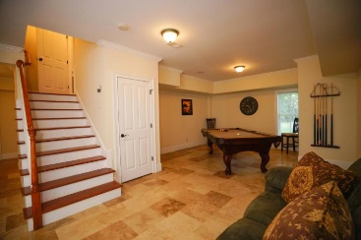
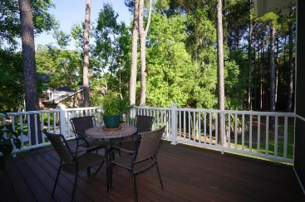

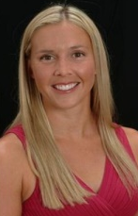
Better than new construction in Dunes West!
3645 Colonel Vanderhorst Circle
Mount Pleasant, SC 29466 | MLS# 15022873 | $925,000
Immaculately kept home that feels and looks brand new! Over an acre private lot in Dunes West overlooking the 8th tee box. This home has everything you need! Let the pictures do the talking!! Walk in the front door to the beautiful open foyer with Brazilian cherry floors and extensive crown molding. To the right of the foyer is the large dining room that connects to the kitchen. The eat-in kitchen offers updated appliances and cabinetry, granite counter tops. Off the kitchen you will find the keeping room that has an abundance of natural light with a wine bar and wine fridge. The living room is spacious with French doors leading to the large newly updated screen porch. The main floor also offers the Master bedroom with separate his/hers closets, large bathroom with separate shower and tub. Upstairs offers 4 bedrooms and 2 full baths. The first floor (some people call it a lowcountry "basement"), can be used as a Mother in law suite or a game room. It also offers a full bath. Other features of this home include, large 3 car garage, surround sound throughout the house and porch, beautiful landscaped yard, newly updated porch and decks, hardwood floors throughout most of the home, and much much more!! Custom closets throughout the home. The backyard has plenty of room for a pool! Also, this home has already been pre-inspected and the home is ready to move in!!
Kristen Kern-Whitehead
Mobile - 843-670-1671
kwhitehead@kwchs.com
www.charlestonislandagents.com
Keller Williams Realty
Charleston Islands
1304 Palm Blvd
Isle Of Palms, SC 29451

